Slide 1
Semerikova Elena
Blokhina Anastasia
Spatial Quantile Analysis of Real Estate Prices in Germany
ERSA, Pecs, 2022

Slide 2
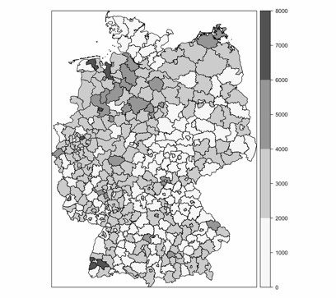
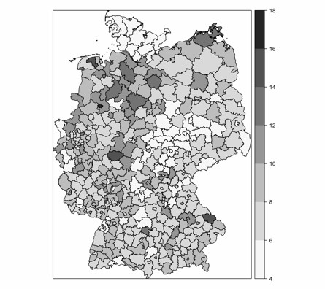
Spatial Quantile Analysis of Real Estate Prices in Germany
Motivation & Aims
We want to find out which factors affect housing prices in poor and rich regions
German regional housing markets are very heterogeneous because of historical diversification
Former GDR regions are overall cheaper in terms of housing prices
Risk of housing bubbles in Munich and Frankfurt
Determinants affect housing prices in regions differently
Selling prices in euro/sqm in 2020
Rental prices in euro/sqm in 2020
Source: authors’ calculations

Slide 3
Spatial Quantile Analysis of Real Estate Prices in Germany
Disparities of German regions
Poverty is a more common feature for Eastern regions rather than Western with the level of 5-7%.
The number of people receiving unemployment benefits by Hartz-IV is 5-15% higher in Eastern regions.
Berlin as a capital of the country has a high population density, while other Eastern regions have lower population density.
Western regions are more attractive for migrants as they possess better economic development level, wider career opportunities, higher social benefits.
In Western regions the disproportion of housing supply structure between rural and urban areas is significant.
Nowadays Eastern regions are characterised by new construction and renovation boom, construction tempo is higher for nearly 20% by recent years
By now housing polarization shifts from East-West to agglomeration level.
German federal lands have different Real Estate Transfer Tax rates. Overall, Eastern lands, surprisingly, have higher property transfer tax rates than Western.

Slide 4
Spatial Quantile Analysis of Real Estate Prices in Germany
Literature
Majority of papers examine via quantile regression method the effects of inner infrastructural factors:
Zambrano-Monserrate et al. (2021) analyse urban green spaces’ effect on housing prices via two-stage quantile regression. The effect varies depending on the submarket and vegetation index.
Özsoy, Sahin (2021) examine data about housing prices in Izmir by real estate agencies in June 2018 and perform quantile regression analysis. They find that infrastructure factors differently correlate with the price depending on price quantile.
Fitzenberger and Fuchs (2017) evaluate the changes after rental reform of 2001. Mostly the reform reduced rents for expensive and new apartments.
The effects of socio-economic factors:
Cajias, Freudenreich, Freudenreich (2020) examine microdata for 7 major cities of Germany from 2013 to 2017 to analyse liquidity of rental dwellings and its determinants using censored quantile regression. The authors find that magnitude and significance of explanatory variables differ across the liquidity quantile. They highlight GDP and vacancy rate as significant determinants.
Tomal (2019) estimate macro-determinants of residential property prices of Polish counties. Average income positively correlates with the prices, mostly for high-priced housing, as its increase characterises the purchasing power of the population.
Peng, Tsai (2019) use housing prices as an independent variable and migration as a dependent variable. Then they estimate quantile regression and conclude that in short run the correlation is asymmetric: negative below 0.5 quantile, is not significant from 0.5 to 0.8 and positive in 0.9.
Our analysis is devoted to demand-side employment, income and migration factors.

Slide 5
Spatial Quantile Analysis of Real Estate Prices in Germany
Determinants
We use demand side determinants:
unemployment level (unemployment level, in %),
pendulum migration rates by the place of residence (migration/population),
employment rate (rate of working population of the region),
wages (current prices, in €),
gross regional product (per capita, in €),
emigration and immigration rates (variable/population).

Slide 6
Spatial Quantile Analysis of Real Estate Prices in Germany
Data & Methodology
We use spatial panel data for 397 NUTS3 regions of Germany for the period 2004 – 2020 taking into account their relative geographical location and prices.
The data for regional prices and determinants are collected by the firm BulwienGesa AG (RIWIS), data for migration was taken from Regional Statistik Genesis.
The dependent variables are logarithms of selling and rental prices of apartments, €/m².
We consider selling and rental prices separately because of various effects of determinants on them. Rental prices react to the change in economic situation faster than less flexible selling ones.
Contiguity spatial matrix is employed (inverse distance matrix with a threshold of 100 km is used for robustness check)

Slide 7
Spatial Quantile Analysis of Real Estate Prices in Germany
Data & Methodology
Model 1
We use MM-QR (Method of Moments-Quantile Regression) estimation procedure. [Machado & Silva 2019]
The basic specification of panel data model with fixed effects is:
$$Q_{\ln{Y}}(τ|X_{it})=\left(α_{i}+δ_{i}q\left(τ\right)\right)+X_{it}β(τ)$$
In our case we have:
$$Q_{\ln{Y}}(τ|X_{it})=\left(α_{i}+δ_{i}q\left(τ\right)\right)+\ln{X_{it}β_{1}(τ) }+{Migration}_{it}β_{2}(τ)$$
Model 2
Then we add weighted variables to get effects for neighbouring regions:
$$Q_{\ln{Y}}\left(τ | X_{it}\right)=\left(α_{i}+δ_{i}q\left(τ\right)\right)+\ln{X_{it}β_{1}\left(τ\right) }+{Migration}_{it}β_{2}\left(τ\right)+WX_{it}β_{3}\left(τ\right)+W{Migration}_{it}β_{4}\left(τ\right)$$

Slide 8
Quantile Regression Analysis of German Regional Housing Market
Data & Methodology
Model 3
Finally we build IVQR model [Chernozhukov & Hansen 2005]
The specification in our case is:
$Q_{∆ln{Y}}\left(τ | {∆X}_{it}\right)=α_{0}+ρW∆ln{Y}+∆ln{X_{it}β_{1}(τ) }+{∆Migration}_{it}β_{2}\left(τ\right)$,
where $Δθ=θ−\overline{θ}$ (within transformation)
As instruments we use:
$\ln{X_{it}} and {Migration}_{it}$
$WX_{it} and W{Migration}_{it}$
$W^{2}X_{it} and W^{2}{Migration}_{it}$

Slide 9
Quantile Regression Analysis of German Regional Housing Market
Data & Methodology - SUMMARY
397 NUTS3 regions of Germany
Panel data
2004-2020
Dependent variables: logarithm of selling and rental price growth rates for an apartment
Independent variables: logarithm of unemployment rate, number of employees, wages, GRP and pendulum migration by living place, emigration and immigration
Contiguity weighting matrix
Model 1 – MM-QR (Machado & Santos Silva, 2019):
$$Q_{\ln{Y}}(τ|X_{it})=\left(α_{i}+δ_{i}q\left(τ\right)\right)+\ln{X_{it}β_{1}(τ) }+{Migration}_{it}β_{2}(τ)$$
Model 2 – Neighbouring regions effects:
$$Q_{\ln{Y}}\left(τ | X_{t}\right)=\left(α+δq\left(τ\right)\right)+\ln{X_{t}β_{1}\left(τ\right) }+{Migration}_{t}β_{2}\left(τ\right)+WX_{t}β_{3}\left(τ\right)+W{Migration}_{t}β_{4}\left(τ\right)$$
Model 3 – IVQR (Chernozhukov & Hansen, 2006):
$$Q_{\ln{Y}}\left(τ | X_{t}\right)=α_{0}+μ_{t}+ρW\ln{Y}+\ln{X_{t}β_{1}(τ) }+{Migration}_{t}β_{2}\left(τ\right)$$
Method of estimation: within transformation $(Δθ=θ−\overline{θ})$, instruments: $\ln{X_{it}} and {Migration}_{it}$, $WX_{t} and W{Migration}_{t}$, $W^{2}X_{t} and W^{2}{Migration}_{t}$.

Slide 10
Data & Methodology
Faculty of Economic Science
THE ROLE OF SPATIAL EFFECTS ON HOUSING MARKET DISPARITIES IN GERMAN REGIONS
Anastasia Blokhina, BEC182
397 NUTS3 regions of Germany
Panel data
2004-2020
Dependent variables: logarithm of selling and rental price growth rates for an apartment
Independent variables: logarithm of unemployment rate, number of employees, wages, GRP and pendulum migration by living place, emigration and immigration
Weighting matrix is binary
Model 1 – MM-QR (Machado & Santos Silva, 2019):
$$Q_{\ln{Y}}(τ|X_{it})=\left(α_{i}+δ_{i}q\left(τ\right)\right)+\ln{X_{it}β_{1}(τ) }+{Migration}_{it}β_{2}(τ)$$
Model 2 – Neighbouring regions effects:
$$Q_{\ln{Y}}\left(τ | X_{t}\right)=\left(α+δq\left(τ\right)\right)+\ln{X_{t}β_{1}\left(τ\right) }+{Migration}_{t}β_{2}\left(τ\right)+WX_{t}β_{3}\left(τ\right)+W{Migration}_{t}β_{4}\left(τ\right)$$
Model 3 – IVQR (Chernozhukov & Hansen, 2006):
$$Q_{\ln{Y}}\left(τ | X_{t}\right)=α_{0}+μ_{t}+ρW\ln{Y}+\ln{X_{t}β_{1}(τ) }+{Migration}_{t}β_{2}\left(τ\right)$$
Method of estimation: within transformation $(Δθ=θ−\overline{θ})$, instruments: $\ln{X_{it}} and {Migration}_{it}$, $WX_{t} and W{Migration}_{t}$, $W^{2}X_{t} and W^{2}{Migration}_{t}$.

Slide 11
Quantile Regression Analysis of German Regional Housing Market
Results for Model 1 – MM-QR (Machado & Santos Silva, 2019): Rental prices
 | 0.1 | 0.2 | 0.3 | 0.4 | 0.5 | 0.6 | 0.7 | 0.8 | 0.9
VARIABLES | rent | rent | rent | rent | rent | rent | rent | rent | rent
Unemployment | -0.148*** | -0.154*** | -0.158*** | -0.163*** | -0.167*** | -0.173*** | -0.180*** | -0.188*** | -0.198***
 | (0.00916) | (0.00755) | (0.00656) | (0.00591) | (0.00573) | (0.00631) | (0.00772) | (0.00995) | (0.0134)
Pendulum migration by the place of residence | 4.20e-07** | 4.19e-07*** | 4.19e-07*** | 4.19e-07*** | 4.18e-07*** | 4.18e-07*** | 4.18e-07*** | 4.17e-07** | 4.16e-07
 | (1.80e-07) | (1.49e-07) | (1.29e-07) | (1.16e-07) | (1.12e-07) | (1.24e-07) | (1.52e-07) | (1.96e-07) | (2.64e-07)
Wages | 0.0434*** | 0.0405*** | 0.0383*** | 0.0360*** | 0.0336*** | 0.0306*** | 0.0272*** | 0.0234*** | 0.0181*
 | (0.00648) | (0.00535) | (0.00464) | (0.00418) | (0.00405) | (0.00446) | (0.00547) | (0.00704) | (0.00951)
GRP | 0.311*** | 0.305*** | 0.300*** | 0.296*** | 0.291*** | 0.284*** | 0.277*** | 0.269*** | 0.258***
 | (0.0252) | (0.0208) | (0.0181) | (0.0163) | (0.0158) | (0.0174) | (0.0213) | (0.0274) | (0.0370)
Immigration | 1.059** | 1.336*** | 1.551*** | 1.765*** | 1.993*** | 2.286*** | 2.604*** | 2.972*** | 3.474***
 | (0.480) | (0.396) | (0.344) | (0.311) | (0.301) | (0.332) | (0.406) | (0.523) | (0.705)
Emigration | 0.538*** | 0.528*** | 0.520*** | 0.513*** | 0.505*** | 0.494*** | 0.483*** | 0.470*** | 0.452**
 | (0.139) | (0.115) | (0.0996) | (0.0898) | (0.0869) | (0.0957) | (0.117) | (0.151) | (0.204)
Observations | 6,352 | 6,352 | 6,352 | 6,352 | 6,352 | 6,352 | 6,352 | 6,352 | 6,352
*** p<0.01, ** p<0.05, * p<0.1
Source: authors’ calculations

Slide 12
Quantile Regression Analysis of German Regional Housing Market
Results for Rental price
Source: authors’ calculations

Slide 13
Quantile Regression Analysis of German Regional Housing Market
Results for Model 1 – MM-QR (Machado & Santos Silva, 2019): selling price
 | 0.1 | 0.2 | 0.3 | 0.4 | 0.5 | 0.6 | 0.7 | 0.8 | 0.9
VARIABLES | sell | sell | sell | sell | sell | sell | sell | sell | sell
Unemployment | -0.147*** | -0.158*** | -0.168*** | -0.179*** | -0.191*** | -0.207*** | -0.225*** | -0.244*** | -0.268***
 | (0.0162) | (0.0139) | (0.0123) | (0.0110) | (0.0104) | (0.0114) | (0.0142) | (0.0182) | (0.0240)
Pendulum migration by the place of residence | 8.52e-07** | 8.68e-07*** | 8.82e-07*** | 8.98e-07*** | 9.17e-07*** | 9.40e-07*** | 9.66e-07*** | 9.93e-07** | 1.03e-06*
 | (3.65e-07) | (3.14e-07) | (2.77e-07) | (2.47e-07) | (2.33e-07) | (2.55e-07) | (3.18e-07) | (4.08e-07) | (5.40e-07)
Wages | 0.0678*** | 0.0663*** | 0.0650*** | 0.0635*** | 0.0617*** | 0.0595*** | 0.0571*** | 0.0545*** | 0.0512***
 | (0.0131) | (0.0113) | (0.00993) | (0.00885) | (0.00837) | (0.00914) | (0.0114) | (0.0146) | (0.0194)
GRP | 0.528*** | 0.518*** | 0.510*** | 0.500*** | 0.489*** | 0.475*** | 0.459*** | 0.442*** | 0.421***
 | (0.0462) | (0.0397) | (0.0350) | (0.0312) | (0.0296) | (0.0323) | (0.0402) | (0.0517) | (0.0684)
Immigration | 1.669** | 1.909*** | 2.116*** | 2.349*** | 2.621*** | 2.966*** | 3.351*** | 3.755*** | 4.271***
 | (0.650) | (0.559) | (0.493) | (0.440) | (0.417) | (0.455) | (0.567) | (0.728) | (0.962)
Emigration | 1.014*** | 1.028*** | 1.040*** | 1.053*** | 1.069*** | 1.089*** | 1.111*** | 1.135*** | 1.165***
 | (0.229) | (0.197) | (0.173) | (0.154) | (0.146) | (0.159) | (0.199) | (0.255) | (0.338)
Observations | 6,352 | 6,352 | 6,352 | 6,352 | 6,352 | 6,352 | 6,352 | 6,352 | 6,352
*** p<0.01, ** p<0.05, * p<0.1
Source: authors’ calculations

Slide 14
Quantile Regression Analysis of German Regional Housing Market
Results for selling price
Source: authors’ calculations

Slide 15
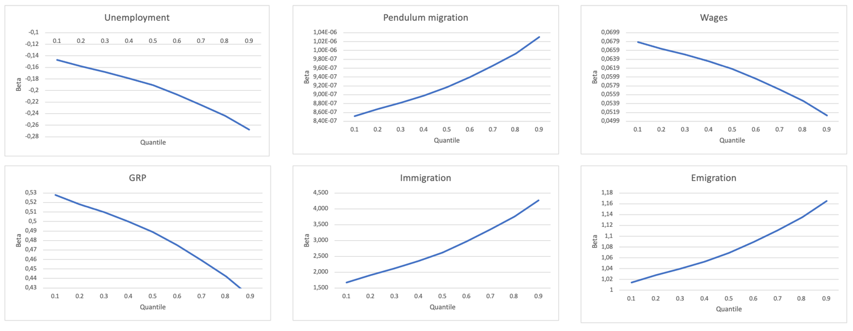
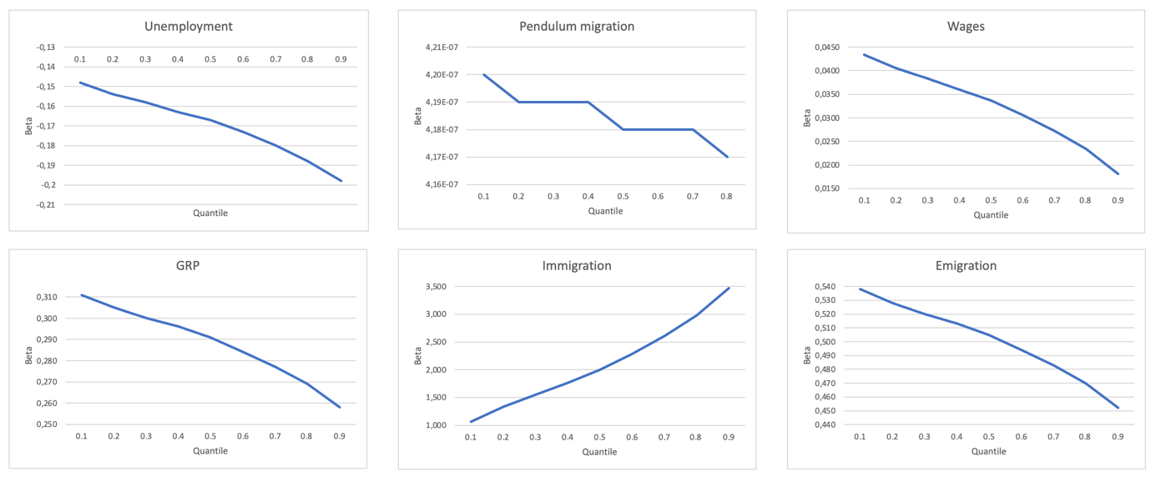
Results for Model 1 – MM-QR (Machado & Santos Silva, 2019):
Faculty of Economic Science
THE ROLE OF SPATIAL EFFECTS ON HOUSING MARKET DISPARITIES IN GERMAN REGIONS
Anastasia Blokhina, BEC182
Sell Prices
Rent Prices
Source: author’s calculations

Slide 16
Quantile Regression Analysis of German Regional Housing Market
Results for Rental price (Neighboring regions)
Source: authors’ calculations

Slide 17
Quantile Regression Analysis of German Regional Housing Market
Results for Model 2 – Neighbouring regions effects (RENT):
 | 0.1 | 0.2 | 0.3 | 0.4 | 0.5 | 0.6 | 0.7 | 0.8 | 0.9
VARIABLES | rent | rent | rent | rent | rent | rent | rent | rent | rent
W*Unemployment | 0.00550 | 0.00843 | 0.0107 | 0.0132 | 0.0159 | 0.0185 | 0.0210 | 0.0234 | 0.0262
 | (0.0643) | (0.0530) | (0.0448) | (0.0360) | (0.0285) | (0.0243) | (0.0245) | (0.0287) | (0.0367)
W*Pendulum migration | 1.30e-06 | 3.16e-06 | 4.57e-06 | 6.22e-06* | 7.92e-06*** | 9.57e-06*** | 1.12e-05*** | 1.27e-05*** | 1.45e-05***
 | (5.91e-06) | (4.87e-06) | (4.12e-06) | (3.31e-06) | (2.62e-06) | (2.23e-06) | (2.26e-06) | (2.64e-06) | (3.37e-06)
W*Number of employees | 0.515* | 0.407 | 0.325 | 0.229 | 0.130 | 0.0335 | -0.0595 | -0.148 | -0.252
 | (0.306) | (0.252) | (0.213) | (0.171) | (0.136) | (0.116) | (0.117) | (0.137) | (0.175)
W*Wages | 0.136* | 0.163** | 0.184*** | 0.208*** | 0.232*** | 0.257*** | 0.280*** | 0.302*** | 0.328***
 | (0.0771) | (0.0636) | (0.0537) | (0.0432) | (0.0342) | (0.0292) | (0.0295) | (0.0345) | (0.0440)
W*GRP | 0.496*** | 0.513*** | 0.526*** | 0.541*** | 0.557*** | 0.572*** | 0.587*** | 0.601*** | 0.617***
 | (0.190) | (0.156) | (0.132) | (0.106) | (0.0840) | (0.0715) | (0.0723) | (0.0846) | (0.108)
W*Emigration | 0.134 | 0.474 | 0.733 | 1.035*** | 1.347*** | 1.650*** | 1.943*** | 2.221*** | 2.548***
 | (0.712) | (0.587) | (0.497) | (0.400) | (0.317) | (0.270) | (0.273) | (0.319) | (0.407)
W*Immigration | 0.707 | 0.795 | 0.861 | 0.939* | 1.019** | 1.097*** | 1.172*** | 1.243*** | 1.327**
 | (1.001) | (0.825) | (0.698) | (0.560) | (0.444) | (0.378) | (0.382) | (0.447) | (0.571)
Observations | 5,955 | 5,955 | 5,955 | 5,955 | 5,955 | 5,955 | 5,955 | 5,955 | 5,955
*** p<0.01, ** p<0.05, * p<0.1
Source: authors’ calculations

Slide 18
Quantile Regression Analysis of German Regional Housing Market
Results for selling price (Neighboring regions)
Source: authors’ calculations

Slide 19
Quantile Regression Analysis of German Regional Housing Market
Results for Model 2 – Neighbouring regions effects (SELL):
 | 0.1 | 0.2 | 0.3 | 0.4 | 0.5 | 0.6 | 0.7 | 0.8 | 0.9
VARIABLES | sell | sell | sell | sell | sell | sell | sell | sell | sell
W*Unemployment | 0.204 | 0.216 | 0.225 | 0.234 | 0.247** | 0.259** | 0.269** | 0.278** | 0.288*
 | (0.248) | (0.205) | (0.174) | (0.145) | (0.116) | (0.105) | (0.112) | (0.130) | (0.159)
W*Pendulum migration | 1.88e-05 | 2.35e-05 | 2.70e-05 | 3.07e-05** | 3.55e-05*** | 4.04e-05*** | 4.41e-05*** | 4.76e-05*** | 5.18e-05***
 | (2.51e-05) | (2.07e-05) | (1.76e-05) | (1.46e-05) | (1.17e-05) | (1.06e-05) | (1.13e-05) | (1.31e-05) | (1.61e-05)
W*Number of employees | 0.877 | 0.638 | 0.458 | 0.264 | 0.0154 | -0.235 | -0.427 | -0.606 | -0.819
 | (1.149) | (0.949) | (0.808) | (0.671) | (0.537) | (0.485) | (0.520) | (0.601) | (0.737)
W*Wages | 0.223 | 0.299 | 0.357* | 0.418** | 0.497*** | 0.577*** | 0.638*** | 0.695*** | 0.763***
 | (0.307) | (0.254) | (0.216) | (0.180) | (0.144) | (0.130) | (0.139) | (0.161) | (0.197)
W*GRP | 0.807 | 0.836 | 0.857* | 0.881** | 0.910*** | 0.941*** | 0.964*** | 0.985*** | 1.011**
 | (0.717) | (0.592) | (0.504) | (0.419) | (0.335) | (0.302) | (0.324) | (0.375) | (0.460)
W*Emigration | 0.792 | 1.553 | 2.126 | 2.742* | 3.531*** | 4.327*** | 4.936*** | 5.507*** | 6.184***
 | (2.831) | (2.339) | (1.992) | (1.655) | (1.325) | (1.197) | (1.280) | (1.481) | (1.817)
W*Immigration | 0.667 | 1.049 | 1.337 | 1.646 | 2.042 | 2.441 | 2.747 | 3.034 | 3.373
 | (3.802) | (3.142) | (2.674) | (2.221) | (1.776) | (1.605) | (1.718) | (1.988) | (2.440)
Observations | 5,955 | 5,955 | 5,955 | 5,955 | 5,955 | 5,955 | 5,955 | 5,955 | 5,955
*** p<0.01, ** p<0.05, * p<0.1
Source: authors’ calculations

Slide 20
Faculty of Economic Science
THE ROLE OF SPATIAL EFFECTS ON HOUSING MARKET DISPARITIES IN GERMAN REGIONS
Results for Model 2 – Neighbouring regions effects:
Sell Prices
Rent Prices
Source: author’s calculations

Slide 21
Results for Model 3 – IVQR (Chernozhukov & Hansen, 2006):
Faculty of Economic Science
THE ROLE OF SPATIAL EFFECTS ON HOUSING MARKET DISPARITIES IN GERMAN REGIONS
 | 0.1 | 0.2 | 0.3 | 0.4 | 0.5 | 0.6 | 0.7 | 0.8 | 0.9
VARIABLES | sell | sell | sell | sell | sell | sell | sell | sell | sell
ρ | 0.163*** | 0.203*** | 0.226*** | 0.246*** | 0.265*** | 0.284*** | 0.302*** | 0.322*** | 0.360***
 | (0.0297) | (0.0253) | (0.0239) | (0.0237) | (0.0243) | (0.0256) | (0.0274) | (0.0301) | (0.0361)
Unemployment | -0.230*** | -0.217*** | -0.209*** | -0.203*** | -0.197*** | -0.191*** | -0.185*** | -0.178*** | -0.166***
 | (0.0154) | (0.0125) | (0.0111) | (0.0103) | (0.00978) | (0.00967) | (0.00991) | (0.0106) | (0.0127)
Wages | 0.0362*** | 0.0393*** | 0.0412*** | 0.0428*** | 0.0443*** | 0.0457*** | 0.0472*** | 0.0488*** | 0.0518***
 | (0.00867) | (0.00703) | (0.00640) | (0.00615) | (0.00619) | (0.00648) | (0.00697) | (0.00773) | (0.00955)
GRP | 0.300*** | 0.276*** | 0.262*** | 0.250*** | 0.239*** | 0.228*** | 0.217*** | 0.205*** | 0.182***
 | (0.0408) | (0.0336) | (0.0306) | (0.0293) | (0.0290) | (0.0298) | (0.0315) | (0.0344) | (0.0416)
Immigration | 5.137*** | 5.807*** | 6.209*** | 6.546*** | 6.867*** | 7.180*** | 7.487*** | 7.833*** | 8.479***
 | (0.273) | (0.253) | (0.264) | (0.285) | (0.312) | (0.344) | (0.380) | (0.424) | (0.512)
Emigration | 0.764*** | 0.817*** | 0.848*** | 0.875*** | 0.900*** | 0.925*** | 0.949*** | 0.977*** | 1.028**
 | (0.205) | (0.185) | (0.194) | (0.212) | (0.237) | (0.266) | (0.298) | (0.337) | (0.414)
Constant | -0.333*** | -0.203*** | -0.125*** | -0.0592*** | 0.00304 | 0.0638*** | 0.123*** | 0.191*** | 0.316***
 | (0.0103) | (0.00591) | (0.00457) | (0.00424) | (0.00385) | (0.00384) | (0.00427) | (0.00499) | (0.00952)
Observations | 6,352 | 6,352 | 6,352 | 6,352 | 6,352 | 6,352 | 6,352 | 6,352 | 6,352
 | 0.1 | 0.2 | 0.3 | 0.4 | 0.5 | 0.6 | 0.7 | 0.8 | 0.9
VARIABLES | rent | rent | rent | rent | rent | rent | rent | rent | rent
ρ | 0.0149 | 0.0371 | 0.0515** | 0.0632*** | 0.0756*** | 0.0874*** | 0.100*** | 0.115*** | 0.136***
 | (0.0307) | (0.0261) | (0.0243) | (0.0237) | (0.0240) | (0.0251) | (0.0272) | (0.0304) | (0.0360)
Unemployment | -0.0488*** | -0.0532*** | -0.0560*** | -0.0583*** | -0.0607*** | -0.0630*** | -0.0656*** | -0.0685*** | -0.0726***
 | (0.00721) | (0.00602) | (0.00548) | (0.00523) | (0.00518) | (0.00534) | (0.00572) | (0.00639) | (0.00761)
Wages | 0.0168*** | 0.0227*** | 0.0265*** | 0.0296*** | 0.0329*** | 0.0360*** | 0.0394*** | 0.0434*** | 0.0490***
 | (0.00462) | (0.00382) | (0.00350) | (0.00340) | (0.00346) | (0.00367) | (0.00405) | (0.00462) | (0.00559)
GRP | 0.115*** | 0.124*** | 0.130*** | 0.135*** | 0.140*** | 0.145*** | 0.150*** | 0.156*** | 0.165***
 | (0.0233) | (0.0197) | (0.0181) | (0.0174) | (0.0171) | (0.0175) | (0.0185) | (0.0204) | (0.0239)
Immigration | 3.945*** | 4.723*** | 5.225*** | 5.632*** | 6.064*** | 6.477*** | 6.924*** | 7.448*** | 8.178***
 | (0.179) | (0.159) | (0.156) | (0.162) | (0.175) | (0.191) | (0.212) | (0.242) | (0.287)
Emigration | 0.0798 | 0.125 | 0.154 | 0.178 | 0.203* | 0.227* | 0.253* | 0.283* | 0.326*
 | (0.133) | (0.113) | (0.108) | (0.109) | (0.116) | (0.126) | (0.141) | (0.161) | (0.194)
Constant | -0.195*** | -0.124*** | -0.0786*** | -0.0416*** | -0.00231 | 0.0352*** | 0.0758*** | 0.123*** | 0.190***
 | (0.00484) | (0.00357) | (0.00273) | (0.00249) | (0.00251) | (0.00252) | (0.00293) | (0.00364) | (0.00458)
Observations | 6,352 | 6,352 | 6,352 | 6,352 | 6,352 | 6,352 | 6,352 | 6,352 | 6,352
Sell Prices
*** p<0.01, ** p<0.05, * p<0.1
Rent Prices
Source: author’s calculations

Slide 22
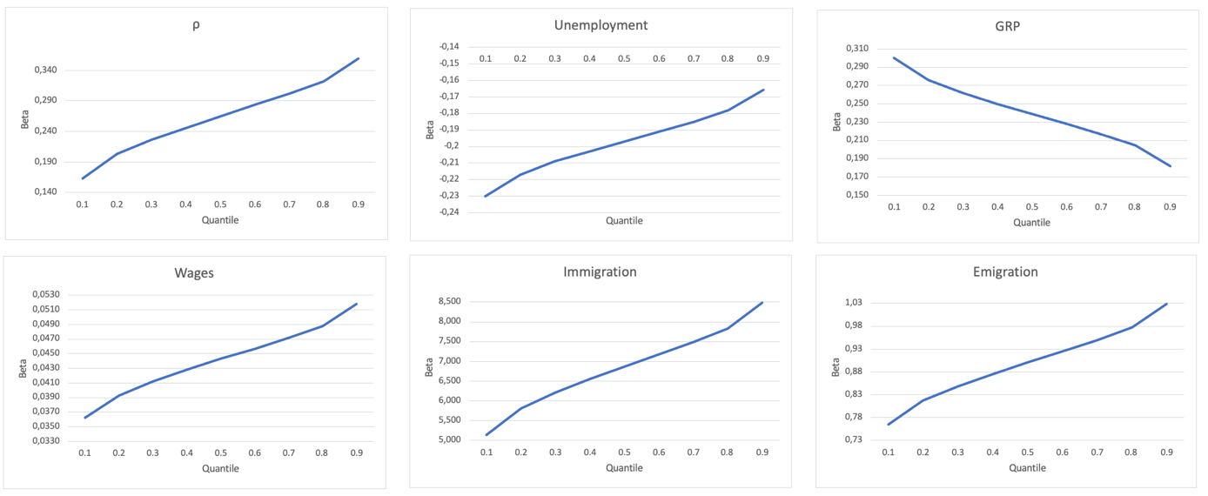
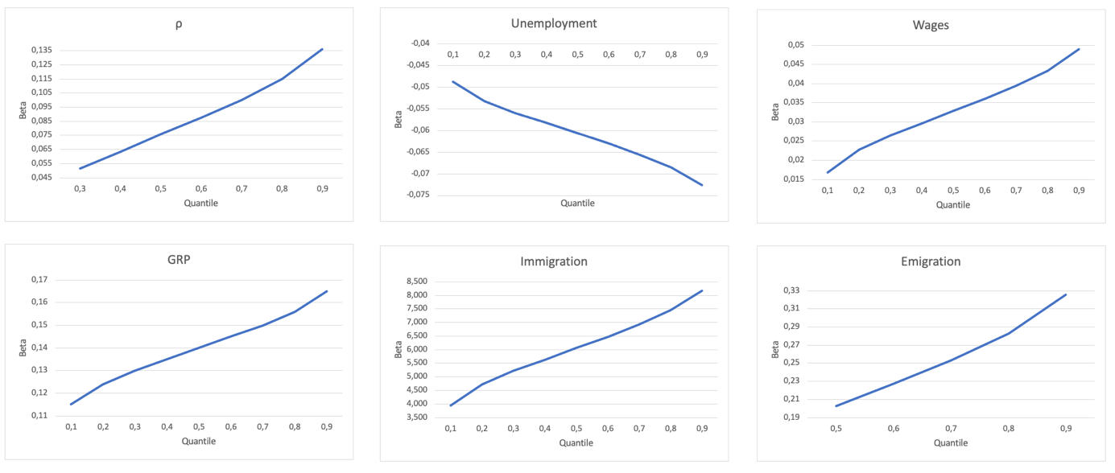
Results for Model 3 – IVQR (Chernozhukov & Hansen, 2006):
Faculty of Economic Science
THE ROLE OF SPATIAL EFFECTS ON HOUSING MARKET DISPARITIES IN GERMAN REGIONS
Anastasia Blokhina, BEC182
Sell Prices
Rent Prices
Source: author’s calculations

Slide 23
Quantile Regression Analysis of German Regional Housing Market
Results for rental price (ivqr)
Source: authors’ calculations

Slide 24
Quantile Regression Analysis of German Regional Housing Market
Results for rental price (ivqr)
 | 0.1 | 0.2 | 0.3 | 0.4 | 0.5 | 0.6 | 0.7 | 0.8 | 0.9
VARIABLES | rent | rent | rent | rent | rent | rent | rent | rent | rent
ρ | 0.502*** | 0.477*** | 0.463*** | 0.449*** | 0.436*** | 0.422*** | 0.407*** | 0.389*** | 0.364***
 | (0.0299) | (0.0257) | (0.0245) | (0.0245) | (0.0255) | (0.0276) | (0.0306) | (0.0351) | (0.0425)
Unemployment | -0.0388*** | -0.0407*** | -0.0419*** | -0.0430*** | -0.0440*** | -0.0452*** | -0.0463*** | -0.0478*** | -0.0498***
 | (0.00672) | (0.00567) | (0.00525) | (0.00505) | (0.00504) | (0.00525) | (0.00567) | (0.00640) | (0.00774)
Wages | 0.0225*** | 0.0278*** | 0.0310*** | 0.0339*** | 0.0368*** | 0.0399*** | 0.0431*** | 0.0470*** | 0.0525***
 | (0.00422) | (0.00348) | (0.00324) | (0.00320) | (0.00334) | (0.00366) | (0.00414) | (0.00484) | (0.00602)
GRP | -0.0115 | 0.0151 | 0.0313* | 0.0460** | 0.0606*** | 0.0763*** | 0.0925*** | 0.112*** | 0.140***
 | (0.0239) | (0.0203) | (0.0187) | (0.0179) | (0.0177) | (0.0181) | (0.0193) | (0.0214) | (0.0256)
Immigration | 4.229*** | 4.764*** | 5.089*** | 5.383*** | 5.676*** | 5.991*** | 6.316*** | 6.706*** | 7.268***
 | (0.144) | (0.137) | (0.143) | (0.154) | (0.170) | (0.191) | (0.214) | (0.246) | (0.295)
Emigration | -0.124 | -0.0197 | 0.0438 | 0.101 | 0.158 | 0.220* | 0.283* | 0.359** | 0.468**
 | (0.110) | (0.0970) | (0.0977) | (0.104) | (0.115) | (0.131) | (0.150) | (0.175) | (0.214)
Constant | 0.545** | 0.291 | 0.136 | -0.00269 | -0.142 | -0.292 | -0.446** | -0.631*** | -0.898***
 | (0.243) | (0.206) | (0.189) | (0.179) | (0.176) | (0.178) | (0.188) | (0.208) | (0.248)
Observations | 5,955 | 5,955 | 5,955 | 5,955 | 5,955 | 5,955 | 5,955 | 5,955 | 5,955
*** p<0.01, ** p<0.05, * p<0.1
Source: authors’ calculations

Slide 25
Quantile Regression Analysis of German Regional Housing Market
Results for selling price (ivqr)
Source: authors’ calculations

Slide 26
Quantile Regression Analysis of German Regional Housing Market
Results for selling price (ivqr)
 | 0.1 | 0.2 | 0.3 | 0.4 | 0.5 | 0.6 | 0.7 | 0.8 | 0.9
VARIABLES | sell | sell | sell | sell | sell | sell | sell | sell | sell
ρ | -0.0653 | 0.102*** | 0.217*** | 0.306*** | 0.383*** | 0.458*** | 0.533*** | 0.617*** | 0.758***
 | 0 | (0.0383) | (0.0344) | (0.0328) | (0.0326) | (0.0335) | (0.0355) | (0.0386) | (0.0456)
Unemployment | -0.191 | -0.168*** | -0.153*** | -0.141*** | -0.131*** | -0.121*** | -0.111*** | -0.0996*** | -0.0808***
 | 0 | (0.0118) | (0.0102) | (0.00927) | (0.00883) | (0.00874) | (0.00899) | (0.00967) | (0.0115)
Wages | 0.0511 | 0.0538*** | 0.0557*** | 0.0572*** | 0.0584*** | 0.0596*** | 0.0608*** | 0.0622*** | 0.0645***
 | 0 | (0.00680) | (0.00608) | (0.00579) | (0.00579) | (0.00599) | (0.00638) | (0.00700) | (0.00836)
GRP | 0.164 | 0.155*** | 0.149*** | 0.144*** | 0.140*** | 0.136*** | 0.132*** | 0.127*** | 0.119***
 | 0 | (0.0356) | (0.0313) | (0.0289) | (0.0278) | (0.0275) | (0.0282) | (0.0301) | (0.0350)
Immigration | 4.073 | 4.314*** | 4.479*** | 4.608*** | 4.718*** | 4.826*** | 4.935*** | 5.056*** | 5.259***
 | 0 | (0.231) | (0.250) | (0.271) | (0.292) | (0.316) | (0.341) | (0.371) | (0.424)
Emigration | 4.294 | 4.378*** | 4.435*** | 4.480*** | 4.518*** | 4.556*** | 4.594*** | 4.636*** | 4.707***
 | 0 | (0.225) | (0.249) | (0.270) | (0.288) | (0.307) | (0.327) | (0.349) | (0.388)
Constant | 5.113 | 4.047*** | 3.319*** | 2.749*** | 2.262*** | 1.785*** | 1.306*** | 0.771** | -0.126
 | 0 | (0.423) | (0.368) | (0.339) | (0.327) | (0.327) | (0.341) | (0.368) | (0.438)
Observations | 5,955 | 5,955 | 5,955 | 5,955 | 5,955 | 5,955 | 5,955 | 5,955 | 5,955
*** p<0.01, ** p<0.05, * p<0.1
Source: authors’ calculations

Slide 27
Quantile Regression Analysis of German Regional Housing Market
Conclusions
The effect of socio-economic factors is heterogeneous across the quantiles
Higher mobility of the population increases the prices of housing, especially in high-priced regions
Socio-economic factors in neighbouring regions significantly affect the prices in considered regions
Spatial correlation is higher for high-priced regions
Presence of agglomeration effect

Slide 28
Thank you for your attention!
We would be glad to answer your questions

