Slide 1
A Spatial quantile regression analysis of housing prices in german regions
Elena Semerikova (NRU HSE, Moscow)
25/05/2021

Slide 2
Motivation
Regional housing prices as a value which represents the general attractiveness of a region, mirrors the state of economy in a region
Real estate prices reflect changes in fundamental macroeconomic indicators (Algieri, 2013)
Spatial connectedness of the regions is usually not taken into account
Accounting for spatial correlation gives at least more efficient estimates and in most cases unbiased
Accounting for spatial correlation is important for the analysis of the real estate market (Pace & Barry & Sirmans, 1998; Pace, 2000).
Real estate market is complex spatial system (Turgel & Pridvigkin 2006).
Regional housing markets is a complicated system of spatial objects

Slide 3
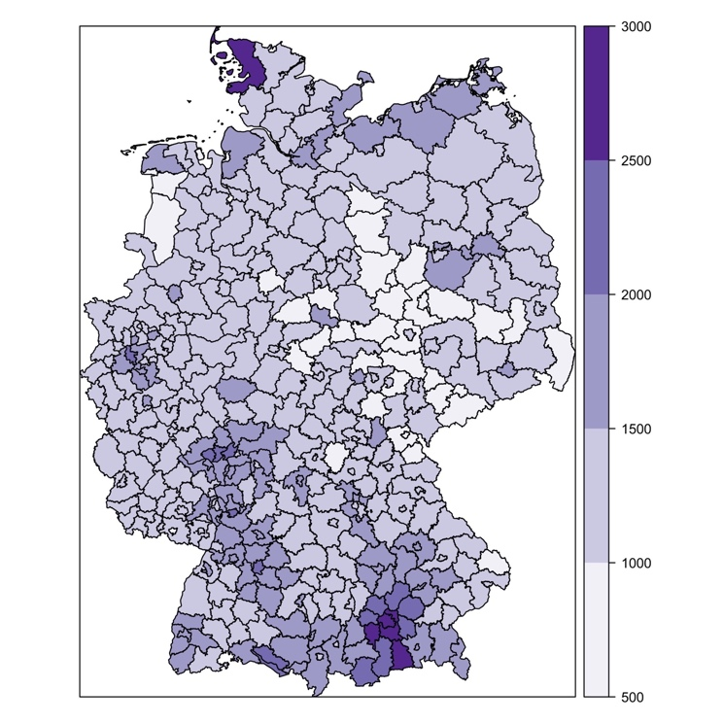
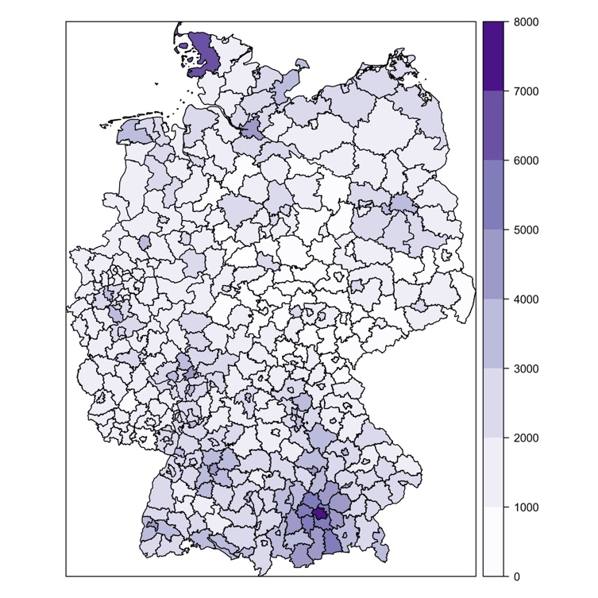
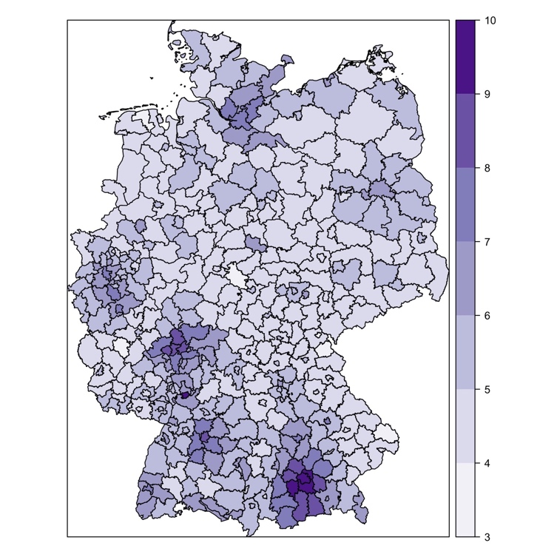
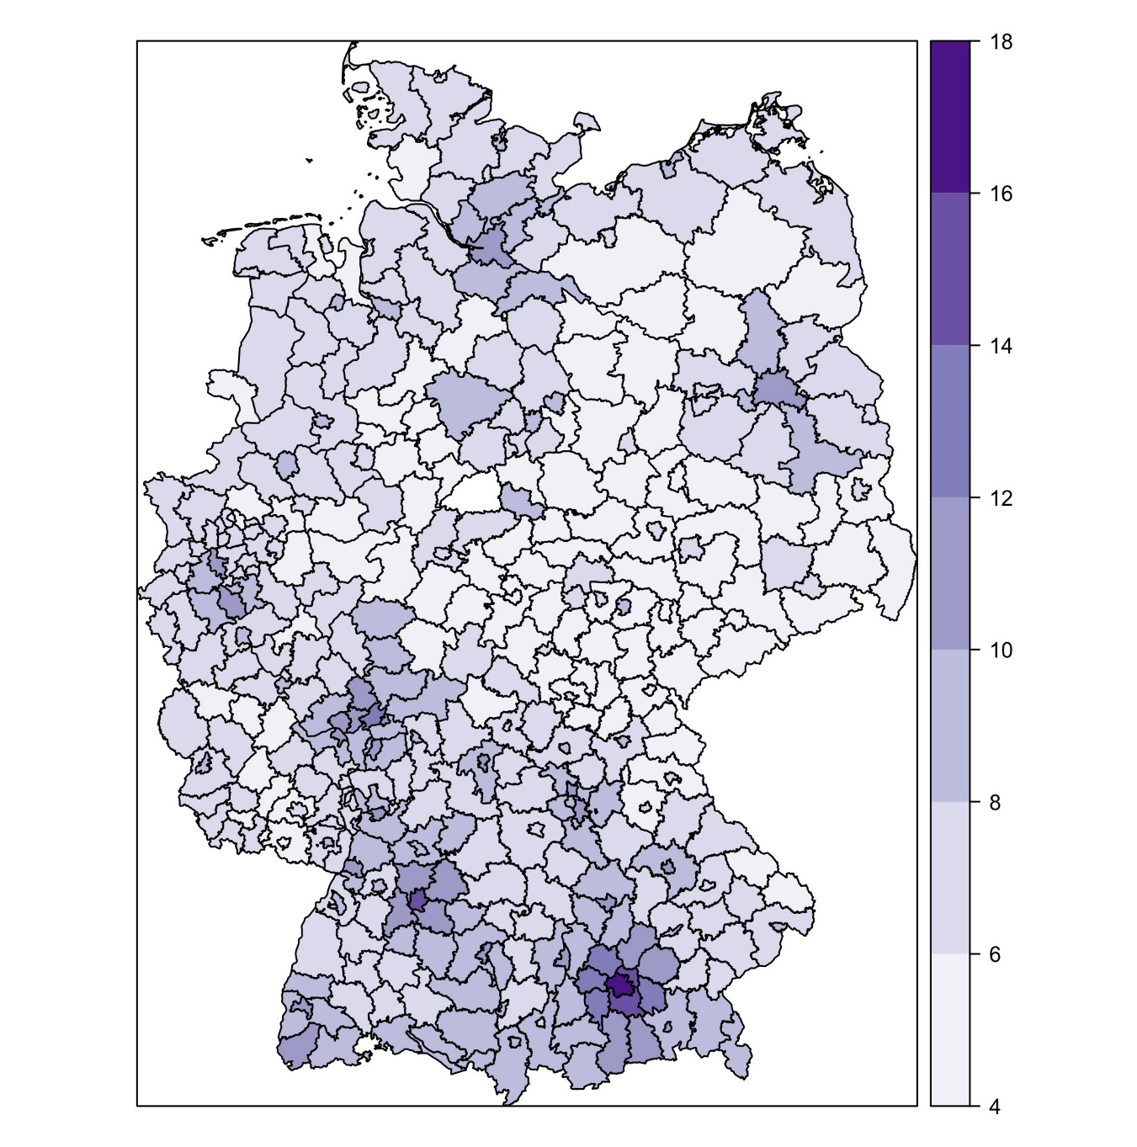
Spatial correlation in housing prices
2004
Sell prices
2018
2004
Rent prices
2018
Housing selling price per squared meter (years 2004 and 2018) and housing rental prices per squared meter (years 2004 and 2018)

Slide 4
Motivation
Rich regions (Munich, Frankfurt, Stuttgart) are different from others
in terms of the effect of determinants
In terms of spatial correlation (high-priced regions are better connected to neighbouring regions)
Regional housing markets is a complicated system of spatial objects with potentially different levels of spatial interconnectedness
Notes:
with potentially different levels of spatial interconnectedness

Slide 5
Motivation
Aim: investigate the determinants of housing prices at different quantiles of prices taking into account spatial connectivity between regions
Quantile regression approach – model regional dissimilarities (differences on effects of determinants)
Spatial quantile regression analysis of regional housing prices (Spatial Quantile Autoregressive model, Spatial Quantile Error model)
Notes:
with potentially different levels of spatial interconnectedness
Cartone A., Postiglione P., Hewings G. J. D. Does economic convergence hold? A spatial quantile analysis on European regions //Economic Modelling. – 2021. – Т. 95. – С. 408-417.

Slide 6
Determinant of housing prices
Non-spatial analysis
Spatial analysis
Real estate prices can be explained by factors such as GDP per capita, factors of institutional development (Égert & Mihaljek, 2007).
Income changes and construction costs are the long-run factors influencing real estate prices (Hort, 1998)
Fundamental indicators are more important than speculative bubbles (Glindro & Subhanij & Szeto & Zhu, 2009).
Migration is one of the most influential factors for real estate prices. However, its influence is dependent on the local regional context (Hanink & Cromley & Ebenstein, 2012)
Neighbouring regions in New Zeland are not cointegrating in housing prices (O'Donovan & Rae, 2009).
Using data for Russian regions Lunkova (2015) finds spatial correlation between housing prices in regions

Slide 7
SpatiAL Quantile Analysis
McMillen D. P. Quantile regression for spatial data. – Springer Science & Business Media, 2012.
Seya H., Axhausen K. W., Chikaraishi M. Spatial unconditional quantile regression: application to Japanese parking price data //The Annals of Regional Science. – 2020. – Т. 65. – №. 2. – С. 351-402.
McMillen and Thorsnes (2003), which focused on the effect of proximity to a copper smelter on property values in Tacoma, Washington.
Regional data:
Cartone A., Postiglione P., Hewings G. J. D. Does economic convergence hold? A spatial quantile analysis on European regions //Economic Modelling. – 2021. – Т. 95. – С. 408-417.

Slide 8
DATA & Methodology
spatial quantile analysis of 401 regions for 2018
spatial panel data quantile analysis (2004 – 2019)
Data from:
BulwienGesa AG (RIWIS regional) offers regional market information "on all districts in Germany and around 350 other German cities”
Development of two market indicators in 401 counties and independent cities for 2018 and 2004 - 2019:
Sell price (Euro/qm)
Rent price (Euro/qm)

Slide 9
DATA & Methodology
The factors influencing housing prices are demand-side and supply-side factors (Reichert, 1990)
VARIABLES
baugen_geb | Construction permits
wgsbstd_geb | Housing stock
svb_wo | Number of employees subject to social insurance
svb_ps.mix | Commuters balance
alq_all | Unemployment rate based on all employed citizens
To be added: | Disposable household income per inhabitant in current prices (Euro)
 | Employee compensation in current prices
 | ?
Notes:
Уровень безработицы (unemp)
Высокий уровень безработицы определяет покупательную способность домохозяйств в определенных рыночных условиях, что в свою очередь сдерживает спрос на жилье, поэтому цены уменьшаются. Ge, 2009; Шумайлова&Абакумов, 2017.
Доля экономически активного населения
(share_eap)
При увеличении доли экономически активного населения больше людей зарабатывают или будут зарабатывать в ближайшем будущем. Следовательно, повышается спрос на недвижимость и увеличивается ее цена.
Реальная заработная плата (wage_real)
При увеличении реальной заработной платы изменяются издержки на строительство нового жилья, следовательно, это оказывает влияние на предложение первичной недвижимости, как следствие увеличивается цена недвижимости. Также она отражает увеличение качества жилья. Potepan, 1996; Абакумов&Ходыкина, 2016; Égert&Mihaljek, 2007.
Реальный средний подушевой доход (income_real)
Является одним из основных факторов, влияющих на принятие решение о покупке жилья. При увеличении доходов растет спрос на рынке недвижимости и её цена. Muth, 1960; Rex, 2000; Ortalo-Magne&Rady, 2001; Algieri, 2013.

Slide 10
Spatial correlation in housing prices
2004
Sell prices
2018
2004
Rent prices
2018
Housing selling price per squared meter (years 2004 and 2018) and housing rental prices per squared meter (years 2004 and 2018)

Slide 11
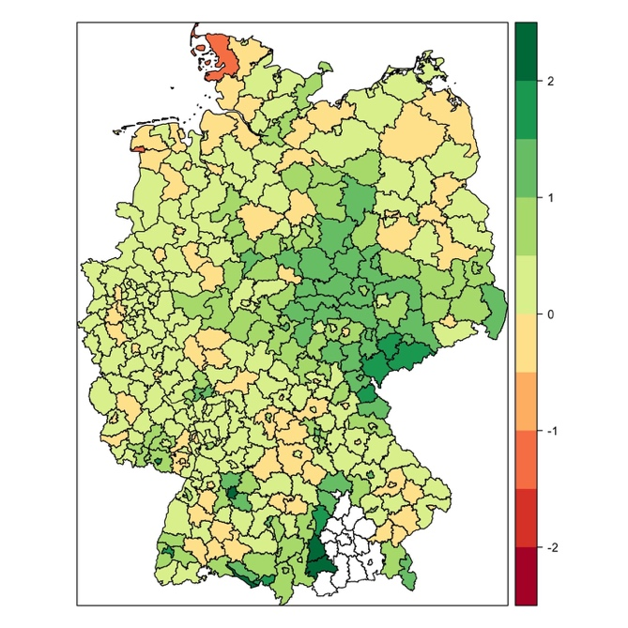
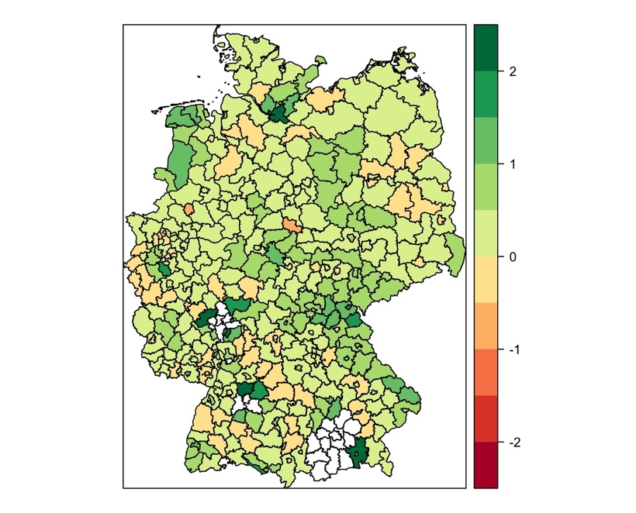
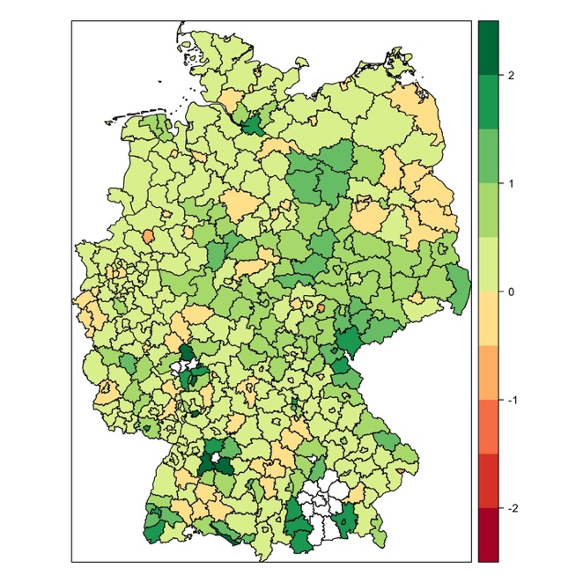
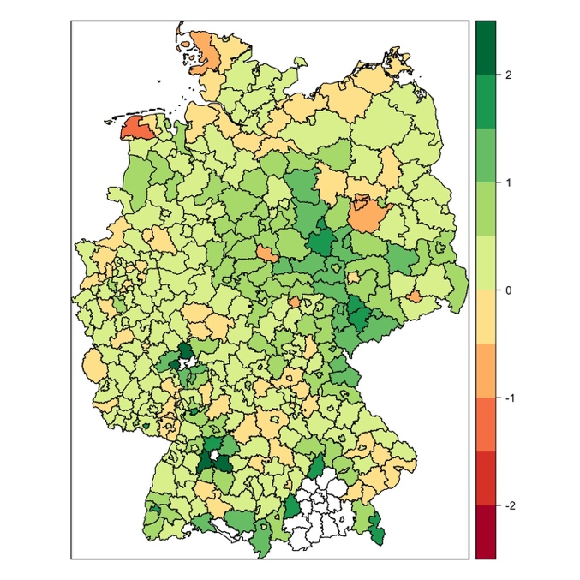
Spatial correlation in housing prices
2004
2015
2004
2015
Sell prices
Rent prices
Local Moran’s I for housing selling prices in 2004 and 2015 and local Moran’s I for housing rental prices in 2004 and 2015.
Local Moran’s $I_{i}=\frac{(P_{i}−\overline{P)}}{S_{i}^{2}}\sum_{j=1,j≠i}^{N}{w_{ij}{(P}_{i}−\overline{P}})$,
where $S_{i}^{2}=\frac{\sum_{j=1,j≠i}^{N}{w_{ij}}}{N−1}−{\overline{P}}^{2}$, $P_{i}$is the sell/rent price, $w_{ij}$ is a weight of a neighbor.

Slide 12
Determinants of Housing Prices: A Spatial Panel Study of German Regions
1. DATA & Methodology
The conditional quantile of a random variable is assumed to be a linear function of randomly distributed exogenous factors:
$$Q_{τ}(Y|X)=x^{′}β_{τ}$$
Quantile regression
$$g= Xθ_{τ}+u_{τ}$$
Notes:
Peeters et al. (2017) noted that the shortcoming of the CQR approach is that the interpretation of the coefficients changes whenever a different set of control vari‐ ables is included in the model.
Firpo et al. (2009) proposed UQR, which can capture not only the within‐group effect, but also the between‐group effect, yielding the total effect.
UQR can capture an estimate of the marginal effect on the “unconditional” quantile of a small increase in a certain characteristic (Fournier and Koske 2013), not on the conditional quantile of the CQR.

Slide 13
Determinants of Housing Prices: A Spatial Panel Study of German Regions
1. DATA & Methodology
The conditional quantile of a random variable is assumed to be a linear function of randomly distributed exogenous factors:
$$Q_{τ}(Y|X)=x^{′}β_{τ}$$
Spatial quantile regression
$$g= ρ_{τ} Wg+Xθ_{τ}+u_{τ}$$
where $ρ_{τ}$ is a spatial autoregressive parameter at quantile $τ$, $W$ is a binary spatial weighting matrix
Notes:
Peeters et al. (2017) noted that the shortcoming of the CQR approach is that the interpretation of the coefficients changes whenever a different set of control vari‐ ables is included in the model.
Firpo et al. (2009) proposed UQR, which can capture not only the within‐group effect, but also the between‐group effect, yielding the total effect.
UQR can capture an estimate of the marginal effect on the “unconditional” quantile of a small increase in a certain characteristic (Fournier and Koske 2013), not on the conditional quantile of the CQR.

Slide 14
Determinants of Housing Prices: A Spatial Panel Study of German Regions
2. Spatial Quantile regression Methods of estimation
$$g= ρ_{τ} Wg+Xθ_{τ}+u_{τ}$$
$Wg$ is endogeneous
Methods of estimation:
Kim and Muller (2004): a double stage quantile regression (DSQR)
Kostov (2013): an empirical likelihood quantile regression (ELQR) estimator
Chernozhukov and Hansen (2005, 2008): instrumental variable quantile regression (IVQR)
Notes:
Kim and Muller (2004): a double stage quantile regression (DSQR)
A straightforward extension of 2SLS, 2SQR proposed by Kim and Muller (2004) is employed to estimate Equation (7). In this method, we still use residential land price, its spatial lag and additional spatial lag mentioned above as instruments to predict the spatially lagged dependent variable W ln y at first. In the following stage, we use the predicted values of W ln y to estimate another quantile regression at the same value of τ, where lny is the dependent
two stage least squares procedure for the spatial linear model defined by Kelejian and Prucha (1998).
DSQR estimates parameters using quantile regressions with random regressors after the endogeneity is treated via preliminary predictive quantile regressions.
Chernozhukov and Hansen (2005) suggest an instrumental variable quantile regression (IVQR) estimator that is a modified version of the standard quantile regression estimator to address the presence of endogenous variables.

Slide 15
2. Methodology
Cross-sectional Quantile Estimation
$$g= ρ_{τ} Wg+Xθ_{τ}+u_{τ}$$
$Wg$ is endogeneous
Method: Instrumental variable quantile regression (IVQR)
Instruments proposed by (McMillen, 2013):
,
$$Z=[X, WX, W^{2}X]$$

Slide 16
3. Methodology
Panel Data Quantile Estimation with fixed effects
$$g_{it}=α_{i}+ X_{it}θ_{τ}+ε_{it}$$
Koenker (2004): quantile regressions for longitudinal data (fixed effects are constant over quantiles)
$$g_{it}=α_{iτ}+ X_{it}θ_{τ}+ε_{it}$$
,
Machado and Santos Silva (2019): quantile regressions with fixed effects affecting the entire distribution

Slide 17
4. Methodology
$$g_{it}=α_{iτ}+ X_{it}θ_{τ}+ε_{it}$$
Method: quantile regressions with fixed effects (Machado and Santos Silva, 2019)
SPAtial Panel Data Quantile Estimation with fixed effects
,
$$g_{it}=α_{iτ}+ X_{it}θ_{τ}+WX_{it}γ_{τ}+ε_{it}$$

Slide 18
1. ESTIMATION RESULTS: QUANTILE REGRESSION without spatial effects (2018, cross-section)
Slope coefficients estimates ${\hat{β}}_{τ}$ for $τ=0.1, …, 0.9$

Slide 19
1. ESTIMATION RESULTS: QUANTILE REGRESSION without spatial effects (2018, cross-section)
Slope coefficients estimates ${\hat{β}}_{τ}$ for $τ=0.1, …, 0.9$

Slide 20
2. Results of Quantile Regression Estimation (2018)
2018 | (1) | (2) | (3) | (4) | (5) | (6) | (7) | (8) | (9)
 | 0.1 | 0.2 | 0.3 | 0.4 | 0.5 | 0.6 | 0.7 | 0.8 | 0.9
VARIABLES | Sell price | Sell price | Sell price | Sell price | Sell price | Sell price | Sell price | Sell price | Sell price
WY | -0.0812 | -0.0249 | 0.0222 | 0.0587 | 0.105 | 0.147 | 0.208 | 0.306* | 0.452*
 | (0.137) | (0.119) | (0.111) | (0.109) | (0.113) | (0.122) | (0.142) | (0.186) | (0.261)
Construction permits | 3.927*** | 3.748*** | 3.598*** | 3.482*** | 3.334*** | 3.200*** | 3.009*** | 2.694*** | 2.232**
 | (0.564) | (0.503) | (0.469) | (0.456) | (0.459) | (0.480) | (0.534) | (0.668) | (0.924)
Housing stock | -0.0194 | -0.0167 | -0.0145 | -0.0128 | -0.0106 | -0.00861 | -0.00577 | -0.00111 | 0.00574
 | (0.0121) | (0.0112) | (0.0105) | (0.00998) | (0.00943) | (0.00901) | (0.00860) | (0.00840) | (0.00932)
Number of employees | 0.00249 | 0.00165 | 0.000953 | 0.000408 | -0.000284 | -0.000912 | -0.00181 | -0.00328 | -0.00545**
 | (0.00336) | (0.00309) | (0.00288) | (0.00273) | (0.00257) | (0.00244) | (0.00230) | (0.00220) | (0.00242)
Commuters balance | 32.74*** | 38.61*** | 43.52*** | 47.34*** | 52.18*** | 56.58*** | 62.86*** | 73.17*** | 88.33***
 | (6.302) | (6.086) | (6.138) | (6.312) | (6.694) | (7.208) | (8.079) | (9.809) | (13.10)
Unemployment | -330.1*** | -347.6*** | -362.2*** | -373.5*** | -387.9*** | -401.0*** | -419.7*** | -450.4*** | -495.5***
 | (55.63) | (51.66) | (49.29) | (48.04) | (47.31) | (47.55) | (49.32) | (55.35) | (70.04)
Constant | 2,440*** | 2,799*** | 3,099*** | 3,331*** | 3,627*** | 3,895*** | 4,279*** | 4,908*** | 5,833***
 | (468.6) | (398.9) | (368.4) | (366.7) | (393.4) | (444.4) | (539.4) | (731.0) | (1,071)
Observations | 401 | 401 | 401 | 401 | 401 | 401 | 401 | 401 | 401

Slide 21
3. Results of Panel Data Estimation (2004 – 2019)
 | (1) | (2) | (3) | (4) | (5) | (6) | (7) | (8) | (9)
 | xtqreg1 | xtqreg2 | xtqreg3 | xtqreg4 | xtqreg5 | xtqreg6 | xtqreg7 | xtqreg8 | xtqreg9
VARIABLES | kp_eurqm | kp_eurqm | kp_eurqm | kp_eurqm | kp_eurqm | kp_eurqm | kp_eurqm | kp_eurqm | kp_eurqm
Construction permits | 0.510*** | 0.557*** | 0.592*** | 0.633*** | 0.681*** | 0.745*** | 0.822*** | 0.922*** | 1.049***
 | (0.0852) | (0.0725) | (0.0651) | (0.0601) | (0.0601) | (0.0699) | (0.0909) | (0.126) | (0.174)
Housing stock | 0.0123* | 0.0113* | 0.0106** | 0.00972** | 0.00872* | 0.00739 | 0.00580 | 0.00371 | 0.00109
 | (0.00693) | (0.00590) | (0.00529) | (0.00488) | (0.00488) | (0.00567) | (0.00737) | (0.0102) | (0.0141)
Number of employees | 0.0103*** | 0.0110*** | 0.0115*** | 0.0121*** | 0.0128*** | 0.0138*** | 0.0149*** | 0.0164*** | 0.0183***
 | (0.00308) | (0.00262) | (0.00235) | (0.00217) | (0.00217) | (0.00252) | (0.00328) | (0.00454) | (0.00629)
Commuters balance | -19.46*** | -20.32*** | -20.98*** | -21.74*** | -22.64*** | -23.84*** | -25.25*** | -27.13*** | -29.48***
 | (3.626) | (3.084) | (2.768) | (2.549) | (2.547) | (2.960) | (3.851) | (5.335) | (7.394)
Unemployment | 1,860*** | 2,047*** | 2,189*** | 2,355*** | 2,549*** | 2,809*** | 3,116*** | 3,522*** | 4,032***
 | (178.8) | (152.1) | (136.7) | (126.3) | (126.8) | (147.7) | (191.6) | (264.1) | (365.2)
Observations | 5,980 | 5,980 | 5,980 | 5,980 | 5,980 | 5,980 | 5,980 | 5,980 | 5,980

Slide 22
4. Results of Panel Data Estimation with Spatial Effects (2004 – 2019)
 | (1) | (2) | (3) | (4) | (5) | (6) | (7) | (8) | (9)
 | Wxtqreg1 | Wxtqreg2 | Wxtqreg3 | Wxtqreg4 | Wxtqreg5 | Wxtqreg6 | Wxtqreg7 | Wxtqreg8 | Wxtqreg9
VARIABLES | kp_eurqm | kp_eurqm | kp_eurqm | kp_eurqm | kp_eurqm | kp_eurqm | kp_eurqm | kp_eurqm | kp_eurqm
Construction permits | 0.0782 | 0.0814 | 0.0840 | 0.0871 | 0.0907 | 0.0956 | 0.101 | 0.107 | 0.115
 | (0.115) | (0.0981) | (0.0874) | (0.0798) | (0.0799) | (0.0949) | (0.125) | (0.162) | (0.217)
Housing stock | -0.0116* | -0.0159*** | -0.0194*** | -0.0236*** | -0.0285*** | -0.0352*** | -0.0428*** | -0.0504*** | -0.0608***
 | (0.00644) | (0.00550) | (0.00491) | (0.00450) | (0.00453) | (0.00539) | (0.00705) | (0.00910) | (0.0122)
Number of employees | 0.00904*** | 0.00980*** | 0.0104*** | 0.0111*** | 0.0120*** | 0.0132*** | 0.0145*** | 0.0159*** | 0.0177***
 | (0.00293) | (0.00250) | (0.00223) | (0.00204) | (0.00204) | (0.00243) | (0.00319) | (0.00413) | (0.00553)
Commuters balance | -10.39*** | -9.601*** | -8.956*** | -8.192*** | -7.285*** | -6.059** | -4.662 | -3.259 | -1.335
 | (3.603) | (3.078) | (2.744) | (2.507) | (2.511) | (2.983) | (3.929) | (5.085) | (6.816)
WX Construction permits | 1.031*** | 1.115*** | 1.184*** | 1.265*** | 1.361*** | 1.492*** | 1.640*** | 1.789*** | 1.993***
 | (0.181) | (0.155) | (0.138) | (0.126) | (0.126) | (0.150) | (0.197) | (0.255) | (0.342)
WX employees | 0.0343*** | 0.0366*** | 0.0385*** | 0.0408*** | 0.0434*** | 0.0470*** | 0.0512*** | 0.0553*** | 0.0610***
 | (0.00256) | (0.00218) | (0.00195) | (0.00178) | (0.00179) | (0.00214) | (0.00279) | (0.00360) | (0.00483)
WX Unemployment | 11.39** | 12.39*** | 13.21*** | 14.18*** | 15.34*** | 16.89*** | 18.67*** | 20.45*** | 22.90**
 | (4.835) | (4.130) | (3.681) | (3.362) | (3.365) | (3.998) | (5.268) | (6.821) | (9.144)
Observations | 5,614 | 5,614 | 5,614 | 5,614 | 5,614 | 5,614 | 5,614 | 5,614 | 5,614

Slide 23
Conclusions
The effect of determinants on housing price level is different for regions of different price level (usually the effect increases)
Spatial correlation is higher for upper-quantile regions (with high prices)
Effect of determinants in neighbouring regions has to be taken into account

Slide 24
Thank you for attention!

Slide 25
Methodology
Spatial Error Model
$$g= Xθ_{τ}+u_{τ}$$
$$u_{τ}=λWu_{τ}+ε_{τ}$$
Estimation approach: FGLS (Kelejian, Prucha, 1999)
Estimate $λ$ with GMM
OLS on transformed variables
,

Slide 26
Methodology
Spatial Error Model
$$g= Xθ_{τ}+u_{τ}$$
$$u_{τ}=λWu_{τ}+ε_{τ}$$
Estimation approach:
Estimate quantile regression
Calculate Moran’s I ($λ$)
OLS on transformed variables
,
Y* $=\left(I −λW\right)Y$
X* $=\left(I −λW\right)X$

Slide 27
Methodology
Spatial Error Model
$$g= Xθ_{τ}+u_{τ}$$
$$u_{τ}=λWu_{τ}+ε_{τ}$$
Estimation approach:
Estimate quantile regression
Calculate Moran’s I ($λ$)
OLS on transformed variables:
,
Y* $=\left(I −λW\right)Y$
X* $=\left(I −λW\right)X$
The procedure reduces Moran’s I on residual from 0.33 to 0.204

Slide 28
Determinants of Housing Prices: A Spatial Panel Study of German Regions
Methodology
Non-spatial model (FE)
$$P_{it}=α_{0}+α_{1}X_{it}+η_{t}+μ_{i}+ε_{it}$$
Spatial Autoregressive Model (SAR)
$$P_{it}=α_{0}+α_{1}X_{it}{+ α_{2}WP_{it}+ η}_{t}+μ_{i}+ε_{it}$$
Spatial Durbin Model (SDM)
$$P_{it}=α_{0}+α_{1}X_{it}+{ α_{2}WP_{it}+α_{3}W\left(X_{it}\right)+ η}_{t}+μ_{i}+ε_{it}$$
,
Spatial Error Model (SEM)
$$P_{it}=α_{0}+α_{1}X_{it}{+ α_{2}WP_{it}+ η}_{t}+μ_{i}+ε_{it}$$
$$ε_{it}=ρWε_{it}+u_{it}$$

Slide 29
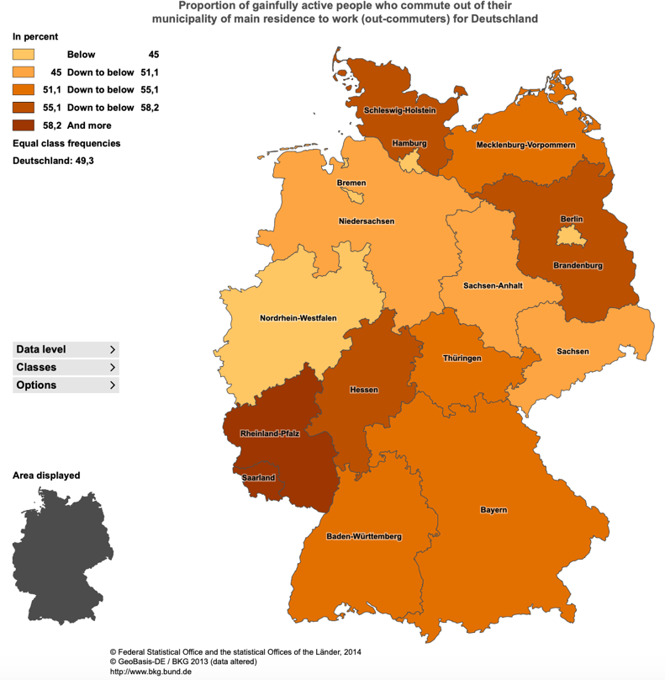
* p<0.05; ** p<0.01; *** p<0.001
Determinants of Housing Prices: A Spatial Panel Study of German Regions
Estimation results for the rent price
 | FE | SAR | SDM |  | SEM
 | rentprice_1 | rentprice_2 | rentprice_3 |  | rentprice_4
VARIABLES |  | SAR | Main | Wx | Main
Unemployment (inverse) | 1.973*** | 1.818*** | 1.575*** | 0.213 | 1.910***
 | (0.197) | (0.187) | (0.212) | (0.324) | (0.195)
Commuters at work (ps_aoy) | -0.00125 | -0.00115 | -0.000865 | -0.0140*** | -0.000702
 | (0.00284) | (0.00269) | (0.00269) | (0.00528) | (0.00269)
Commuters at residence (ps_woy) | -0.00612** | -0.00493* | -0.00390 | 0.00764 | -0.00573**
 | (0.00291) | (0.00276) | (0.00277) | (0.00497) | (0.00277)
Employees (svb_aoy) | -1.84e-05*** | -1.53e-05*** | -1.39e-05*** | -3.44e-05*** | -1.44e-05***
 | (3.19e-06) | (3.04e-06) | (3.05e-06) | (5.58e-06) | (3.07e-06)
Disposable income (vgrvek_ewy) | -5.60e-05*** | -5.55e-05*** | -5.55e-05*** | 2.21e-05 | -5.61e-05***
 | (9.96e-06) | (9.41e-06) | (9.41e-06) | (1.81e-05) | (9.44e-06)
Share of employed people (svb_q2y) | 6.990*** | 6.522*** | 5.880*** | 2.101 | 6.557***
 | (0.863) | (0.817) | (0.853) | (1.463) | (0.838)
Employee’s compensation (vgraney) | 1.78e-05 | 1.65e-05 | 2.11e-05 | 0.000117*** | 1.22e-05
 | (2.38e-05) | (2.25e-05) | (2.26e-05) | (4.28e-05) | (2.26e-05)
Number of employees (vgrany) | 0.0198*** | 0.0165*** | 0.0142*** | 0.0292*** | 0.0159***
 | (0.00344) | (0.00327) | (0.00331) | (0.00586) | (0.00332)
Gross domestic product per worker (vgrbip_ewty) | -1.61e-06 | -1.87e-06 | -1.29e-06 | -1.34e-06 | -1.79e-06
 | (1.69e-06) | (1.60e-06) | (1.60e-06) | (2.86e-06) | (1.60e-06)
rho |  | 0.232*** | 0.193***
 |  | (0.0188) | (0.0203)
lambda |  |  |  |  | 0.234***
 |  |  |  |  | (0.0199)
Constant | 144.1
 | (178.1)
Time effects | Yes | Yes | Yes | Yes | Yes
Observations | 4,776 | 4,776 | 4,776 | 4,776 | 4,776
Number of names | 398 | 398 | 398 | 398 | 398
AIC |  | 61713 | 61652 | 61652 | 61729
BIC |  | 61855 | 61853 | 61853 | 61871

Slide 30
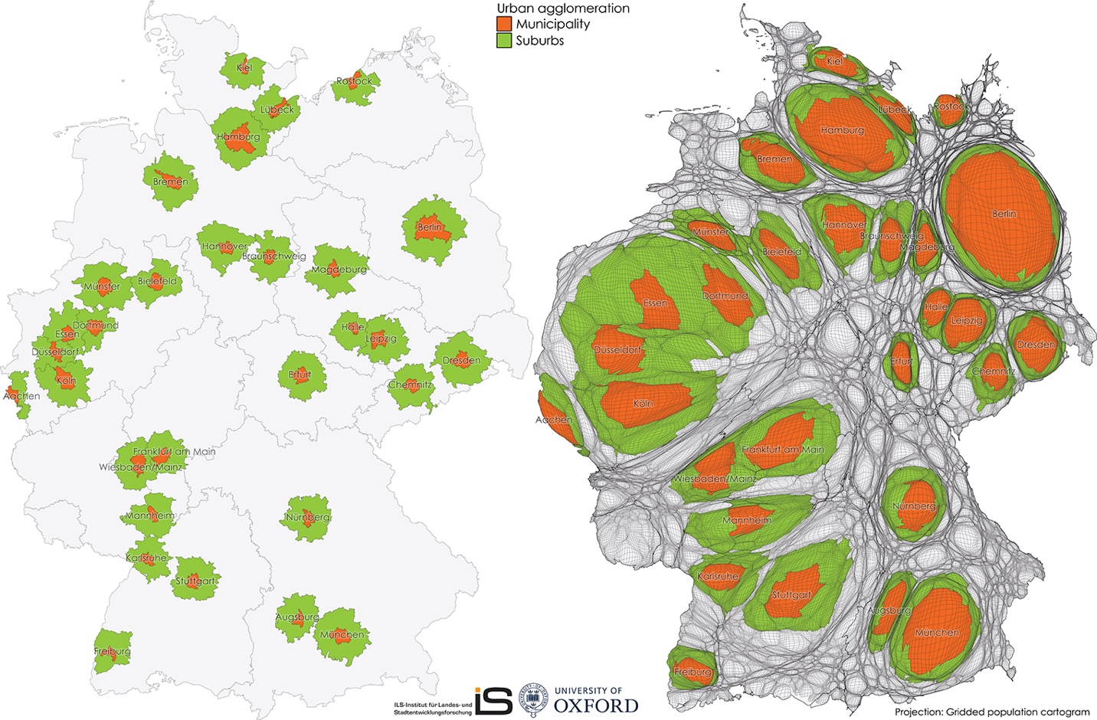
* p<0.05; ** p<0.01; *** p<0.001
Determinants of Housing Prices: A Spatial Panel Study of German Regions
Estimation results for the sell price
 | FE | SAR | SDM |  | SEM
 | sellprice_1 | sellprice_2 | sellprice_3 |  | sellprice_4
VARIABLES |  | SAR | Main | Wx | Main
Unemployment (inverse) | 1,424*** | 1,318*** | 1,251*** | -297.5* | 1,418***
 | (111.0) | (104.2) | (117.9) | (180.5) | (110.6)
Commuters at work (ps_aoy) | -2.318 | -2.304 | -1.983 | -4.885* | -2.120
 | (1.599) | (1.496) | (1.496) | (2.932) | (1.493)
Commuters at residence (ps_woy) | 1.541 | 2.291 | 2.608* | 3.850 | 1.792
 | (1.637) | (1.533) | (1.538) | (2.760) | (1.536)
Employees (svb_aoy) | -0.00352** | -0.00129 | -0.000287 | -0.0225*** | -0.000120
 | (0.00179) | (0.00169) | (0.00170) | (0.00309) | (0.00171)
Disposable income (vgrvek_ewy) | -0.0240*** | -0.0248*** | -0.0249*** | 0.00750 | -0.0248***
 | (0.00560) | (0.00524) | (0.00523) | (0.0101) | (0.00524)
Share of employed people (svb_q2y) | 4,638*** | 3,906*** | 3,348*** | 2,107*** | 3,757***
 | (484.8) | (457.5) | (475.3) | (817.8) | (474.7)
Employee’s compensation (vgraney) | 0.0163 | 0.0174 | 0.0243* | 0.0108 | 0.0176
 | (0.0134) | (0.0125) | (0.0126) | (0.0239) | (0.0126)
Number of employees (vgrany) | 3.578* | 0.919 | -0.836 | 24.87*** | -0.412
 | (1.931) | (1.820) | (1.839) | (3.240) | (1.857)
Gross domestic product per worker (vgrbip_ewty) | -0.00322*** | -0.00347*** | -0.00309*** | 0.00189 | -0.00353***
 | (0.000949) | (0.000889) | (0.000891) | (0.00159) | (0.000891)
rho |  | 0.232*** | 0.193***
 |  | (0.0188) | (0.0203)
lambda |  |  |  |  | 0.234***
 |  |  |  |  | (0.0199)
Constant | 144.1
 | (178.1)
Time effects | Yes | Yes | Yes | Yes | Yes
Observations | 4,776 | 4,776 | 4,776 | 4,776 | 4,776
Number of names | 398 | 398 | 398 | 398 | 398
AIC |  | 61713 | 61652 | 61652 | 61729
BIC |  | 61855 | 61853 | 61853 | 61871

