Slide 1
NRU HSE, School of Finance
38th EBES conference 2022, Poland
Survey: Students’ Propensity to Innovate
Prepared by Evdokimova Mariia,
Scientific advisor: Stepanova Anastasia, PhD in finance.
Warsaw, 2022

Slide 2
Agenda
38th EBES Conference, Poland
Relevance of the research
Propensity to innovate
Sensation seeking
Creativity
Innovative performance: risk-attitude and proactivity
Hypotheses
Data gathering
Survey results
Correlation matrices
Propensity to innovate analysis
Risk-attitude analysis
Conclusion

Slide 3
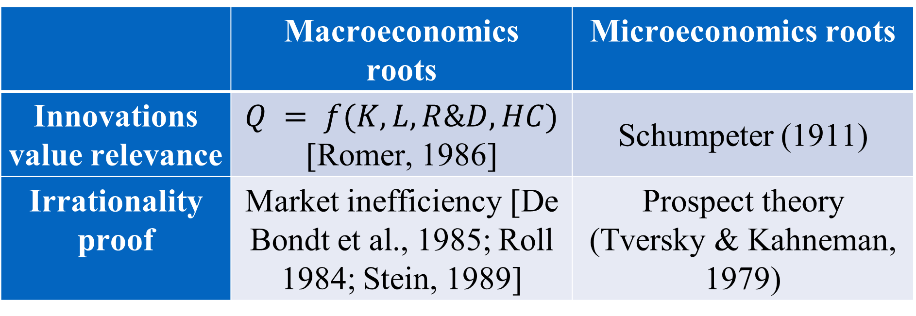
Relevance of the research
38th EBES Conference, Poland
 | Macroeconomics roots | Microeconomics roots
Innovations value relevance | $Q = f(K, L, R\&D, HC)$ [Romer, 1986] | Schumpeter (1911)
Irrationality proof | Market inefficiency [De Bondt et al., 1985; Roll 1984; Stein, 1989] | Prospect theory (Tversky & Kahneman, 1979)
Since 1990-s moving to knowledge based economy [Johannessen & Olsen, 2010]
In 2021 4/10 the most profitable companies in the world are IT companies
Objectives of the study:
− To analyze innovation creation process at the individual level;
− To identify individual propensity to innovate (PtI) and its determinants;
− To prepare and conduct a survey measuring PtI and its determinants;
The object of the research is innovations creation.
The subject of the research is individual propensity to innovate.
The goal: to estimate the individual propensity to innovate and reveal its determinants.

Slide 4
Propensity to innovate
38th EBES Conference, Poland
Individual innovation creation process
Motive
Sensation seeking [Zuckerman, 1994]
Innovative performance
Proactivity, risk [Hormiga et al., 2013; McGurik et al., 2015]
Prerequisites
Creativity: risk-taking, and knowledge [Yagolkovskiy, 2019]
Individual propensity to innovate (PtI) - to what extent person is able to create innovation? [0, 9] in accordance with AltKirt
We’re going to measure PtI in dependence on innovation creation process steps
Students’ survey
Alternative Kirtman Adoption Inventory (Altkirt) [Bobic et al. (1999)]
A Thinking characterized by precision, reliability, efficiency, prudence, discipline
Thinking characterized by lack of discipline, linking of unrelated ideas, unusual thought patterns
B Interested in finding problems to solve
Interested in solving problems
C If rules don’t fit, behind them a bit
Prefer to work within established rules
D Solutions sought by tried and true methods
Use unproven ideas in seeking solution
E Can maintain high accuracy for long periods of work
Work best for short bursts of high intensity
F Bending the rules for one person is unfair to the rest
Bending the rules if necessary makes bureaucracy human
G Impractical, unpredictable, change-oriented type
Practical, predictable, take-care-of-business type
H Command of specialized knowledge
Command of general knowledge
I When involved in a project, I forget that other people are involved and probably should be consulted
When involved in a project, I am still considerable of others

Slide 5
Sensation seeking
38th EBES Conference, Poland
Definitions:
BSSS [Hoyle et al. (2002)]:
“. . . a trait defined by the seeking of varied, novel, complex, and intense sensations and experiences, and the willingness to take physical, social, legal, and financial risks for the sake of such experience” (Zuckerman, 1994)
Schweizer (2006) used the term “novelty seeking” based on information that ‘novelty-seeking genes’ gens were found: “DRD4, DRD2-A2, SLC6A3- 9” [Benjamin et al. (1996), Ebstein et al. (1996), Prolo and Licinio (2002)]. Novelty seeking is often considered as a concept relevant to the need to seek out new information, and to exploratory activity in response to novel stimulation [Cloninger et al. (1994)].
1. I would like to explore strange places.
2. I get restless when I spend too much time at home.
3. I like to do frightening things.
4. I like wild parties.
5. I would like to take off on a trip with no pre-planned routes.
6. I prefer friends who are excitingly unpredictable.
7. I would like to try bungee jumping.
8. I would love to have new and exciting experiences, even if they are illegal.
Measurement
Zuckerman, 1979 suggested Sensation-Seeking Scale (SSS) contains 40 self-estimate questions in 10-item scale which may be structured in 4 big seeking groups: Thrill and Adventure Seeking, Experience Seeking, Disinhibition and Boredom Susceptibility.
Thrill and Adventure Seeking (TAS), and it contained items expressing a desire to engage in sports or other activities involving speed or danger.
Experience Seeking (ES), and it represented the seeking of experience through the mind and senses, travel, and a nonconforming life-style.
Disinhibition (Dis), which seemed to represent the desire for social and sexual disinhibition as expressed in social drinking, partying, and variety in sexual partners.
Boredom Susceptibility (BS), represented an aversion to repetition, routine, and dull people, and restlessness when things are unchanging.

Slide 6
creativity
38th EBES Conference, Poland
Definitions:
Creativity tests:
“Bringing something into being that is original (new, unusual, novel, unexpected) and also Valuable (useful, good, adaptive, appropriate)” [Ochse (1990)];
‘‘Creative thought or behavior must be both novel-original and useful-adaptive’’[Feist (1998)];
‘‘... creativity must entail the following two separate components. First, a creative idea or product must be original... However, to provide a meaningful criterion, originality must be defined with respect to a particular sociocultural group. What may be original with respect to one culture may be old news to the members of some other culture... Second, the original idea or product must prove adaptive in some sense. The exact nature of this criterion depends on the type of creativity being displayed’’ [Simonton (1999)];
‘‘Creativity is the ability to produce work that is both novel (i.e., original, unexpected) and appropriate (i.e., useful, adaptive concerning task constraints)’’ [Sternberg & Lubart (1999)];
‘‘Creativity is the interaction among aptitude, process, and the environment by which an individual or group produces a perceptible product that is both novel and useful as defined within a social context.’’ [Plucker et al. (2004)];
№ | Test and author
1 | Remove association test (RAT) by Mednick (1962)
2 | Guilford’s Alternate Uses test [Guilford (1950)]
3 | Torrance’ test of creative thinking [Torrance (1972)]
4 | Johnson’s test [Runco & Johnson (2002)]
5 | Picturesque test of creative thinking by Urban & Jellen (2005)
6 | Emotional creativity tests [Averill (1999)]
7 | The Creative Achievement Questionnaire (CAQ) [Carson et al. (2005)]
8 | The Creative Behavior Inventory developed by Hocever (1979)
9 | The Creative Achievement Scale [Ludwig (1992)]
10 | The Biographical Inventory of Creative Behaviours (BICB) [Furnham et al. (2008)]

Slide 7
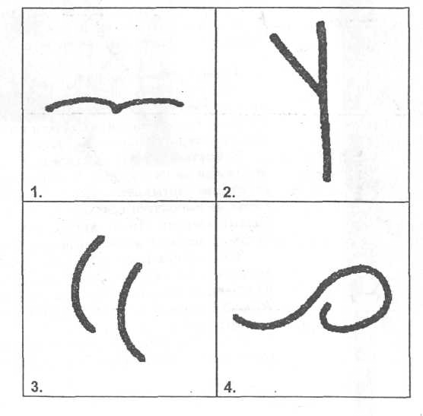
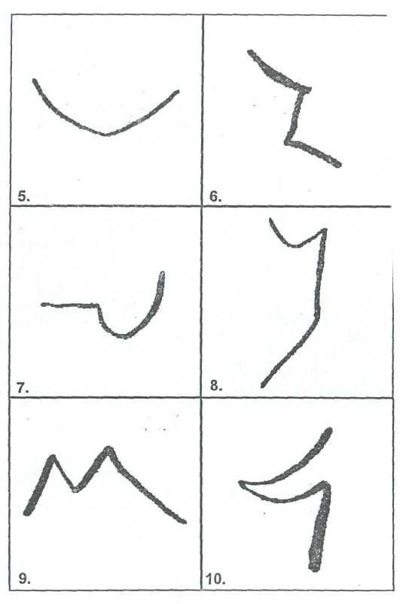
Creativity measurement
38th EBES Conference, Poland
Johnson’s questionnaire:
Torrance’s test:
CAQ:
Feel the subtle, vague, and complex features of the world around you.
Put forward and express a large number of different ideas.
Suggest different types and categories of ideas.
Suggest additional details, ideas, versions or solutions.
Show imagination, a sense of humor and develop hypothetical capabilities.
Demonstrate behavior that is unexpected, original, but useful in solving a problem.
Refrain from taking the first, typical, generally accepted position that comes to mind and put forward different ideas and choose the best.
Show confidence in your decision, despite the difficulties that have arisen; take responsibility for a non-standard position, an opinion that contributes to solving the problem.
Activity | Never | Rare | Sometimes | Often | Always
Painting, sculpture
Music
Dance
Dizain, hand craft
Writing
Theater, film
Other:
Mednick’s test:
There is a triple of words for which you need to find another word so that it is combined with each of the three suggested words. Example: clock, violin, unity
Answer: master (watch master, violin master, unique master)

Slide 8
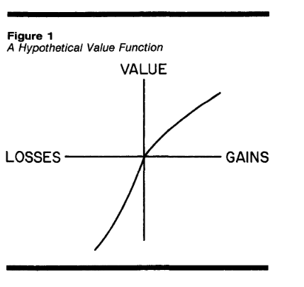
Innovative performance
38th EBES Conference, Poland
Risk-attitude
Proactivity
Gneezy & Potters (1997)
Schweizer (2006) highlighted the main determinants of innovative performance: achievements need, self-confidence, perseverance, assertiveness, proactivity, extraversion, and cooperativeness
Suppose you have 1,000 rubles at your disposal, and you are asked to choose which part of a thousand rubles you will invest. The investment will either generate an income 2.5 times higher than the original investment or zero income. How much are you willing to invest?
Eckel & Grossman (2002)
Kahneman, Tversky (1984) “Choices, Values, and Frames”
Choice (50/50 Gamble) | Low payoff, rub. (Probability = 50%) | High payoff, rub. (Probability = 50%)
Gamble 1 | 280 | 280
Gamble 2 | 240 | 360
Gamble 3 | 200 | 440
Gamble 4 | 160 | 520
Gamble 5 | 120 | 600
Gamble 6 | 20 | 700
Hypothesis: Willingness to receive under risk is higher than willingness to invest under risk.

Slide 9
Hypotheses
38th EBES Conference, Poland
 | PtI | Risk-attitude | Source
H1 | SS |  | Schweizer (2006), Zuckerman (1994)
H2 | Creativity |  | Schweizer (2006), Yagolkovskiy (2019)
H3 | Risk-attitude |  | Schweizer (2006), Loch (2017) and Shen et al. (2018)
H4 | Proactivity |  | Schweizer (2006)
H5 |  | Age | Brooks et al. (2018); Guenzel & Malmendier (2020); Serfling (2014)
H6 |  | Male | Adams & Ragunathan (2017); Charness et al. (2013); Rossi et al. (2017)
H7 |  | Income | Hubar et al. (2020)
H8 |  | Partner | Roussanov & Savor (2014)
H9 |  | Big family experience | Ngan-ling Chow & Zhao (1996)
H10 |  | Disaster | Bernile et al. (2017)
H11 |  | Education (field, level and number of Universities) | Allemand et al. (2017)
H12 |  | Working experience | Allemand et al. (2017)
H13 |  | Investing experience | Figner & Weber (2011)
H14 |  | Entrepreneurship | Hormiga et al. (2013); McGuirk et al. (2015)
H15 |  | Extreme Sports | Brymer (2010)

Slide 10
DATA gathering
38th EBES Conference, Poland
NRU HSE economics students and recent graduates (< 3 years)
153 respondents from 650, response rate is 23%
Wave | Date | Respondents | Responses | Audience | Respponse | Format | Comment | Announcement
wave 0 | 24-25 Sep | graduates | 20 | 20 | 100,0% | online | no motivation | individual message
 |  | 2 + 3 bac stat | 2 | 20 | 10,0% | online | no motivation | chat
wave 1 | 12 Oct | 3 bac econom | 20 | 20 | 100,0% | offline | no motivation | announcement
wave 2 | 29 Oct | 2 bac econom | 10 | 58 | 17,2% | online | no motivation | announcement
wave 3 | 1 Nov | PhD | 1 | 215 | 0,5% | online | no motivation | chat
 |  | 2-3 bac econom | 7 | 234 | 3,0% | online | no motivation | chat
wave 4 | 11-16 Nov | 4 bac | 72 | 78 | 92,3% | online | motivation | announcement
 |  | 3 bac stat | 5 | 9 | 55,6% | online | motivation | announcement
 |  | 2 + 3 bac stat | 18 | 26 | 69,2% | online | week motivation | announcement
 |  |  | 155 | 680 | 22,8%
Response rate in dependence on motivation
Response rate in dependence on addressing
Wave | Score motivation | Week motivation | No motivation | Average
wave 0 (Sep’21) |  |  | 55% | 55%
wave 1 (Oct’21) – offline |  |  | 100% | 100%
wave 2 (Oct’21) – ann. |  |  | 21% | 21%
wave 3 (Nov’21) – chat |  |  | 6% | 6%
wave 4 (Nov’21) – motive | 87% | 69% |  | 84%
Average | 87% | 69% | 34% | 55%
Wave | Announcement | Chat | Individual message | Average
wave 0 (Sep’21) |  | 10% | 100% | 55%
wave 1 (Oct’21) – offline | 100% |  |  | 100%
wave 2 (Oct’21) – ann. | 21% |  |  | 21%
wave 3 (Nov’21) – chat |  | 6% |  | 6%
wave 4 (Nov’21) – motive | 84% |  |  | 84%
Average | 72% | 7% | 100% | 55%

Slide 11
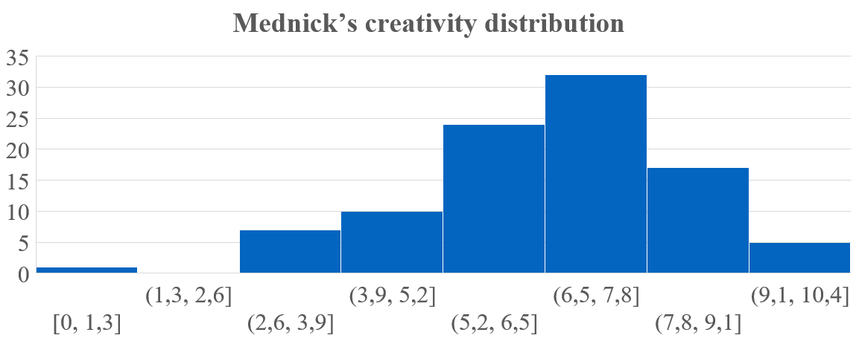
Survey results
38th EBES Conference, Poland
Descriptive statistics
Variable | Obs | Mean | Std. Dev. | Min | Max
PtI | 153 | 3,6 | 1,9 | 0,0 | 9,0
BSSS | 153 | 31,7 | 9,9 | 9,0 | 56,0
RT_inv | 152 | 642,6 | 295,2 | 0,0 | 1000,0
RT_recive | 153 | 3,7 | 1,3 | 1,0 | 6,0
RT_self | 153 | 2,1 | 0,4 | 1,0 | 3,0
Johnson | 20 | 28,8 | 4,0 | 21,0 | 36,0
CAQ | 132 | 8,3 | 4,3 | 0,0 | 22,0
Torrance | 19 | 9,9 | 4,6 | 2,0 | 19,0
Mednick | 105 | 6,6 | 1,7 | 0,0 | 10,0
Age | 153 | 21,1 | 2,2 | 18,0 | 28,0
Male | 152 | 0,6 | 0,5 | 0,0 | 1,0
Income | 153 | 2,2 | 2,0 | 0,0 | 6,0
Student | 153 | 0,9 | 0,3 | 0,0 | 1,0
Working | 153 | 0,6 | 0,5 | 0,0 | 1,0
Educ_years | 153 | 3,8 | 1,1 | 2,0 | 9,0
N_higher_educ | 153 | 1,2 | 0,5 | 0,0 | 3,0
N_jobs | 153 | 1,5 | 1,2 | 0,0 | 5,0
Activity | 153 | 2,6 | 0,8 | 1,0 | 4,0
Investment | 153 | 0,64 | 0 | 0 | 1
Extreme | 153 | 0,5 | 0,5 | 0,0 | 1,0
Addicted | 153 | 0,3 | 0,5 | 0,0 | 1,0

Slide 12
Survey results
38th EBES Conference, Poland

Slide 13
Correlation matrices
38th EBES Conference, Poland
PtI correlation with sensation-seeking, creativity, and risk-taking.
 | PtI | BSSS | Torrance | RT_inv | RT_rec | RT_self
PtI | 1.0000
BSSS | 0.2840* | 1.0000
Torrance | 0.2029 | 0.3559 | 1.0000
RT_inv | 0.1693 | 0.0729 | 0.0705 | 1.0000
RT_rec | 0.2204* | 0.2670* | 0.3394 | 0.4201* | 1.0000
RT_self | 0.3993* | 0.2234* | 0.4210* | -0.0586* | -0.0360* | 1.0000
 | PtI | BSSS | Mednick | RT_inv | RT_rec | RT_self
PtI | 1.0000
BSSS | 0.3456* | 1.0000
Mednick | 0.0410 | 0.0711 | 1.0000
RT_inv | 0.0485 | 0.1609* | 0.1028 | 1.0000
RT_rec | 0.1799* | 0.2757* | 0.0257 | 0.1930* | 1.0000
RT_self | 0.2835* | 0.4487* | -0.0068 | 0.2201* | 0.3007* | 1.0000
* p<0.1
N obs. = 19
* p<0.1
N obs. = 105
Risk-taking correlation matrix
 | RT receive | RT inv | RT self estim | Extreme | Activity | Parents function | Working | Age | Male
RT receive | 1.0000
RT inv | 0.1930* | 1.0000
RT self estim | 0.2201* | 0.3007* | 1.0000
Extreme | 0.1680* | 0.1718* | 0.3476* | 1.0000
Activity | 0.1125 | 0.1221 | 0.2817* | 0.1573* | 1.0000
Parents function | -0.0095 | 0.0256 | 0.1951* | 0.1756* | 0.1480* | 1.0000
Working | 0.1199 | 0.0882 | 0.0305 | -0.1520* | 0.1380* | 0.1236 | 1.0000
Age | -0.0370 | -0.0178 | -0.1001 | -0.0831 | -0.0096 | 0.0440 | 0.3483* | 1.0000
Male | -0.1588* | -0.2028* | -0.1429* | -0.1354* | 0.0670 | 0.1287 | -0.0154 | -0.0049 | 1.0000
RT to receive, to invest and self-estimated are correlated positively
Extreme sports, activity and bearing parents function in childhood increases risk-taking
Working experience decreases interest to extreme sports
Men are more risky than women
* p<0.1
N obs. = 151

Slide 14
Multinominal logit estimation
PtI analysis
OLS estimation
VARIABLES | PtI
BSSS | 0.119***
CAQ | 0.00901
Mednick | -0.0868
2.Activity | -0.137
3.Activity | 0.153
4.Activity | 3.085*
RT_inv | -0.000339
RT_recive | 0.0150
Investment_exp | -0.862
Business_exp | -0.401
1.Relationship | 1.913***
2.Relationship | 0.396
3.Relationship | -4.754**
Big_family | 1.150
Parents_function | -0.531
1.Parents_educ | -2.968*
2.Parents_educ | -3.974**
Disaster | 0.731
Hobbies | -1.137
Sports | 0.0726
Extreme | -0.842
Addicted | -0.0425
Age | -0.382
Male | 0.00923
1.Income | -0.682
2.Income | 0.145
3.Income | -1.386
4.Income | -0.360
5.Income | -2.607*
6.Income | -0.607
Working | -0.102
Self_employed | -0.457
Educ_years | 0.045
Awards | 0.143
2.N_higher_educ | 2.004**
3.N_higher_educ | 1.235
1.N_jobs | 1.977**
2.N_jobs | 0.627
3.N_jobs | 0.719
4.N_jobs | 0.984
Observations | 105
School of Finance
VARIABLES | PtI
BSSS | 0.0481**
CAQ | 0.0268
Mednick | -0.00963
Activity | 0.496*
RT_inv | -0.000218
RT_recive | 0.150
Investment_exp | -0.702*
Business_exp | 1.101*
Relationship | -0.0542
Big_family | 0.216
Parents_function | -0.307
Parents_educ | -0.840**
Disaster | 0.193
Hobbies | -1.320**
Sports | 0.395
Extreme | 0.0352
Addicted | 0.453
Age | -0.0329
Male | 0.0863
Income | -0.0209
Working | 0.714
Self_employed | -0.833
Educ_years | 0.0468
Awards | -0.227
N_higher_educ | 0.948**
N_jobs | -0.329
Constant | 2.350
Observations | 105
R-squared | 0.421
$${PtI}_{i}= α+β_{1}∗{SensationSeeking}_{i}+β_{2}∗{RiskTaking}_{i}+β_{3}∗{Creativity}_{i}+β_{4}∗{Proactivity}_{i}+Controls+ε_{i}$$
Based on Yagolkovskiy, 2019
Variable | Measurement
Propensity to innovate | Alternative Kirton adoption inventory (AltKirt), a short version of Kirton adoption inventory developed by Bobic et al. (1999);
Sensation- seeking | Brief sensation seeking scale (BSSS) developed by Hoyle et al. (2002) – short version of sensation seeking scale elaborated by Zuckerman et al. (1978);
Creativity | 1) Torrance's (1972) test of creative thinking for an offline survey, 2) Mednick's (1962) verbal creativity test for an online survey, 3) Creative achievements questionnaire (CAQ) – both for online and offline surveys;
Risk-taking | 1) Self-estimation, 2) Gneezy & Potters (1997) method, 3) Eckel & Grossman (2002) method;
Proactivity | 1) Self-estimation, 2) Rewards, 3) Regular hobbies and sports.
Standard errors in parentheses
*** p<0.01, ** p<0.05, * p<0.1

Slide 15
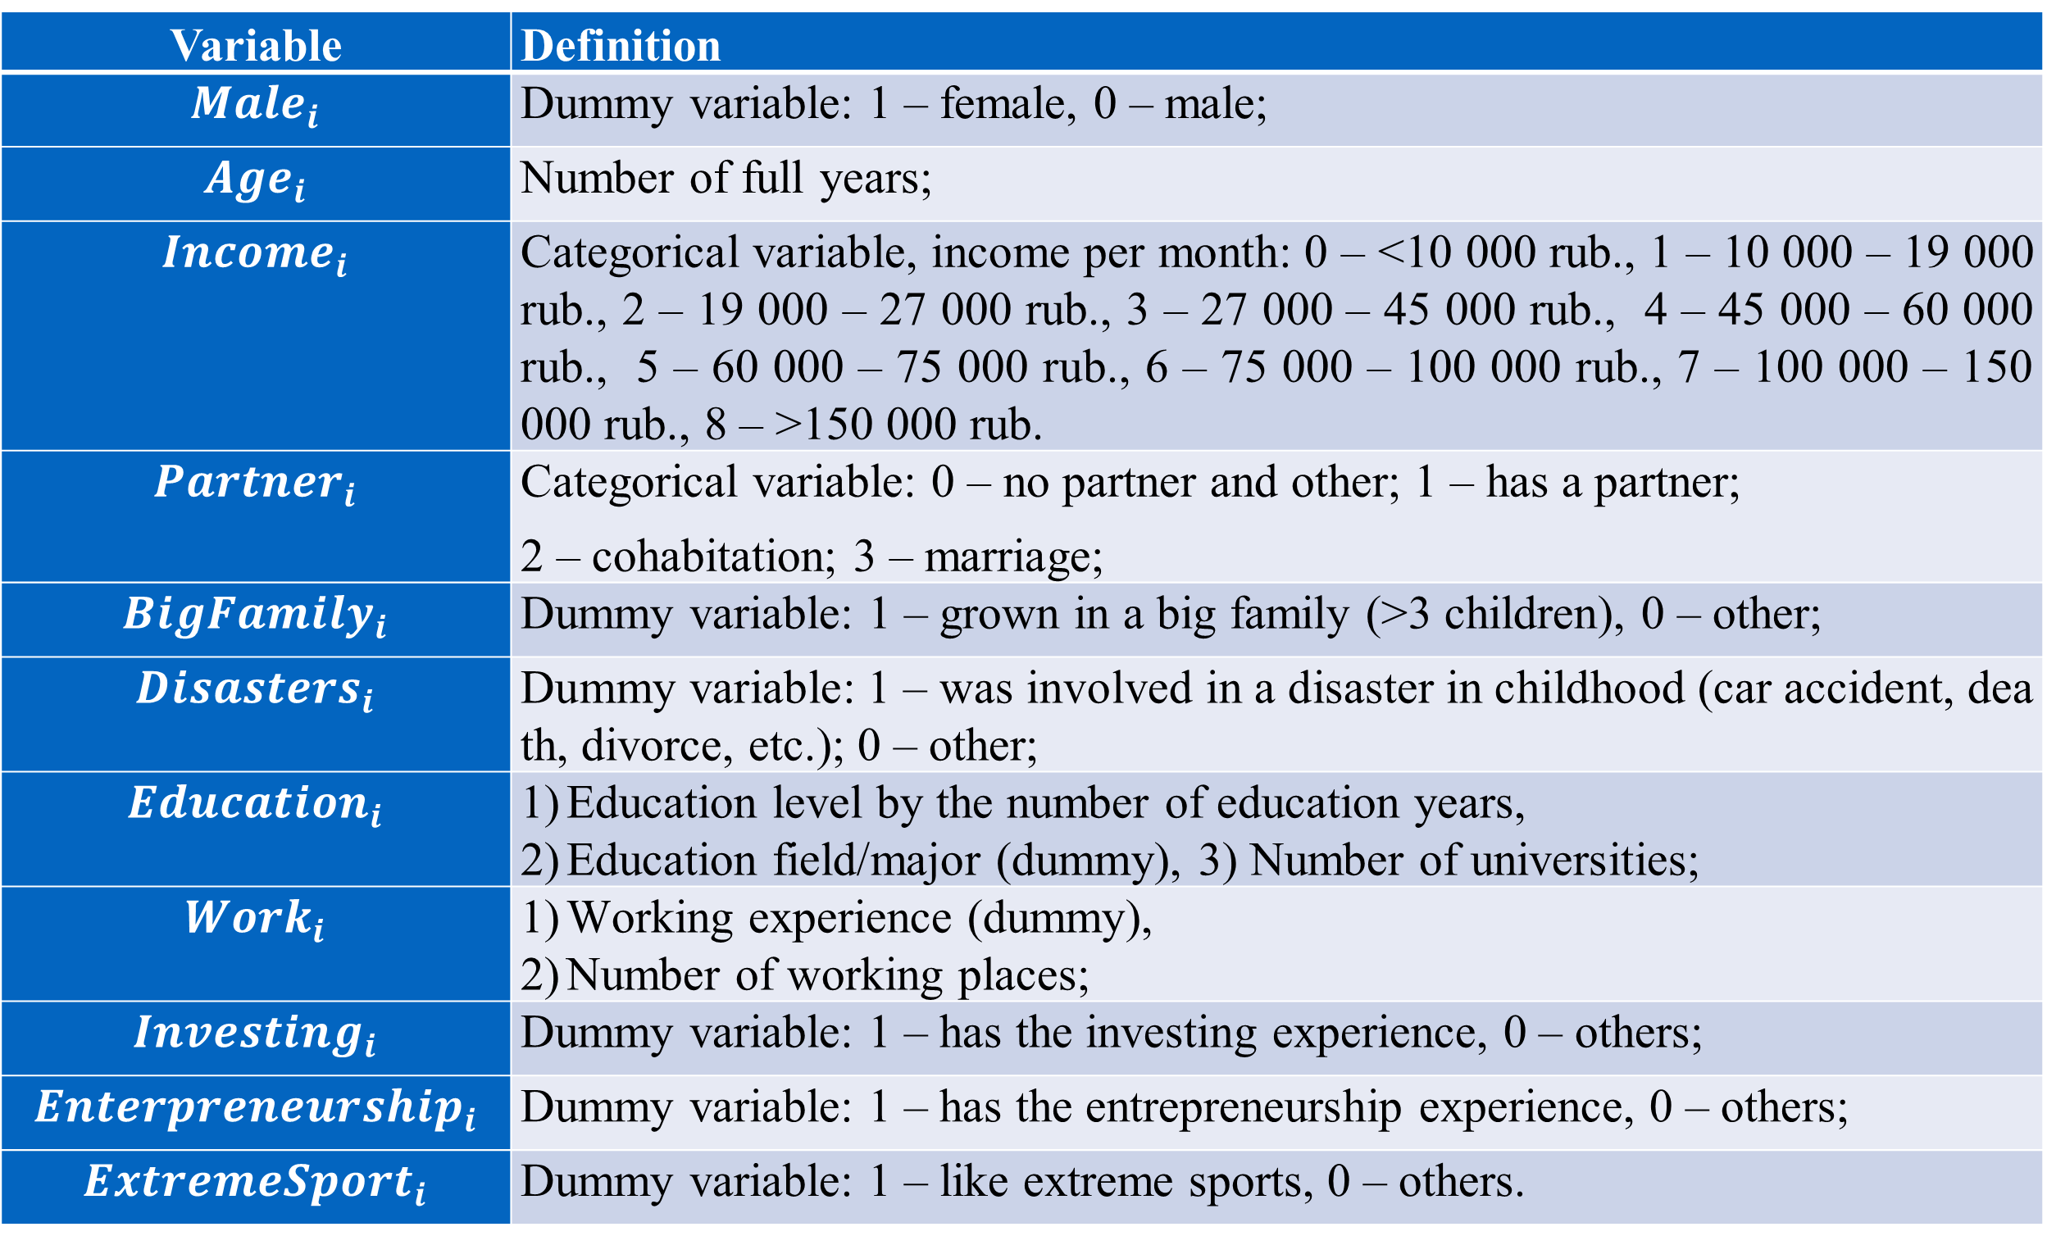
Risk-attitude analysis
VARIABLES | RT_recive | RT_inv
Male | -0.472** | -66.52
 | (0.228) | (49.31)
Age | -0.0240 | -29.36
 | (0.0835) | (18.31)
Income | 0.0142 | 5.150
 | (0.0700) | (15.03)
Relationship | -0.123 | 7.604
 | (0.140) | (30.20)
Big_family | -0.190 | 0.375
 | (0.332) | (71.38)
Disaster | -0.465 | 7.962
 | (0.310) | (66.57)
Educ_years | 0.0377 | 51.95
 | (0.157) | (34.29)
Working | 0.346 | 39.02
 | (0.274) | (59.14)
Investment_exp | 0.105 | 96.23*
 | (0.245) | (52.97)
Business_exp | 0.0927 | 15.51
 | (0.392) | (84.15)
Extreme | 0.420* | 93.92*
 | (0.231) | (49.76)
Constant | 4.021*** | 955.3***
 | (1.404) | (305.6)
Observations | 152 | 151
R-squared | 0.097 | 0.120
School of Finance
$${Risk}_{i}= α+β_{1}∗{Male}_{i}+β_{2}∗{Age}_{i}+β_{3}∗{Income}_{i}+β_{4}∗{Partner}_{i}+β_{5}∗{BigFamily}_{i}+β_{6}∗{Disasters}_{i}+ β_{7}∗{Education}_{i}+β_{8}∗{Work}_{i}+β_{9}∗{Investing}_{i}+β_{10}∗{Enterpreneurship}_{i}+β_{11}∗{ExtremeSport}_{i}+ε_{i}$$
Variable | Definition
$${Male}_{i}$$ | Dummy variable: 1 – female, 0 – male;
$${Age}_{i}$$ | Number of full years;
$${Income}_{i}$$ | Categorical variable, income per month: 0 – <10 000 rub., 1 – 10 000 – 19 000 rub., 2 – 19 000 – 27 000 rub., 3 – 27 000 – 45 000 rub., 4 – 45 000 – 60 000 rub., 5 – 60 000 – 75 000 rub., 6 – 75 000 – 100 000 rub., 7 – 100 000 – 150 000 rub., 8 – >150 000 rub.
$${Partner}_{i}$$ | Categorical variable: 0 – no partner and other; 1 – has a partner; 2 – cohabitation; 3 – marriage;
$${BigFamily}_{i}$$ | Dummy variable: 1 – grown in a big family (>3 children), 0 – other;
$${Disasters}_{i}$$ | Dummy variable: 1 – was involved in a disaster in childhood (car accident, death, divorce, etc.); 0 – other;
$${Education}_{i}$$ | Education level by the number of education years, Education field/major (dummy), 3) Number of universities;
$${Work}_{i}$$ | Working experience (dummy), Number of working places;
$${Investing}_{i}$$ | Dummy variable: 1 – has the investing experience, 0 – others;
$${Enterpreneurship}_{i}$$ | Dummy variable: 1 – has the entrepreneurship experience, 0 – others;
$${ExtremeSport}_{i}$$ | Dummy variable: 1 – like extreme sports, 0 – others.
Standard errors in parentheses
*** p<0.01, ** p<0.05, * p<0.1

Slide 16
Conclusion
38th EBES Conference, Poland
PtI and risk
Contribution of the study
Interesting findings
Development of propensity to innovate measurement based on observable facts
Evaluation of propensity to innovate and risk taking determinants
Proved positive correlation between risk-attitude and PtI, creativity and sensation-seeking
 | Age | Sports
Age | 1.0000
Sports | -0.0909 | 1.0000
PtI | Respondents | Average RT_inv | Average RT_recive
1 | 17,00 | 600,00 | 3,24
2 | 32,00 | 590,32 | 3,13
3 | 32,00 | 649,38 | 3,94
4 | 26,00 | 647,85 | 4,31
5 | 17,00 | 782,35 | 3,71
6 | 13,00 | 553,85 | 3,54
7 | 11,00 | 709,09 | 3,91
8 | 3,00 | 750,00 | 4,00
Сorr with PtI |  | 0,54 | 0,54
N obs. = 126
 | Torrance | CAQ
Torrance | 1.0000
CAQ | -0.0586 | 1.0000
Problems
N obs. = 19
PtI and creativity relationship is not significant
How to combine/compare risks and creativity?
PtI and creativity
 | PtI_1 | PtI_4 | Mednick | CAQ
PtI_1 | 1.0000
PtI_4 | 0.1519* | 1.0000
Mednick | 0.0541 | -0.0654 | 1.0000
CAQ | -0.0921 | 0.2375* | 0.1631* | 1.0000
Limitations of the research
Continuation of the research
We are not consider popular individuality descriptive approach called “Big five personal traits”
We are not going to measure IQ
Possible selection bias
Divide respondents into 2 groups: adaptors (PtI =<3) and innovators (PtI >=7)
Work out on PtI index consisted of observable individual determinants
Next research step: estimate CEO PtI
N obs. = 105

Slide 17
Thank you for the attention!
Email: evdokimovamary@mail.ru

