Slide 1
Управление портфелем опционов в риск-нейтральном мире
Голембиовский Дмитрий Юрьевич
Московский государственный университет,
Банк зенит

Slide 2
Real option markets
Usually exchange-traded options on an underlying asset expire on a day of the month, often the third Friday or the last business day preceding the third Friday.
The options traded usually expire during some closest consecutive months, as well as the next some months following in the month’s trading cycle. For instance, options trading on 8 March 2012, might have expiration dates in March 2012, April 2012, May 2012 (three consecutive months) as well as June 2012, September 2012, December 2012 and March 2013 (the next four months in the March cycle). Options of several strikes for each expiration month are traded at the same time.
Every day exchanges calculate the settlement price of each option after completion of trading. The fundamental works on stock option pricing were published by Black and Scholes and Merton in 1973. The formula for futures options was suggested by Black in 1976. Although an enormous number of alternative option pricing models have been developed since that time, exchanges nevertheless usually use these models for calculating the settlement prices of European options. To price American options the scheme of Cox, Ross, and Rubinstein is commonly applied. Some exchanges use this scheme for European options also.

Slide 3
Collateral. Standard Portfolio ANalysis of Risk
Settlement prices are used for evaluation of option positions and for calculation of collateral. To hold derivative positions some collateral is required by exchanges. Derivative portfolio collateral is the sum of two components: the amount of money which is necessary for immediate closing option positions (option liquidation value) and estimation of maximal possible one day losses. The second component is usually named maintenance margin. If the option liquidation value is negative (money will be received from the closing of the positions), it decreases the needed collateral. Some exchanges also calculate the so called initial margin which is required to open positions. The initial margin is simply the maintenance margin multiplied by some coefficient which is more than unity.
In 1988 the Chicago Mercantile Exchange (CME) developed the SPAN methodology (Standard Portfolio ANalysis of Risk) for maintenance margin calculation. The first step of SPAN is Scanning Risk. 16 scenarios of underlying price and implied volatility are considered. Portfolio losses corresponding to each scenario are calculated. The maximum of these 16 figures is the Scanning Risk of the portfolio. The next steps of SPAN make the estimation of possible one-day portfolio losses more precise. They take into account divergence of the same derivatives for different maturities, spread credits from derivatives on different underlying assets, risk increasing close to delivery and short option minimal charge.Every day exchanges calculate the settlement price of each option after completion of trading. The fundamental works on stock option pricing were published by Black and Scholes and Merton in 1973. The formula for futures options was suggested by Black in 1976. Although an enormous number of alternative option pricing models have been developed since that time, exchanges nevertheless usually use these models for calculating the settlement prices of European options. To price American options the scheme of Cox, Ross, and Rubinstein is commonly applied. Some exchanges use this scheme for European options also.

Slide 4
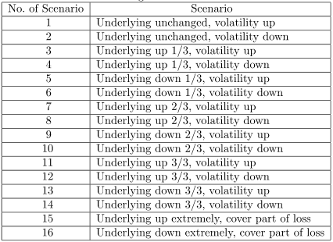
Standard Portfolio ANalysis of Risk. Scanning risk scenarios

Slide 5
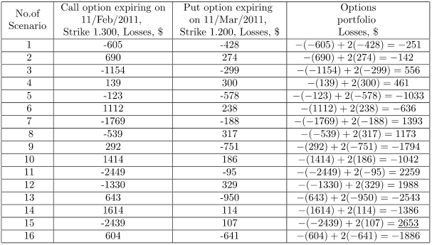
Scanning risk example on 11.01.2011 with EUR/USD American Style Options

Slide 6
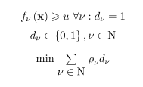
Risk-neutral world. How to invest?
The risk-neutral world is a widespread model of financial markets. In the risk-neutral world the price of an option is equal to its expected payoff discounted at the risk-free interest rate. That is why the expected return of any option portfolio is equal to the risk-free rate. The same yield can be obtained investing in the risk-free asset. Portfolio optimization taking into account the expected portfolio return must lead to the portfolio which consists of the risk-free asset if risk aversion is employed by the program.
However, it is possible to restructure the portfolio dynamically in such a way that it provides higher return with probability close to unity and lower return (possibly a large negative return) with a given low probability. For developing such a strategy the appropriate technique is multistage stochastic programming with the so called safety-first criterion¹.
¹ Roy, A. D., Safety First and the Holding of Assets. Econometrica, 1952, July, 431-450.
(1)
(2)
(3)

Slide 7
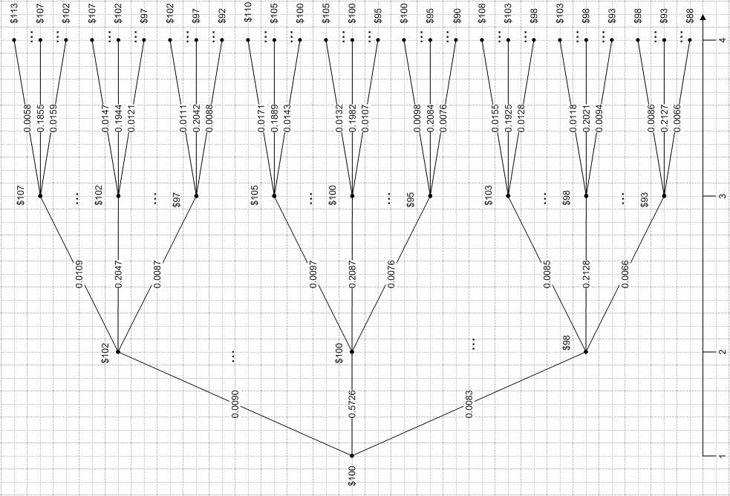
Scenario tree for the stochastic program

Slide 8
Underlying prices in the nodes of the tree

Slide 9
Model of the risk-neutral options market
For simplicity the working days are considered only. There are 21 working days in each month. So, in this respect a year consists of 252 days. Each trading day is considered as one moment; we do not consider online trading.
The options expire on the 21st day of the relevant month. Settlement on the expired options is fulfilled immediately after trading. The new options appear on the 1st day of each month.
It is also assumed that underlying asset spot price follows a geometric Brownian motion. The underlying price volatility is a constant. Options are priced based on the Black-Scholes formula.
Some commission is collected for each trade.
For simplicity, underlying asset trading is not considered; an investor can buy and sell options only.
On any day only such options are traded for which the logarithms of the ratios of their strikes over the current underlying price belong to the interval
(4)
where r is a risk-free rate, t is time to expiry. These conditions simulate low options liquidity near expiry and for strikes which are far from the money.
To trade options on the market, collateral is required. In our market the maintenance margin is determined according to the first step of Standard Portfolio ANalysis of Risk (SPAN)

Slide 10
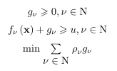
Problem of option portfolio optimization. I
(5)
(6)
(7)

Slide 11
Problem of option portfolio optimization. II
(8)
(9)
(10)
(11)
(12)
‘
‘
‘
(13)
(14)

Slide 12
Problem of option portfolio optimization. III
‘
(15)
(16)
(17)
(18)
(19)
(20)

Slide 13
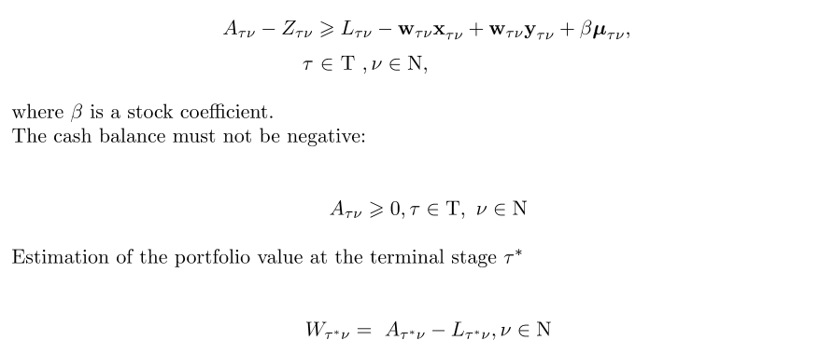
Problem of option portfolio optimization. IV
‘
‘
(21)
(22)
(23)
(24)
(25)
(26)

Slide 14
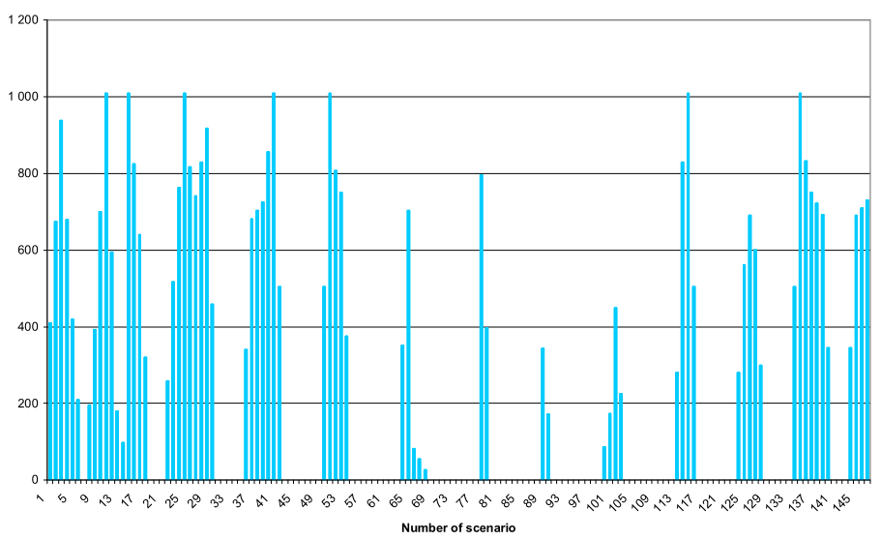
Values of variables in the result of one expiration portfolio optimization
The summarized probability of inactive scenarios is 0.0178 during solving the approximate problem with as the weights in the optimization criterion. The according exact mix-Boolean optimization problem provides the relevant probability value 0.0140.

Slide 15
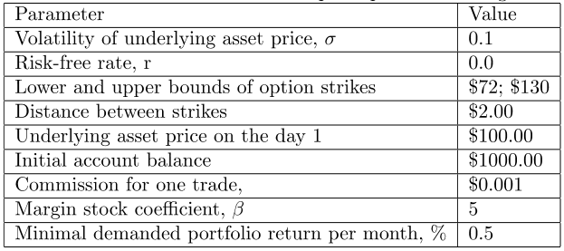
Parameters of simulation of option portfolio management

Slide 16
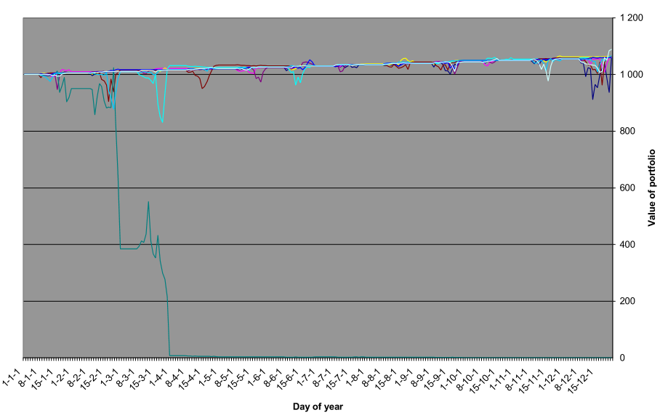
Results of portfolio management simulation. One expiration option portfolio. Exact optimization mix-Boolean problem has been solved.

Slide 17
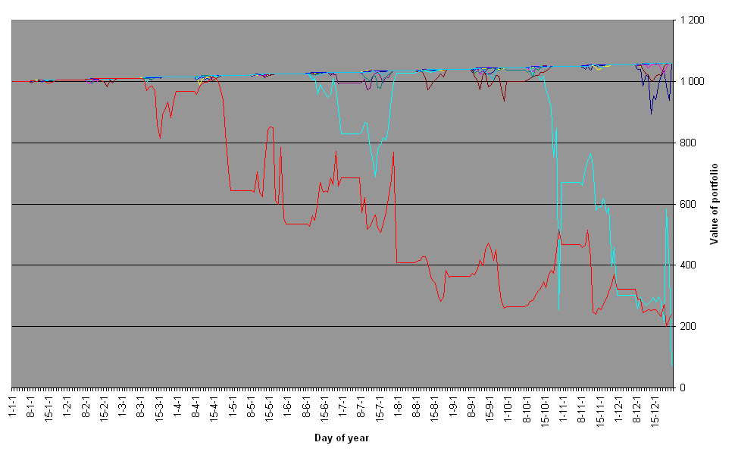
Results of portfolio management simulation. One expiration option portfolio. Linear approximation of mix-Boolean problem has been solved.

Slide 18
The strategy of option portfolio management with dual expiration dates
The portfolio started on the 1st day of the 1st month from the account balance $1000. The portfolio was optimized every second day (all odd dates). Untill the 7th day only options of one expiration were included in the portfolio. Starting from the 7th day, if the probability of not reaching the demanded portfolio value was more then 0.001, the options of the next expiration were included in the optimization. Under this the planning horizon was set to the end of the next month.
If the options of the second expiration were not opted for, the portfolio expired at the end of the current month. The following simulation started from the obtained sum of money.
In the opposite case the portfolio continued to the next month. The same algorithm of the portfolio management repeated: if starting from the 7th day of the month the probability of providing the demanded portfolio value was not proved satisfactory, then the options which expire in the next month were added.
The following scenario trees were constructed for the described optimization. During the portfolio optimization on the 1st, 3rd and 5th day of any month the scenario tree had the structure C-7-14-21. Here "C" means that the root node of the tree accords with the current day, "7", "14" and "21" mean that the second, third and fourth stages of the tree accords with the 7th, 14th and 21st day of the current month. Starting from the 7th day if the options of the next expiration were not icluded in the optimization problem, the tree could have the structures C-14-21 or C-21. In the case of adding the next expiration options to the portfolio, the planning horizon was set to the end of the next month. The according tree structure can be presented as C-14-21-21 or C-21-21, i.e. the last stage of the tree accords with the 21st day of the next month.

Slide 19
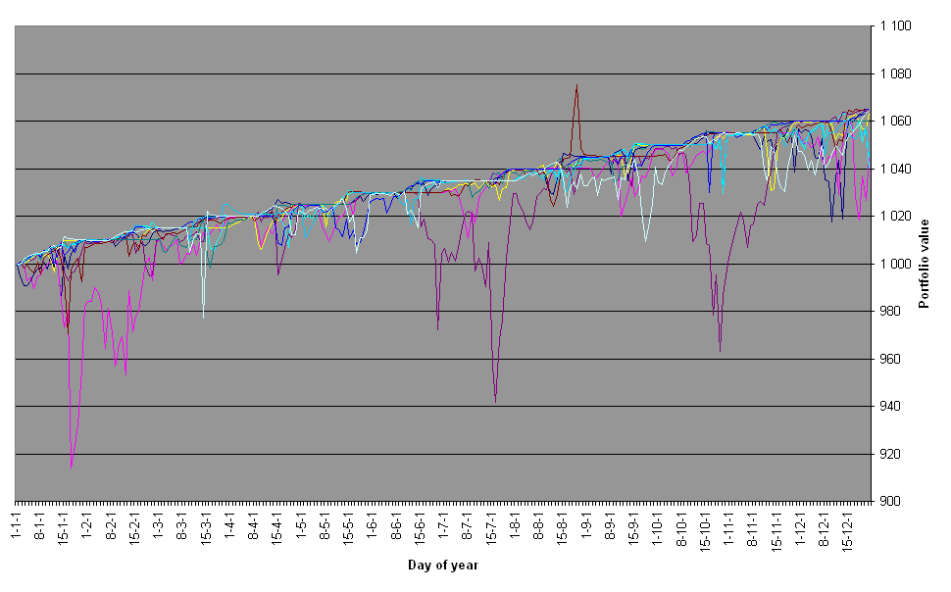
Results of portfolio management simulation. Dual expirations option portfolio. Linear approximation of mix-Boolean problem has been solved.

Slide 20
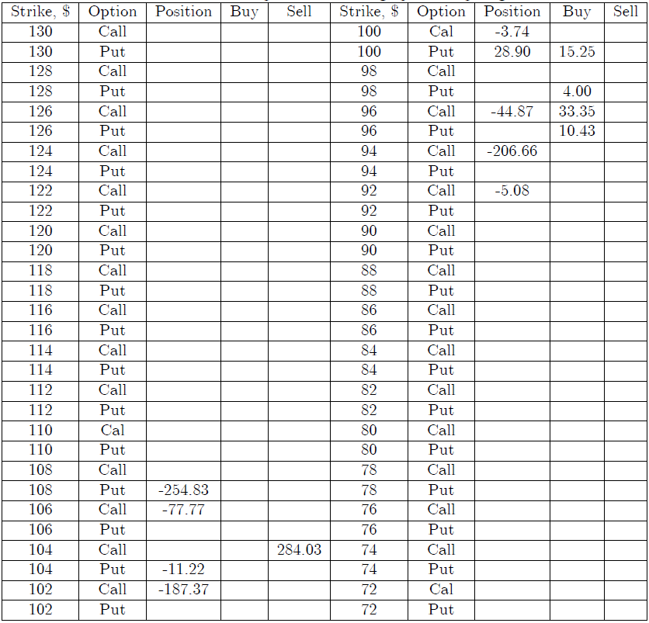
7th day of the first month. Portfolio and results of the optimization using options expiring in the current month. The obtained probability of not reaching the demanded return was 0.00402,
which is more than the adopted level 0.001.

Slide 21
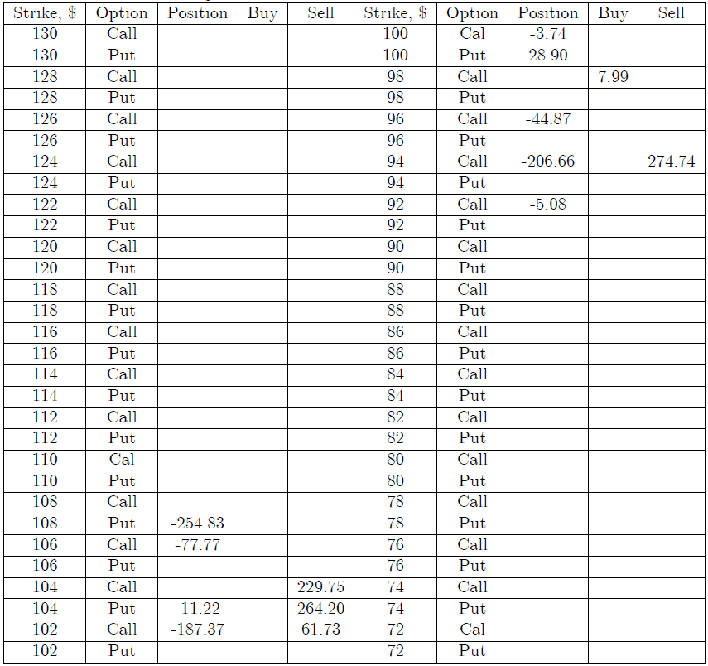
7th day of the first month. Portfolio and results of the optimization using options of dual expiration dates. Recommendations on the first expiration options are in the table. For the next expiration options buying of 10.76 Calls with the strike $98 is recommended. The probability of not reaching the demanded return is 0.00274.

Slide 22
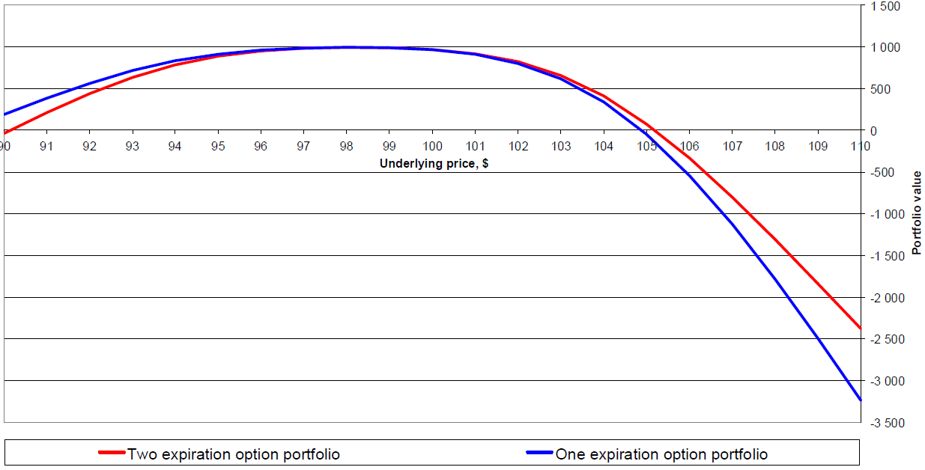
Values of the portfolios with one and with dual expirations on the 7th day of 1st month

Slide 23
Conclusion
In the risk-neutral world the expected return from investment in any option portfolio corresponds with the risk-free rate. However, it is possible to manage portfolio dynamically in such a way that it provides higher return with a probability close to unity and lower return (possibly large negative return) with a given low probability.
The model of option portfolio optimization in the risk-neutral world based on multistage stochastic programming was developed. The so called “safety first” criterion was used for the optimization.
The linear approximation of the mixed-Boolean optimization problem with the “safety first” criterion was suggested. It reduced the demanded computer time essentially and permitted to optimize the portfolio with dual expiration dates. It was experimentally shown that the solution of the approximate problem is close to the solution of the exact problem.
Ten 1-year traces of option portfolio management with dual expiration dates were simulated. No single track finished with a loss. It can be concluded that the resultant probability of success of the portfolio management is quite close to unity.
The developed portfolio management strategy can be groundwork for constructing trading strategies for the real option markets.

