Slide 1

Faculty of Economics and Business
Start Adding Personal Value
Marcel Timmer

Slide 2
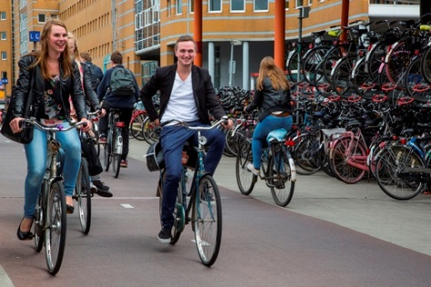
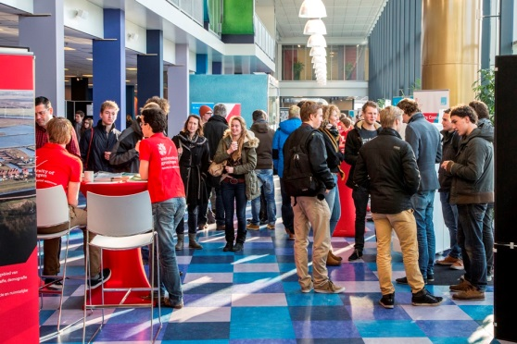
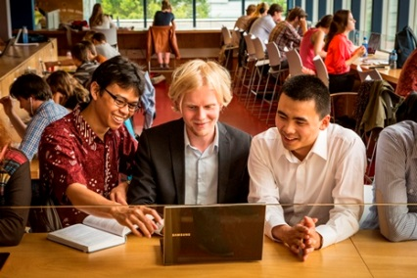
Date 19-9-2015 | 2
Presentation / content
City of Groningen
University of Groningen
Faculty of Economics and Business
Education
Research
Ambiance
Internationalisation
Career services
Corporate relations

Slide 3
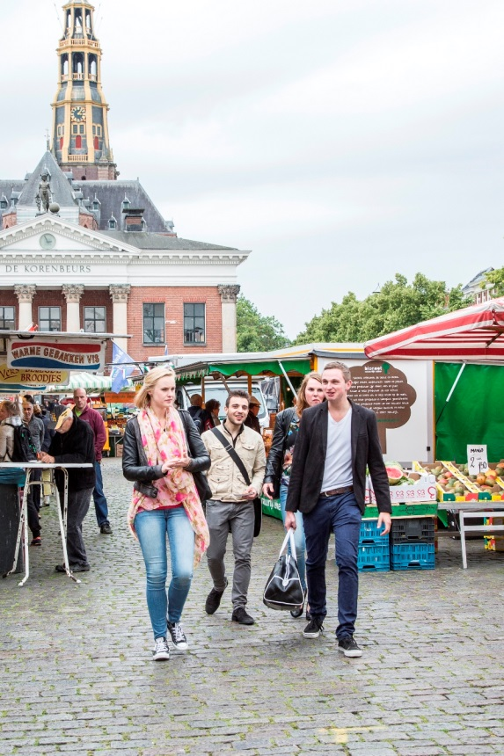

City / Groningen
Founded in 1040
Cultural / economic capital of the north
University town
- 200,000 inhabitants (2014)
- 50% younger than 35 years old
Intimate and friendly city, open Dutch culture
Recent awards
Best student city of the Netherlands
Best inner city of the Netherlands
Safest city in the Netherlands
European city with the highest quality of life
Second most cultural city of the Netherlands
Highest satisfaction rating in Europe for education facilities, healthcare services and public spaces

Slide 4
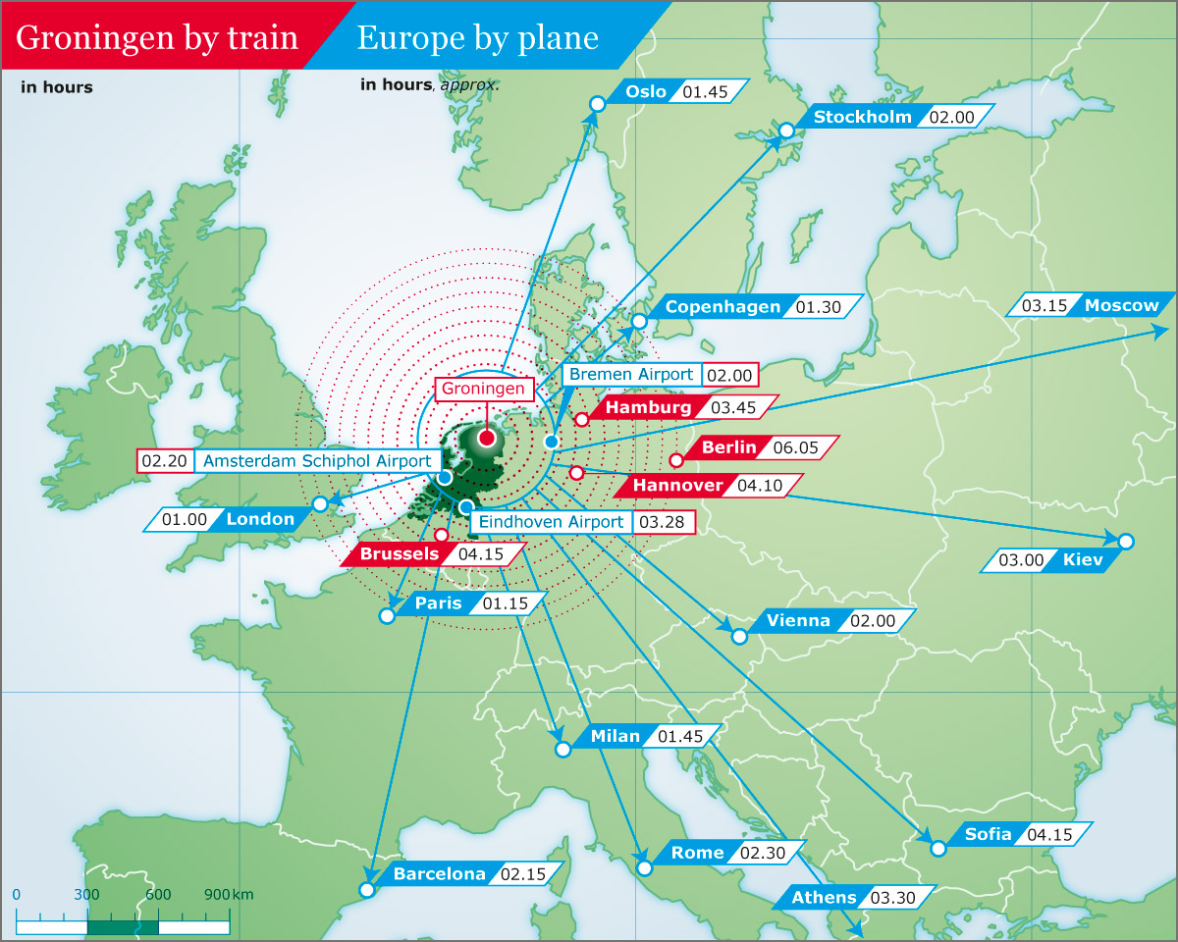
Date 19-9-2015 | 4

Slide 5







City / living costs
Housing ± €350-500 / month
Health insurance ± €100-120 / month
Food ± €150-250 / month
Spending money ± €75 / month
Bicycle ± €45-100 / year
Books ± €300 / semester
Language course ± €100-450 / course
Total 1 year (excl. tuition) ± €10,000 - €12,000

Slide 6
Date 19-9-2015 | 6
City / student accommodation
The city is the campus!
No University-owned student accommodation: private market
The student accommodation provider in the Netherlands, SSH, will assist you in finding housing for your first year in Groningen: www.sshxl.nl/en (after the 1st year, students find their own accommodation without a problem)
There are currently a range of options, including 11 ‘student houses’, ranging from 25 to 300+ rooms
Typical 1st year accommodation: single furnished room with shared facilities
Internet connection
Between €350 to €500 per month

Slide 7
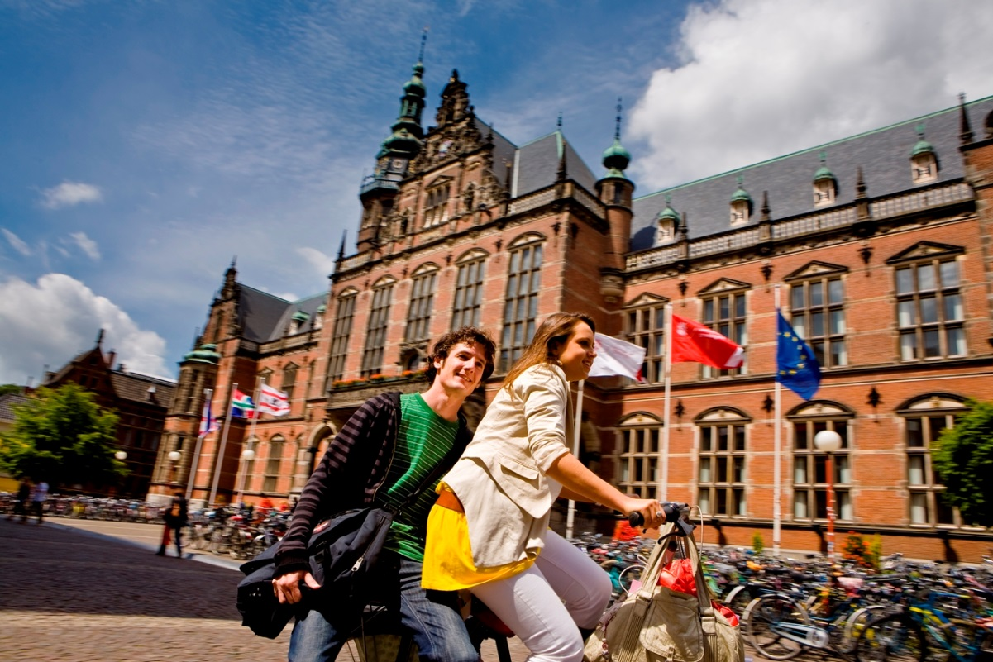
Date 19-9-2015 | 7
Notes:
University intro slide

Slide 8
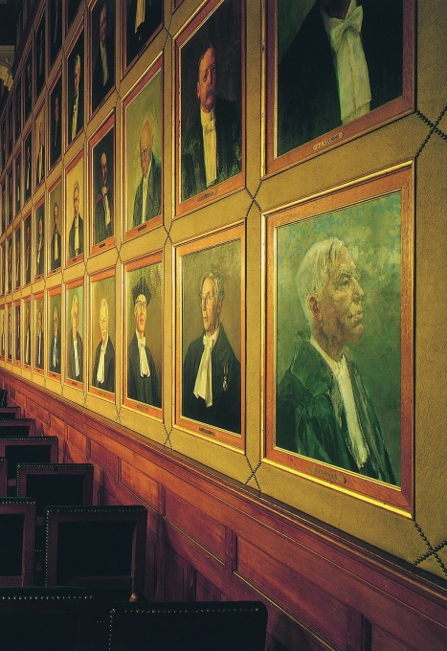
University / history
Founded 23 August 1614 – 400 years!
One of the oldest research institutions in Europe
Aletta Jacobs, first female student in the Netherlands
Frederik Zernike, Nobel Prize for Physics (1953)
Wubbo Ockels, first Dutch astronaut
Wim Duisenberg, first president of European Bank
Klaas Knot, current president of Dutch Central Bank
Two Royal Princes of the House of Orange as economics graduates. One princess graduated in business administration

Slide 9
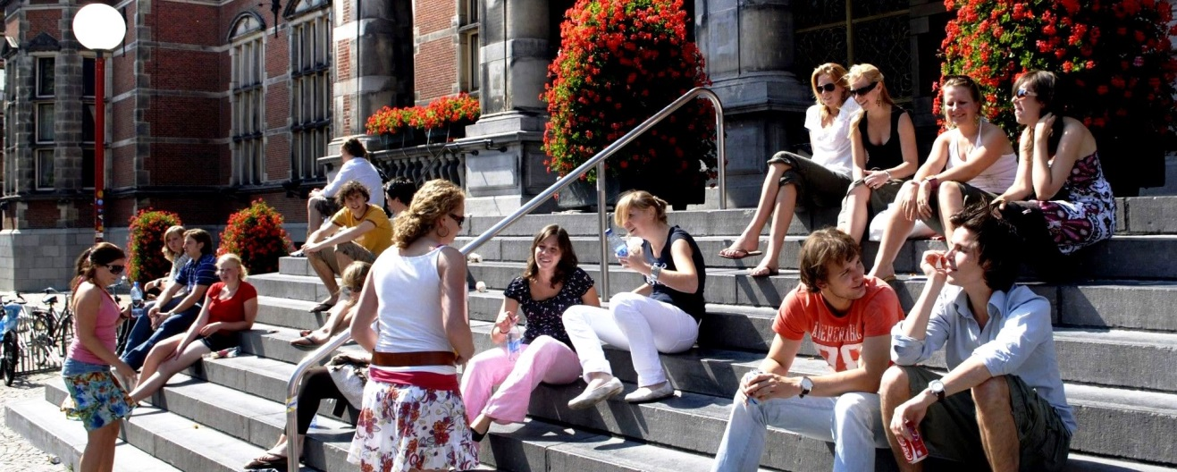
Date 19-9-2015 | 9
University / present
“400 years of excellence in teaching and research”
Mission:
The University of Groningen provides high quality teaching and research, is internationally oriented, respects differences in ambition and talent, works actively with business, the government and the public, and ranks among the best universities in Europe.

Slide 10
University / present
10
University rankings
#56 | ESI Citation Impact most productive universities worldwide
#82 | Academic Ranking of World Universities Worldwide (2014)
#90 | QS Worldwide (2014-15)
#92 | NTU Ranking Worldwide (2013)
#117 | Times Higher Education (2014-15)
Leading research university
Excellent reputation for academic teaching and research
Bachelor, master and PhD programmes in many fields
Careers services
Best employer of all Dutch universities
Excellent computer facilities
Excellent sports facilities
International learning environment
English official language of the University
Exciting, friendly, vibrant

Slide 11

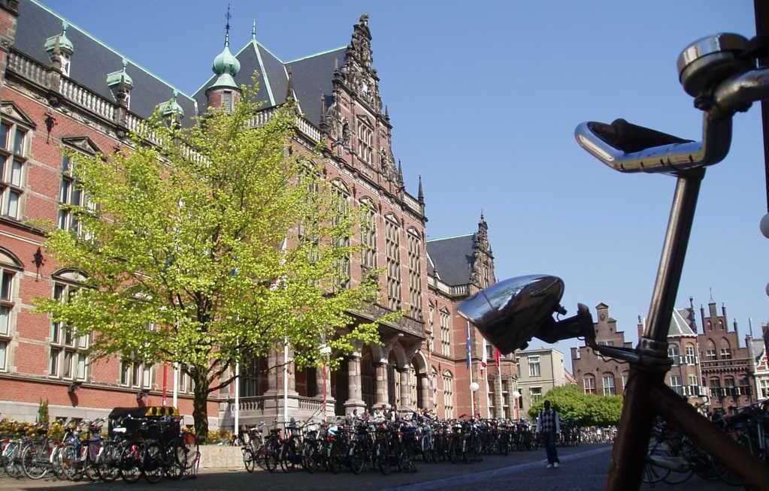
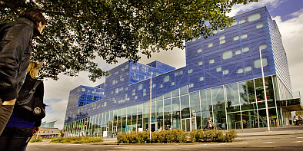
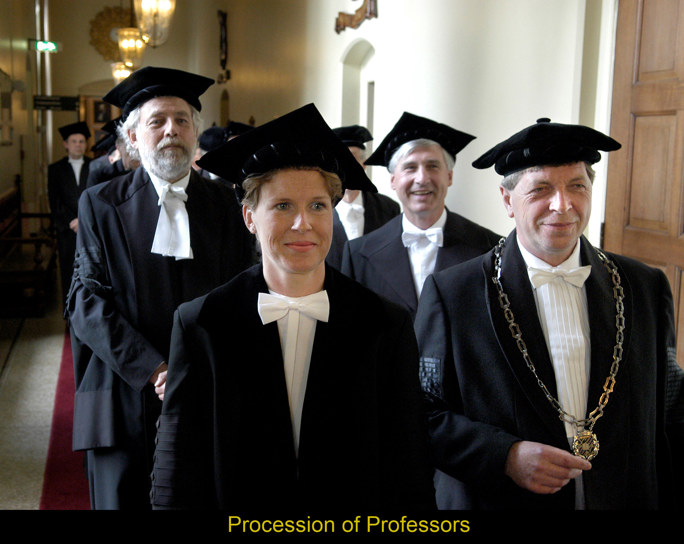
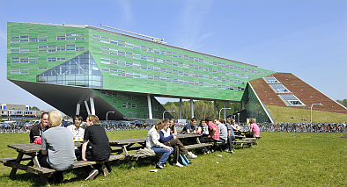
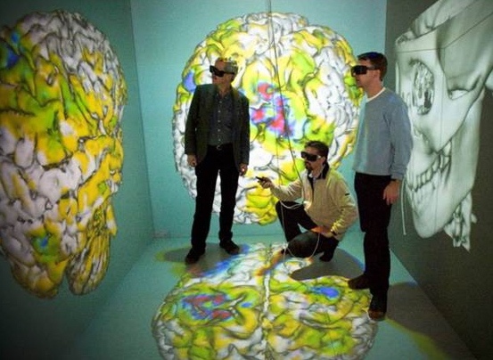
Date 19-9-2015 | 11
University / ”modern classical”

Slide 12
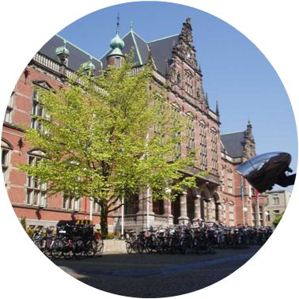
Date 19-9-2015 | 12
University / facts & figures (2014)
€614 million
annual turnover
30,000
students
3,300
international Ba/Ma students (115 nationalities)
6,400
academic publications annually
1,500
PhD students,
(800 international)
500
full professors
1,100
incoming / 1000 outgoing exchange
6,500 staff
(20% international)

Slide 13
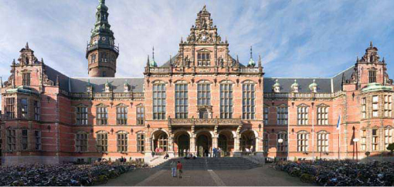
University / 10 faculties
FEB rankings 2013
#76-100 | ARWU Economics and business worldwide
#105 | UT Dallas Ranking Business schools worldwide
Arts
Behavioural and Social Sciences
Economics and Business
Law
Mathematics & Natural Sciences
Medical Sciences
Philosophy
Spatial Sciences
Theology and Religious Studies
University College Groningen

Slide 14
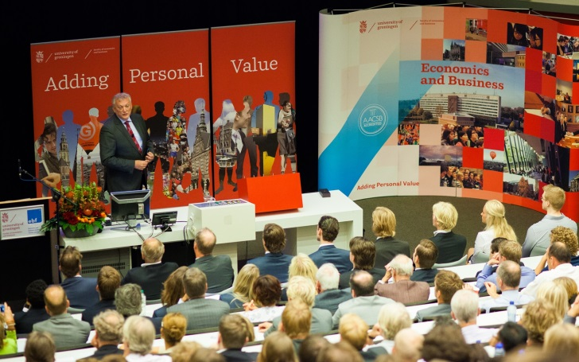
Date 19-9-2015 | 14
University / education
All degree programmes:
45 Bachelor’s / 146 Master’s
English-taught degree programmes:
21 Bachelor’s / 107 Master’s
7 Erasmus Mundus programmes
Several international double degree programmes
(most in the Faculty of Economics and Business)
14 Research Master programmes
1500 PhD students
110,000 alumni
Innovative, cross disciplinary, real-life problems
Focus on healthy ageing, energy, sustainable society

Slide 15
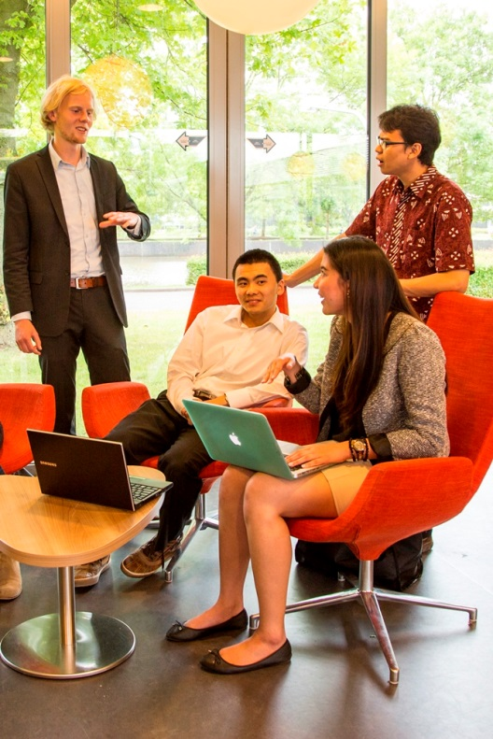
Date 19-9-2015 | 15
University / research
Top research-university
Scientific profiling: Energy, Healthy Ageing,
Sustainable Society
9 Graduate Schools
3,100 FTE academic staff, 504 full professors
1,500 Phd students
14 Research Master programmes
6,400 academic publications
€ 167.5 contract research

Slide 16
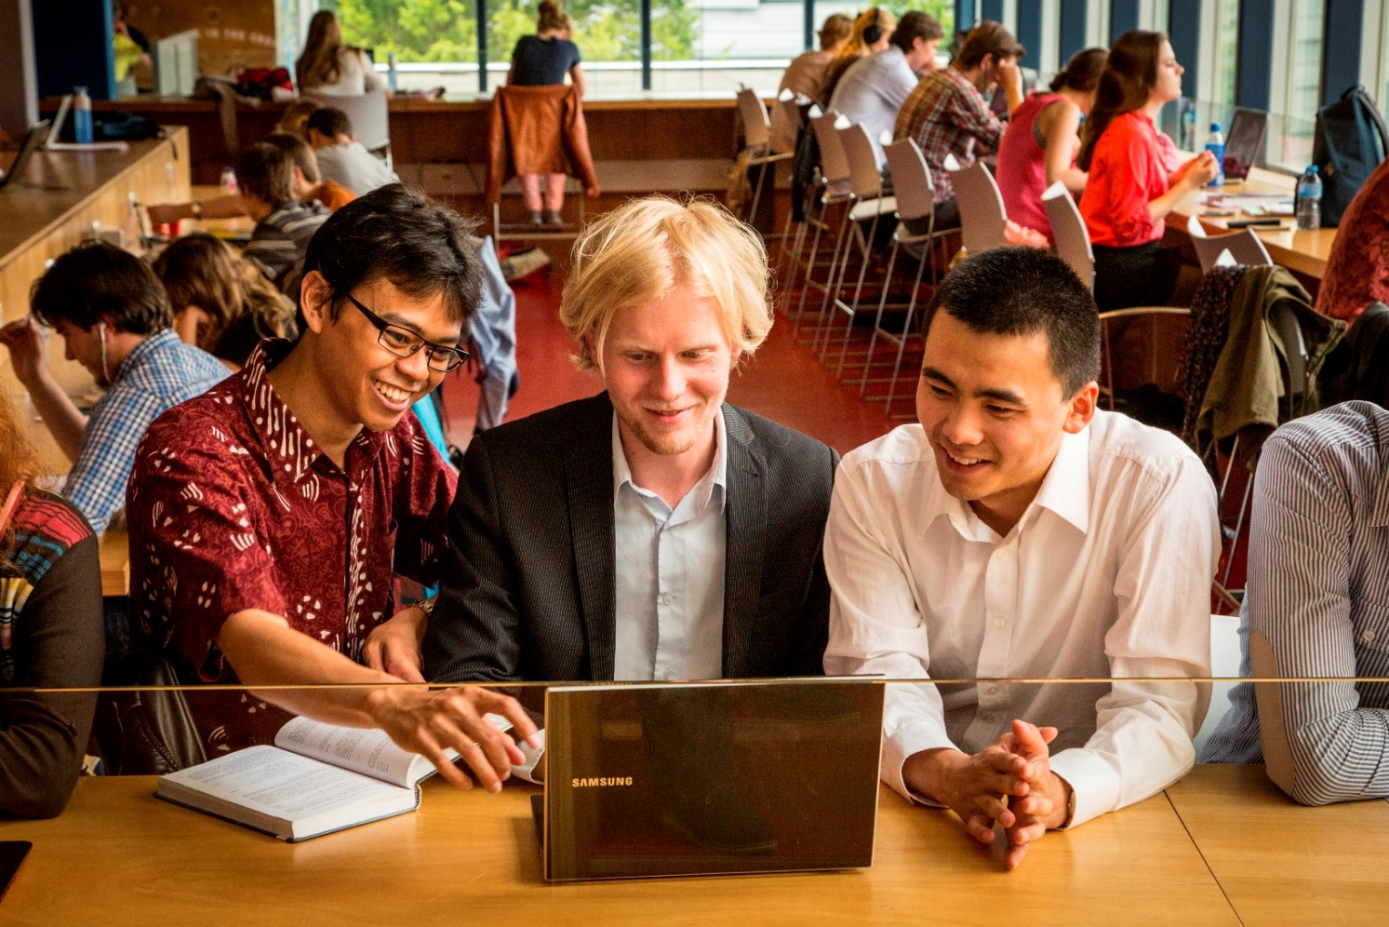
Date 19-9-2015 | 16
Notes:
Faculty intro slide

Slide 17
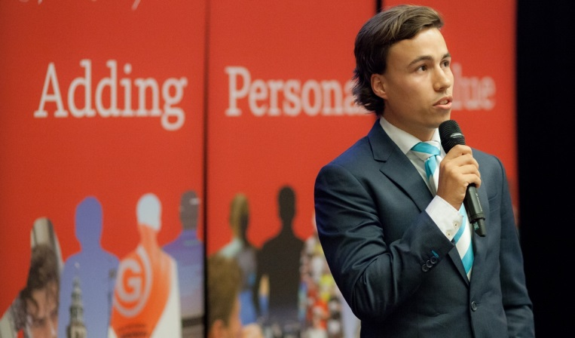
Faculty / facts & figures
Belongs to the 1% of business schools worldwide with AACSB and EQUIS accreditations
More than 50 nationalities make up the student body
20% (and growing) of the student body is international
95% of graduates surveyed found a job within three months
€45 million annual budget
Business and career services

Slide 18
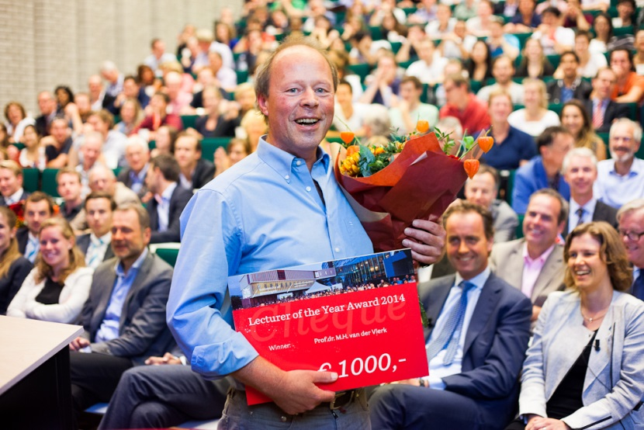
Faculty / facts & figures
36 nationalities represented among staff (30% international staff)
345 academic staff / 115 non-academic staff
231 FTE core faculty
77 full professors
51 associate professors
106 assistant professors,
  (among those 45 new TT-candidates)
76 lecturers
Hononary doctorates (2014): Paul Polman, Professor Dani Rodrik

Slide 19
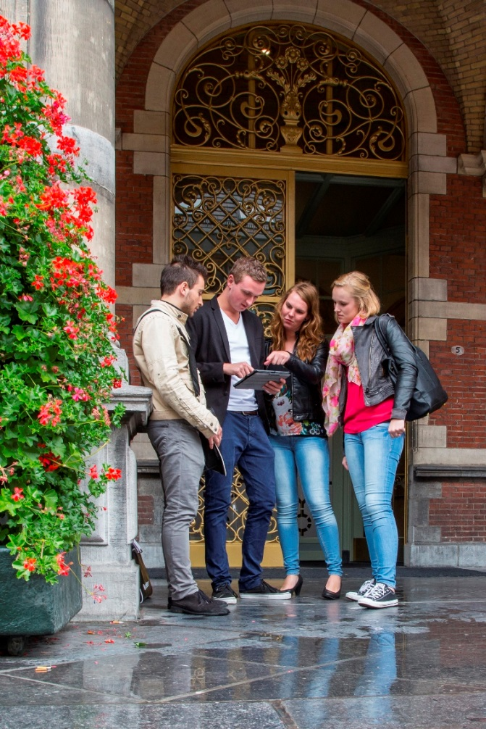
Faculty / students 2014
More than 6,000 degree students
≈ 4,500 BSc
≈ 1,500 MSc
150 PhD students
45 research master students
813 international degree students
330 incoming exchange students
418 outgoing exchange students

Slide 20







Faculty / accreditations

Slide 21




Date 19-9-2015 | 21
Faculty / identity
Open – We learn and work in an easily accessible academic community with our internal and external stakeholders.
Personal – We debate and cooperate closely with each other as co-producers in a way that is inclusive and individual.
Ambitious – We foster excellence in all areas of activity and stimulate our staff, students and alumni to aim high and strive for the best.
Down to earth – We combine friendly accessibility with sound practicality.

Slide 22
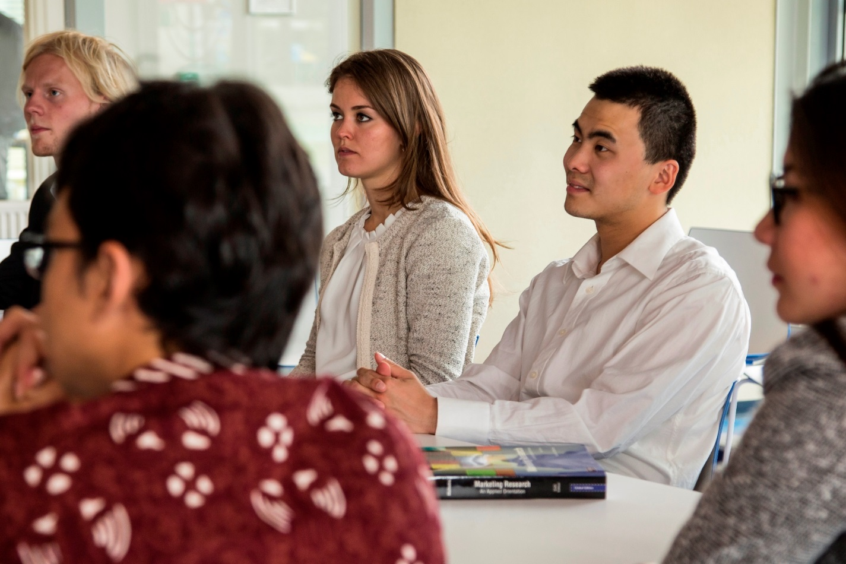
Date 19-9-2015 | 22
Notes:
Education intro slide

Slide 23
Date 19-9-2015 | 23
Education / Master of Science (1)
Taught in English:
Business Administration:
- Track Change Management
- Track Organizational & Management Control
- Track Small Business & Entrepreneurship
- Track Strategic Innovation Management
Econometrics, Operations Research and Actuarial Studies
Economics
Economics and Business (2 year Research Master)
Finance
Human Resource Management
International Business and Management
International Economics and Business
International Financial Management
Marketing
Supply Chain Management
Technology and Operations Management

Slide 24
Education / Master of Science (2)
Profile
1 year, full time
60 ECTS credits
“advanced level” (introductory courses only in the BSc)
1st semester: 30 ECTS credits of course work
2nd semester: 20/25 ECTS credits master’s thesis; 5/10 ECTS credits of course work
Research master: 2-years, 120 ECTS credits; highly selective; preparation for PhD or other research-oriented positions

Slide 25

Education / admissions MSc
Application for international prospects is possible when you have:
Academic bachelor degree in the field of economics and/or business
Degree level equivalent to a Dutch university bachelor’s degree
Some prior knowledge of the field of study of the MSc
Programme-specific prior knowledge requirements
Satisfactory level of English
- TOEFL 580/237/92
- IELTS 6.5
- Cambridge Proficiency A, B, C or Cambridge Advanced English
GMAT (≥600+ accepted; <500 denied) or positive GRE score
* Admissions requirements for research master: www.rug.nl/research

Slide 26
Date 19-9-2015 | 26
Education / pre MSc programmes
English-taught
1-year, 60 ECTS credits
For applicants who have a bachelor’s degree, but not of the right level / in the right field
No BSc degree: Certificate of Completion + admission to MSc
1st semester: - mathematics
- research methods
- organisation theory & design
- bachelor’s thesis
2nd semester: courses relevant to the MSc of choice
Strict requirements!

Slide 27
Date 19-9-2015 | 27
Education / tuition fees 2015-2016
Programme | EU/EEA nationals | Non-EU/EEA nationals
Bachelor of Science (3 years) | €1,951 (per year) | €7,800 (per year)
Pre-Master (1 year) | €2,926,50 (per year) | €2,926,50 (per year)
Master of Science (1 or 2 year) | €1,951 (per year) | €13,600 (per year)

Slide 28
Date 19-9-2015 | 28
Education / application
Application Deadlines
- BSc programmes 15 April
- MSc programmes 1 May / 1 November
- Research Master programme 15 April (with scholarship: 1 January)
Step 1 Apply online: www.rug.nl/howtoapply
Step 2 Board of Admissions makes final decision
Step 3 When accepted, Admissions Office takes care of visa procedure
Step 4 FEB assists with finding student accommodation (via SSH)
Step 5 Arrival: enjoy your time in Groningen!

Slide 29

Education / summer course
English language proficiency
26-hour, 2-week intensive course at the end of August
University of Groningen Language Centre
Course fee: €160 (2014) for students
Three levels available: pre-intermediate, intermediate and advanced
*Summer course not intended for students wanting to gain official higher IELTS score, but simply to improve English skills (students need sufficient level of English before coming to Groningen)
**Language courses available all year round, including Spanish, French and more.

Slide 30
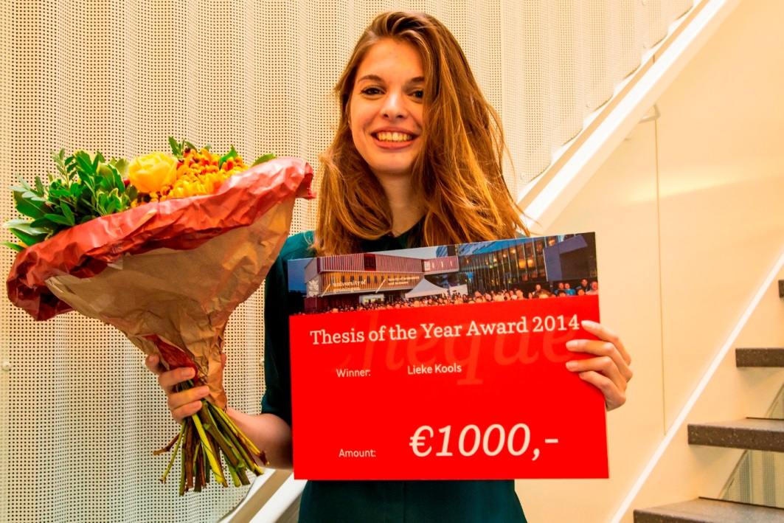
Date 19-9-2015 | 30
Notes:
Research intro slide

Slide 31
Date 19-9-2015 | 31
Research / overview
At the heart of our educational philosophy (RDE) and service to society/corporate world
Both academic and practice-oriented research meet highest international standards: best international refereed academic journals and publishers
Funding: 50% governmental (1st stream, 40% of “lump-sum”); 50% external (2nd/3rd stream)
SOM Research School (Accredited by Royal Dutch Academy of Sciences): SOM Applied Research
  SOM Research Institute: 6 Research Programmes; about 170 (associate) fellows
  SOM Graduate School: Honours BSc; Research Master (2 year, 50 students); PhD programme: 150 PhD students
  SOM Applied Research: 13 centres of expertise (applied research)

Slide 32
Date 19-9-2015 | 32
Research / research programmes
Conducting internationally outstanding academic research related to the firm in its economic environment in the following areas of expertise:
Economics, Econometrics and Finance
Global Economics & Management
Human Resource Management & Organisational Behaviour
Innovation & Organisation
Marketing
Operations Management & Operations Research

Slide 33
Research / research master
High quality research master with unique positioning
Goal: select the brightest and most ambitious students and enable them to do scientific research in economics and/or business
Excellent preparation for a PhD-position or research-oriented job
Two-year programme, intensive and challenging
Opportunities for attending workshops and courses
Cohorts of 25-30 students per year
6 different profiles/specialisations
Limited number of scholarships available

Slide 34
Research / PhD programme
High quality PhD programme
3 years (for PhD paid by the RUG)
Direct link between the 6 research programmes and the PhD programme, which guarantees high quality supervision by SOM fellows
Double degree PhD programme with the Chinese Academy of Sciences
Good mix of students, in terms of male/female and Dutch/international
Many students obtain positions at quality universities after finishing the PhD

Slide 35
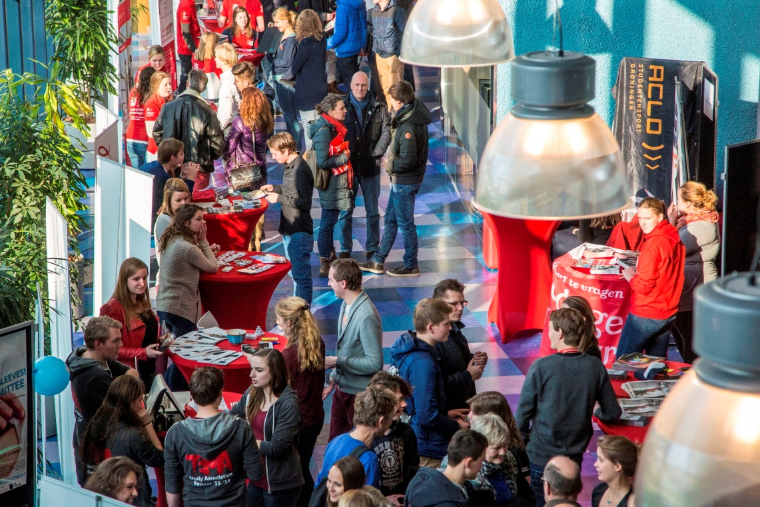
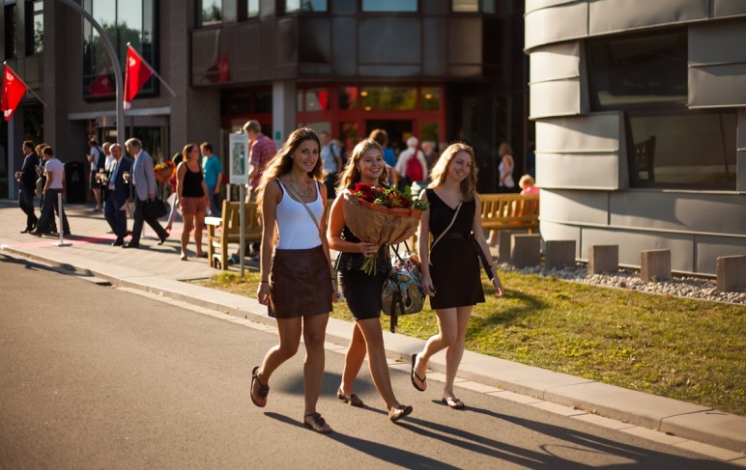
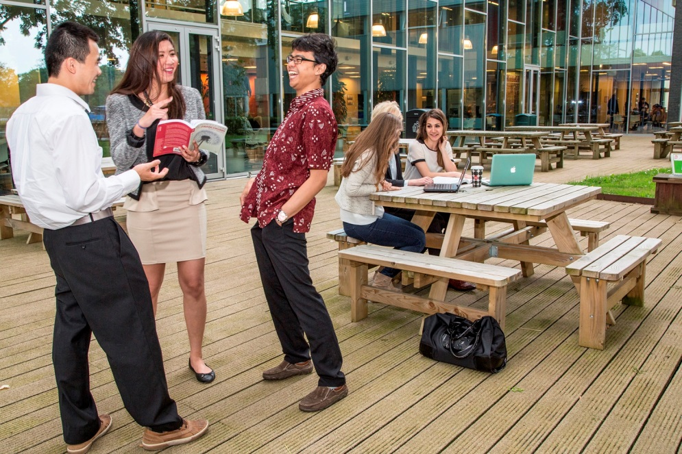
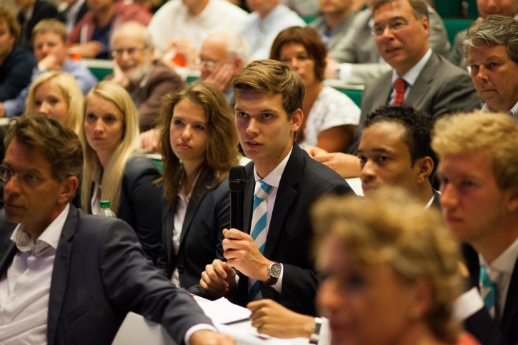
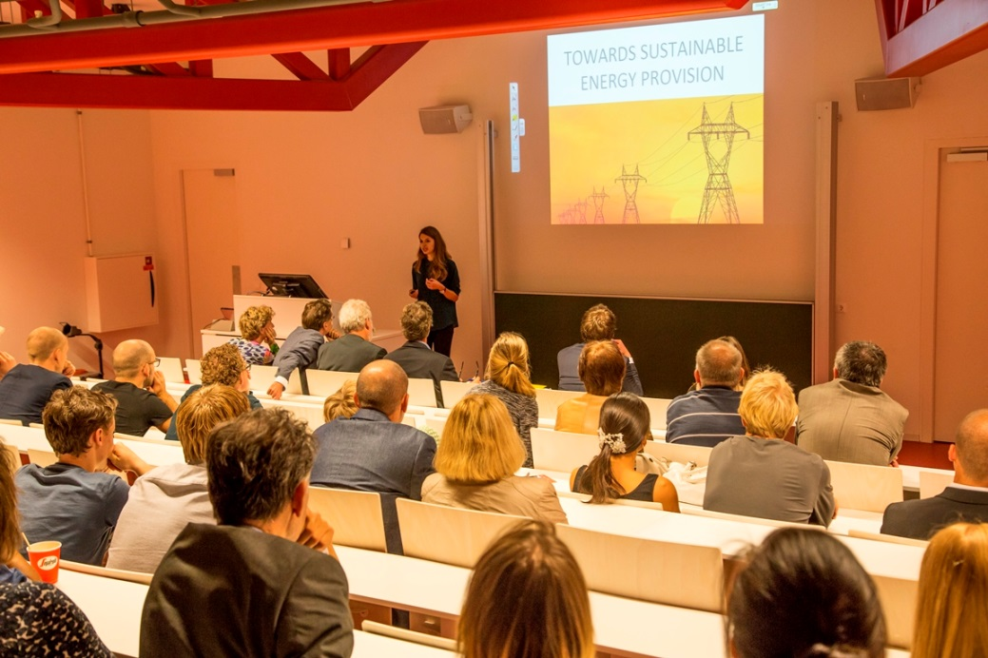

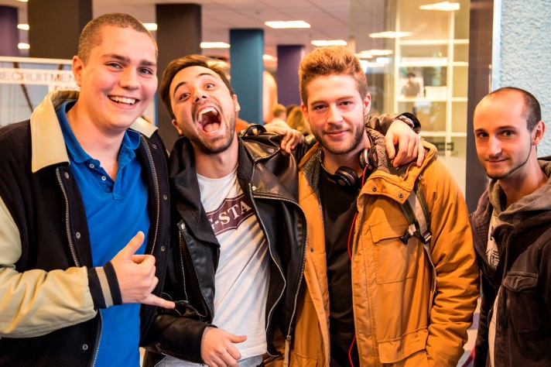
Date 19-9-2015 | 35
Notes:
Ambiance intro slide

Slide 36
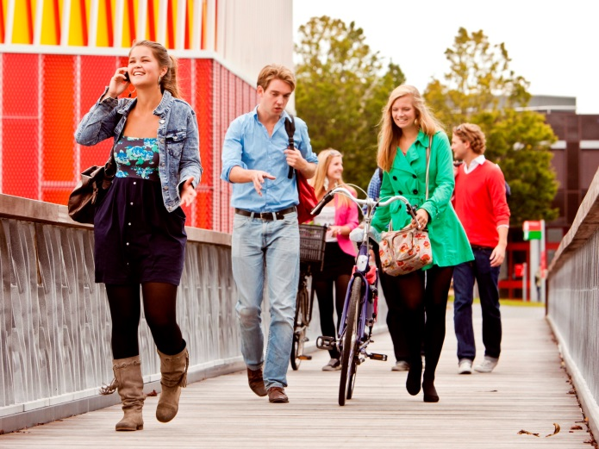
Date 19-9-2015 | 36
Ambiance / overview
FEB aims to provide a stimulating and international environment for students and staff
Extensive student support facilities
FEB Student Support Desk
FEB Careers Company
FEB Restaurant
Activities of student association EBF
Newly renovated building (Student Plaza)
Wireless internet connection
Excellent sports facilities at ACLO
Reflection room
International student associations: Chinese, Indonesian, Indian, African, Iranian, Latin American ......

Slide 37
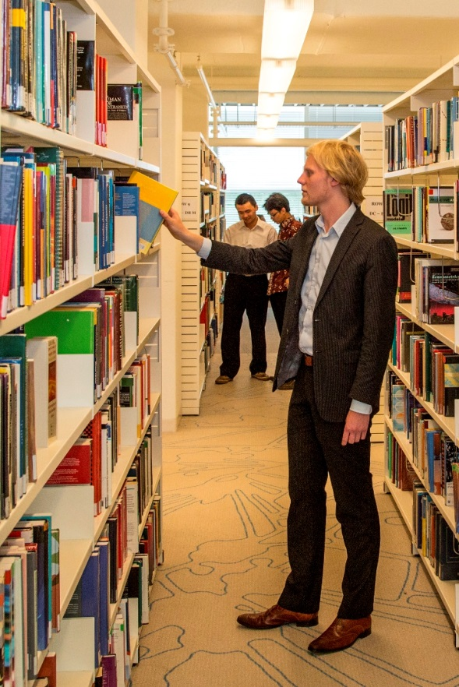
Ambiance / facilities & services
Honours College for exceptional talent
Immense University library
Housing office
Careers Company
International Service Desk
Groningen Language Centre

Slide 38
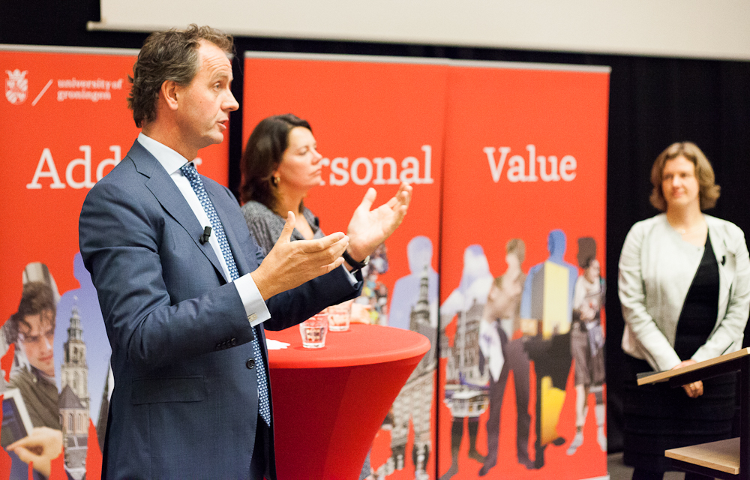
Date 19-9-2015 | 38
Notes:
Corporate links intro slide: Timo Huges, President and director of NS, and Dertje Meijer, CEO Port of Amsterdam, both FEB alumni, open 2014 academic year

Slide 39
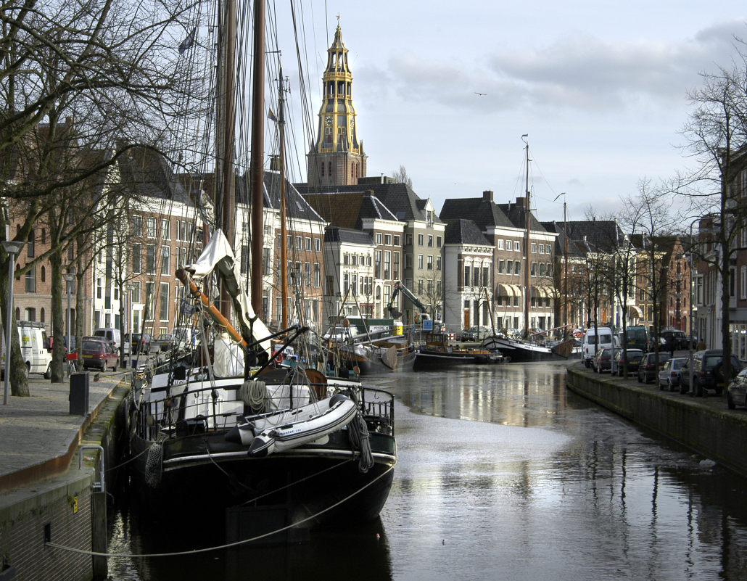
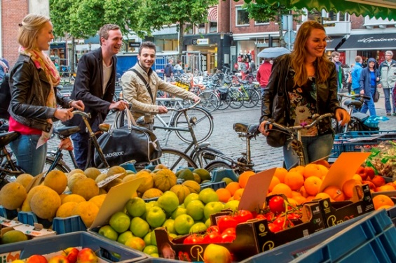
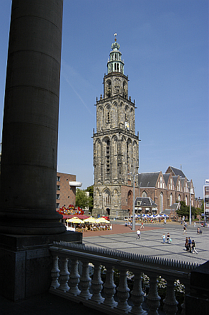
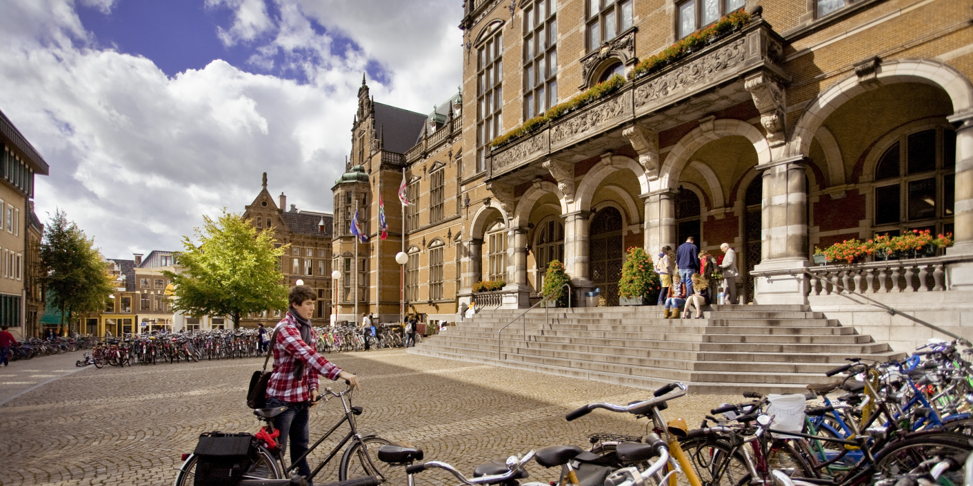
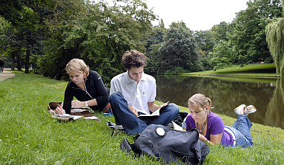
Date 19-9-2015 | 39

Slide 40


Thank you for your attention
40
Prof. dr. J.H. Garretsen
Dean of the Faculty of Economics and Business
j.h.garretsen@rug.nl
+31 (0)50 363 8627
www.rug.nl/feb
Start Adding Personal Value in Groningen

Slide 41
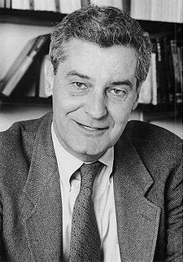
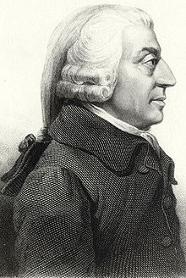
“ Why some countries are rich, while others are poor?…..
Once you start thinking about this, it is hard to think about anything else.”
1995 Nobel laureate Robert Lucas
Would be Nobel laureate Adam Smith writer of “The Wealth of Nations” (1776)

