Slide 1
How do regional contexts shape higher education system? (case of Russia)
Oleg Leshukov
Daria Platonova
Dmitry Semyonov
Higher School of Economics, Institute of Education, Moscow
Annual conference of CHER, Lisbon, September 7, 2015

Slide 2
Competition and efficiency
“the governments' main objective has been to increase the efficiency and … the state fosters competition between the institutions in a higher education market” (Horta et al. 2008).
RQ: Does the degree of competition on the regional higher education markets coincide with the efficiency of regional higher education systems?
Regional higher education system: the set of higher education institutions (summarizing performance indicators)

Slide 3
Russian higher education
85 regions, 969 HEI +1482 branches
High level of heterogeneity in higher education sector
25 years of marketization/expansion of privateness in higher education:
New units:
402 non-state HEIs
476 branches of non-state HEIs (satellite HEIs)
Low mobility even for HEIs enrollers →
regional isolation and “closeness” in terms of students attraction

Slide 4
Competition within Russian HEIs: mechanizms
Public funding on competitive basis
Tuition fees
public and private HEIs prepare application for the number of students that is expected to be funded by the State
education and research quality – better HEIs get more budgetary-funded student numbers
In public HEIs 46% of students are funded by public sources and 54% -- by households.
61% of Russian students are paying tuition fees

Slide 5
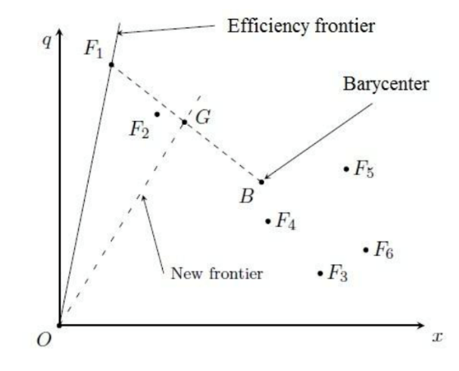
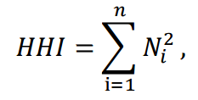
Methodology
Efficiency of regional higher education system
Competition within HEIs as a market mechanism
Data Envelopment Analysis (DEA): estimation of the distance from the frontier
the Herfindahl–Hirschman Index
Where N is the number of students in institution i of region , weighed to total number of students in HEIs within a region.

Slide 6
Regional HE efficiency: input/output parameters
 | Parameters | Source
Input 1 | Funding of regional HE system per normalized number of students | Federal Statistics Agency, 2013
Output 1 | Number of students (bachelor's, master's level or their equivalents) per 10 000 population
Output 2 | Number of enrolled full-time students per number of school-leavers, who passed the USE
Output 3 | Share of students in “publically efficient” HEIs | The Monitoring of HEIs Efficiency, 2013
Ccылки/что графики означают

Slide 7
DEA Efficiency Scores and Competition Environment
Pearson's correlation between efficiency scores and HHi is (-0.34)***

Slide 8
Efficiency scores and HHi by socio-economic groups of regions
 | Type of region | Correlation
1 | Developed regions | -0.24
2 | Developing regions | -0.50**
3 | Low-performing regions | -0.64*

Slide 9
Conclusion
Competition is related to the efficiency of higher education in the regions with weaker economy
Universal policy decisions are not appropriate for heterogeneous countries/areas
Measures towards increasing/decreasing competition (e.g. mergers)

Slide 10
Thank you for attention!
oleshukov@hse.ru
dplatonova@hse.ru
dsemyonov@hse.ru
Higher School of Economics,
Institute of Education, Moscow
http://ioe.hse.ru/

