Slide 1
The Problems of Constructing Time Series of Russian Supply and Use tables for use in international projects
Edward Baranov
Igor Kim
Dmitry Piontkovski
Elena Staritsyna
XVI April International Academic Conference on Economic and Social Development
National Research University Higher School of Economics (HSE)
April 7-10, 2015
Notes:
1

Slide 2
1. Motivation
For 1995-2003 Rosstat developed supply and use tables (SUTs) based on Soviet classifications
Since 2004 development of SUTs has not been carried out due to transition of Russian statistics to the OKVED and OKPD classifications harmonized with NACE rev.1 and CPA
First Russian benchmark SUTs for 2011 harmonized with NACE rev.1/CPA are to appear at the end of 2015
There are serious difficulties for applied research of Russia and Russian participation in international projects (such as WORLD KLEMS)
2

Slide 3
2. Review of the conversion of SUTs in the Soviet classifications into the NACE rev.1
Global Trade Analysis Project (GTAP), (www.gtap.agecon.purdue.edu)
For 2003 symmetric IO table in the Soviet classifications for 22 products was converted and disaggregated into 59 ISIC products
World Input-Output Database (WIOD), (www.wiod.org)
For 1995-2009 SUTs in the NACE rev.1/CPA at current and previous year prices for 35 industries and 59 products are developed using1995 converted benchmark IO tables as a basis
In both works
The official concordance tables OKONH-NACE rev.1 do not contain quantitative proportions of distribution between the codes in the Soviet and NACE rev.1 classifications
benchmark IO table for 1995 was used
Moscow, 2015
3
Notes:
3

Slide 4
3. Research goals
Development of a methodology for conversion of use tables and valuation matrices in the Soviet classifications into the NACE rev.1/CPA
Development of a methodology for the construction of time series for use tables and valuation matrices at current and constant prices for 2004-2010 on basis of tables for 2003
Approbation of our methodologies
4

Slide 5
4. Why 2003?
Last full set of aggregate use tables and valuation matrices in the Soviet classifications
First expenditure approach GDP and disaggregated data of production account in the NACE rev.1
Unpublished disaggregated use table at purchasers’ prices in the soviet classifications from Rosstat
Unpublished production matrix in the NACE rev.1 from Rosstat
Detail data on the production of hundreds of specifics products
5

Slide 6
5. Features of our research
Construction of use tables and valuations matrices for 42 products and 42 economic activities:
the use table for domestic output at basic prices
the use table for imports at basic prices
transport margins table
trade margins table
net taxes on products table
which add up to the use table at purchasers' prices
Construction of quantitative transformation matrices between the Soviet classifications and the NACE rev.1/CPA for each of these tables
These are the main differences between our approach and ways suggested by GTAP and WIOD
6

Slide 7
6. Problems of converting from Soviet classifications to the NACE rev.1/CPA
Fundamental differences between the Soviet and NACE rev.1/CPA classifications
Methodological changes in trade margins
Considerable differences between data on production account in the Soviet classifications and NACE rev.1
Incompleteness of the initial data for converting tables into the rev.1/CPA
7

Slide 8
7. Examples of discrepancies between estimates converted from the Soviet classification and data from production account in NACE rev.1, billion rubles
Co-de | Activities | Output at basic prices, 2003 |  |  | Intermediate consumption, 2003
 |  | Trans-formed from OKONH | Produc-tion account in NACE rev.1 | Diffe-rences | Trans-formed from OKONH | Production account in NACE rev.1 | Diffe-rences
11 | Extraction of crude petroleum and natural gas; service activities incidental to oil and gas extraction, excluding surveying | 1192 | 1216 | +24 (2% from data in NACE rev.1) | 386 | 607 | +221 (36,4% from data in NACE rev.1)
G | Wholesale and retail trade; repair of motor vehicles, motorcycles and personal and household goods | 3842 | 3602 | -240 (6,7% from data in NACE rev.1) | 1283 | 1030 | -253 (24,6% from data in NACE rev.1)
8
Notes:
8

Slide 9
8. Problems of converting from Soviet classifications to the NACE rev.1/CPA
Fundamental differences between the Soviet and NACE rev.1/CPA classifications
Methodological changes in trade margins
Considerable differences between data on production account in the Soviet classifications and NACE rev.1
Incompleteness of the initial data for converting tables into the rev.1/CPA
Moscow, 2015
9
Notes:
9

Slide 10
9. Problems of converting from Soviet classifications to the NACE rev.1/CPA
Possession of the information to construct transformation matrices only for the use table of domestic production and the use of table of imports
Necessity to develop a method to convert valuation matrices
10

Slide 11
10. Conversion to the NACE rev.1/CPA
Development of a two-step procedure for the conversion of use tables and valuation matrices into the NACE rev.1/CPA:
Step 1: Disaggregation of detailed use table at purchasers’ prices in the Soviet classification into its five components using a variation of GRAS algorithm
Step 2: Conversion of disaggregated and balanced tables into
the NACE rev.1/CPA using transformation matrices
11

Slide 12
11. Disaggregation of detailed use table at purchasers’ prices
Data: detailed (95 x 115) use tables at purchasers’ prices, row and column totals for use tables at basic prices and all valuation tables, aggregated data for all five tables (in the form of 25 x 25 tables).
Problem: to construct the five tables at the detailed level
Solution: a 4-proportional balancing (using GRAS algorithm in the version of Lenzen et al., 2009) of a 3D table of size 5 x 95 x 115 based on expert approximations of all 5 tables as benchmarks
12

Slide 13
12. Information for constructing time series of use tables at basic prices and valuation matrices
Production accounts for 69 types of activity and expenditure approach GDP
Unpublished detailed production matrices in the NACE rev.1
Export and import data in the detailed nomenclature from Federal Customs Service and the Bank of Russia
Converted use tables at basic prices and valuation matrices for 2003
Moscow, 2015
13
Notes:
13

Slide 14
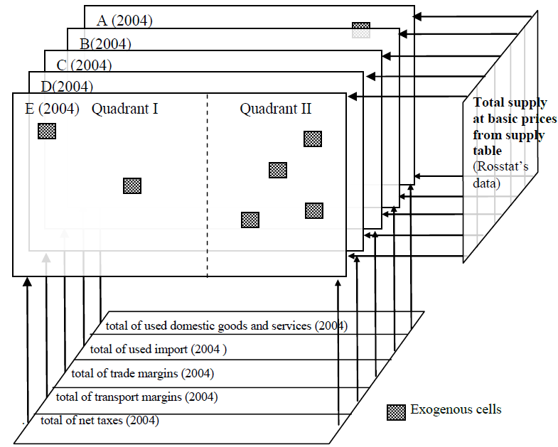
13. Construction of time series of use tables at basic prices and valuation matrices (example for 2004)
A - use table of domestically produced goods at basic prices
B - use table of imports at basic prices
C - table of transport margins
D - table of trade margins
E - table of net taxes on products
Moscow, 2015
14
Notes:
14

Slide 15
14. Features of methodological approach for constructing time series
Application of RAS method and data for 2003 to calculate column totals for matrices of intermediate consumption and final demand of each of five tables
Row totals of valuation matrices were calculated expertly
Some figures were defined exogenously for table of net taxes (due to the annual changes in the tax and customs legislation)
Application of RAS method to calculate rectangular matrices (for intermediate consumption and final demand) of each of five tables for subsequent years
Moscow, 2015
15
Notes:
15

Slide 16
15. Deriving use tables and valuation matrices at constant prices
For goods, the retrospective series of producer price indices in NACE are only for aggregate products
For services, official data is only available for freight tariffs and communication services
Therefore, we plan to construct deflators for more disaggregated products (using unpublished information)
The application of the same deflator for all uses of product
Moscow, 2015
16
Notes:
16

Slide 17
16. Further work
Testing different projection methods (apart from RAS) in order to select the most preferred for Russia
The examination of backward projection possibilities for the period prior to 2003 (a lack of totals from the SNA in the NACE rev. 1/CPA for the period before 2002 have to be taken into account)
After the publication of detailed Russian SUT for 2011 by Rosstat, all our time-series need to be reconsidered
Moscow, 2015
17
Notes:
17

Slide 18
Thank you for your attention!
Moscow, 2015

