Slide 1



Demonopolization Perspectives in Russian Football: Experience of Krasnodar City
The 8th ESEA European Conference on Sport Economics
Ksenia Andreeva, PhD candidate
National Research University Higher School of Economics, Moscow

Slide 2

Plan
Basics of the research. The core issue
Concept of exclusivity
Football exclusivity in Europe
Optimal number of clubs in a city – Krasnodar experiment
Perspectives of demonopolization in Russia
New competitive policy
Discussion and feedback
Two types of statements – propositions and proved results

Slide 3
Core issue
Krasnodar experience: the mean sum attendance was higher than the highest one in the league (in 2013/2014). It means that either football popularity has grown or supply has become sufficient
  No changes in prices
  Interest to derby
  No correlation between attendance and its rivals results
Hypothesis of weak patient for a particular club – Yaroslavl (Shinnik and Lokomotiv)
Temporary policy – Lokomotiv Moscow in 2000-2002. Higher attendance of the Saturn-Lokomotiv games than average; FC Tosno
Measures of regulatory policy and its limitations – no possibilities to increase popularity
Control supply (badminton)
Derby effect (B. Buraimo, R. Simmons, 2008) - 6.4% increase of audience
How does the number of clubs in the city influence consumers’ welfare and under what conditions does it positively influence the average attendance?

Slide 4
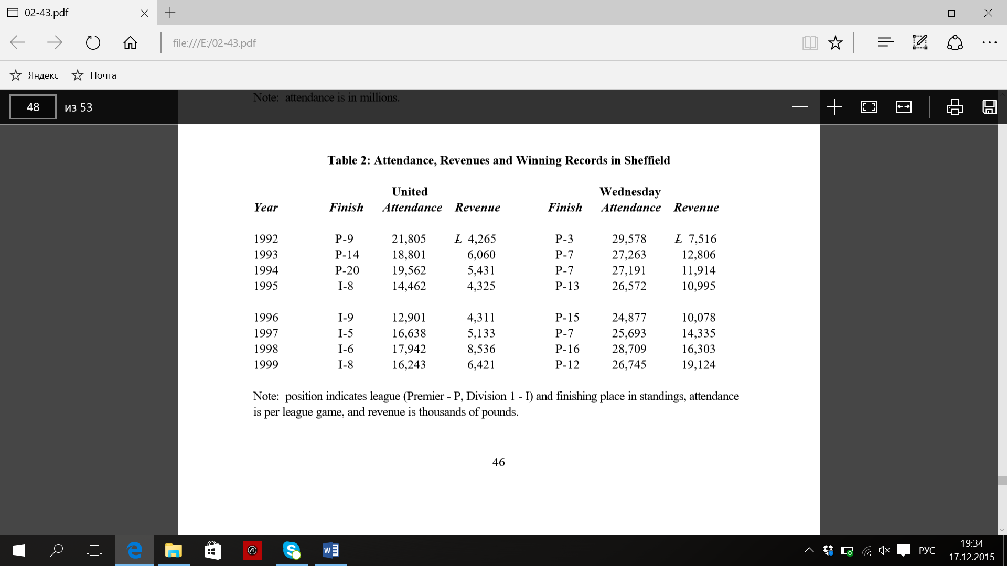
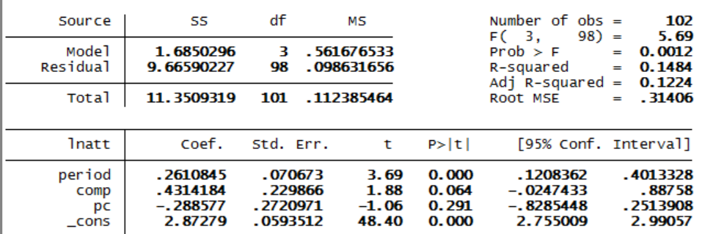
Exclusivity and sports monopoly
Noll R. G. The organization of sports leagues (2003)
Three types of exclusivity: league, territory and club. Some countries develop institutional barriers to sustain territory exclusivity (USA)
Sheffield in England: United and Wednesday. Withdrawal from the market of one club does not influence the attendance of the second (should be checked for other cities like Birmingham)

Slide 5
Exclusivity and sports monopoly – 2
Breuer M. The demand for football tickets depending on the number of clubs in a city – Empirical evidence from Germany (2009)
two clubs playing in two different stadiums
wealth function depends on the utility of service of a particular quality minus travel costs: U(Ɵ1) – tD and U(Ɵ2) – t(1 – D) – Hotelling model
if clubs play in different leagues, the indifferent consumer leaves in D-distance from the stadium: D* = (U(Ɵ1) –U(Ɵ2) )/2t+1/2
if clubs play in the same league, the indifferent consumer leaves in the center: D*= 1/2.
the empirical results show that in six German cities with two-club model from 1963 consumer preferences have not been changed due to the appearance of a rival club

Slide 6
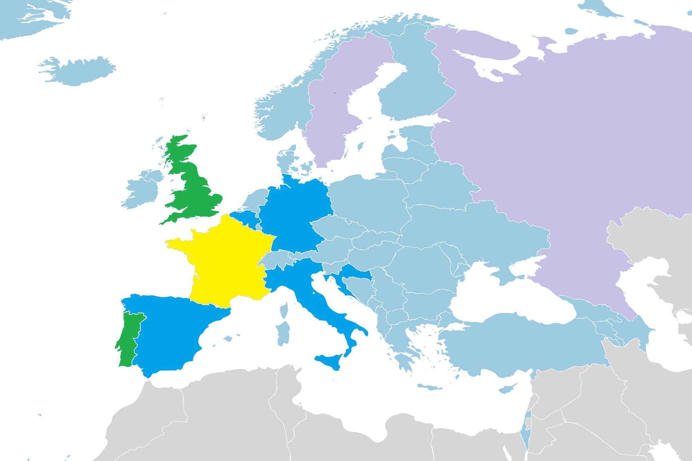
Football exclusivity in Europe. Historical retrospective (stability from 1990s)
Three types of leagues:
Strong competition in the capital and several cities with 2 clubs (England, Sweden, Portugal)
A couple of cities with 2 clubs (Spain, Germany, Italy, Croatia , Belgium)
Non-competitive leagues within one city (France)
Occasional experiments*: Sweden, Russia (strong competition in the capital, 1 city with 2 clubs)
Actually it means that there may be capital-oriented competition with at least 2 clubs in the capital (Austria, Azerbaijan), distributed competition (one or several regional cities with competitive clubs), non-competitive leagues and super-competitive leagues.
Exception – Rotterdam with 3 clubs
* Experiment lasts less than 5 seasons

Slide 7
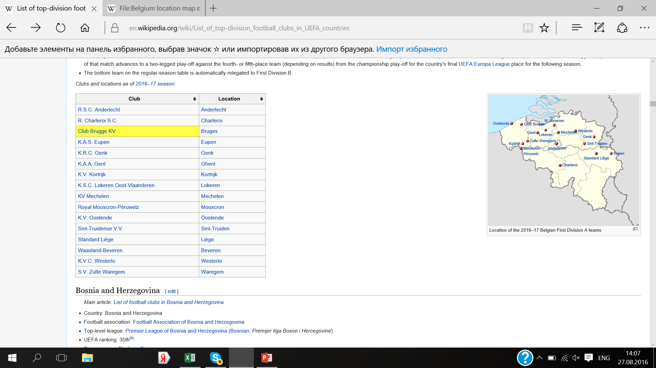
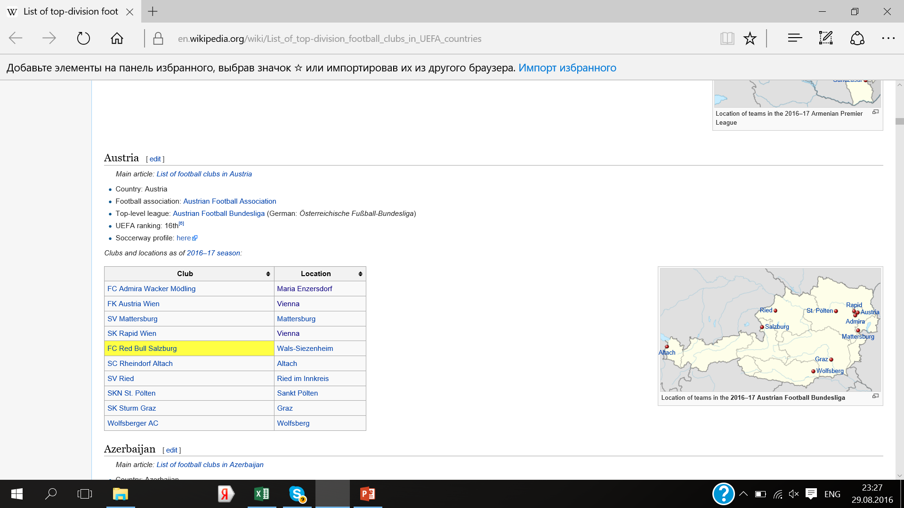
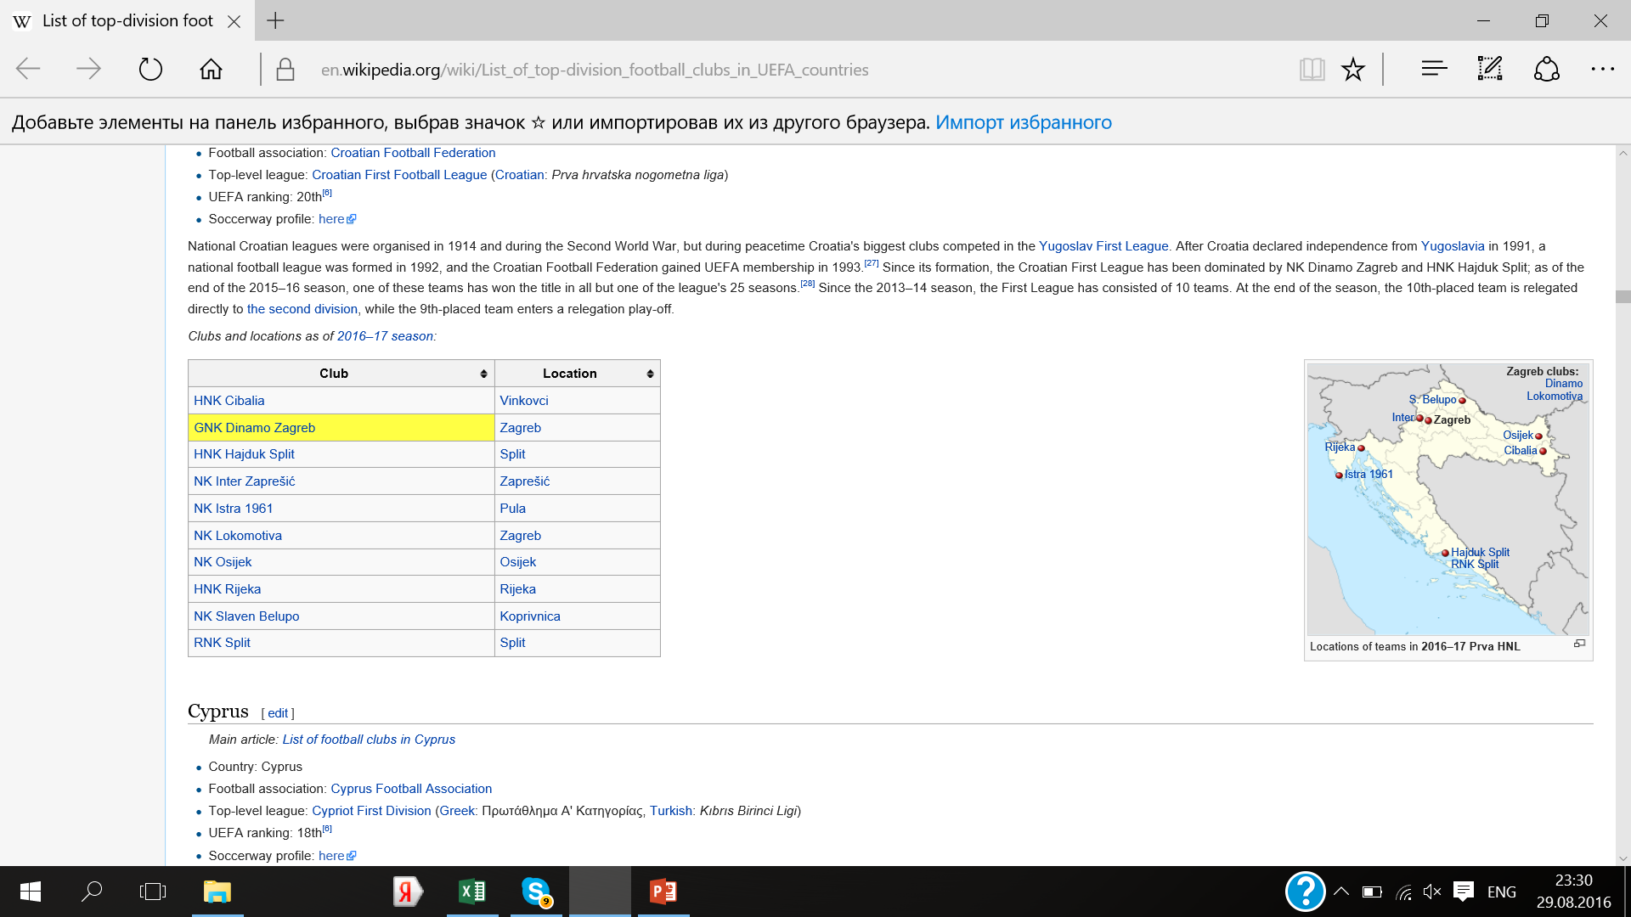
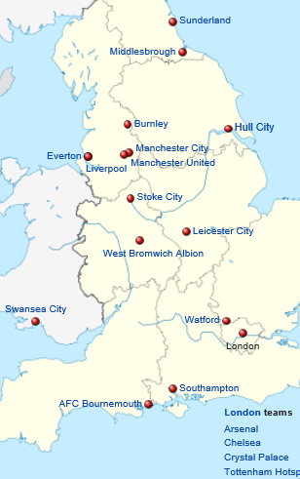
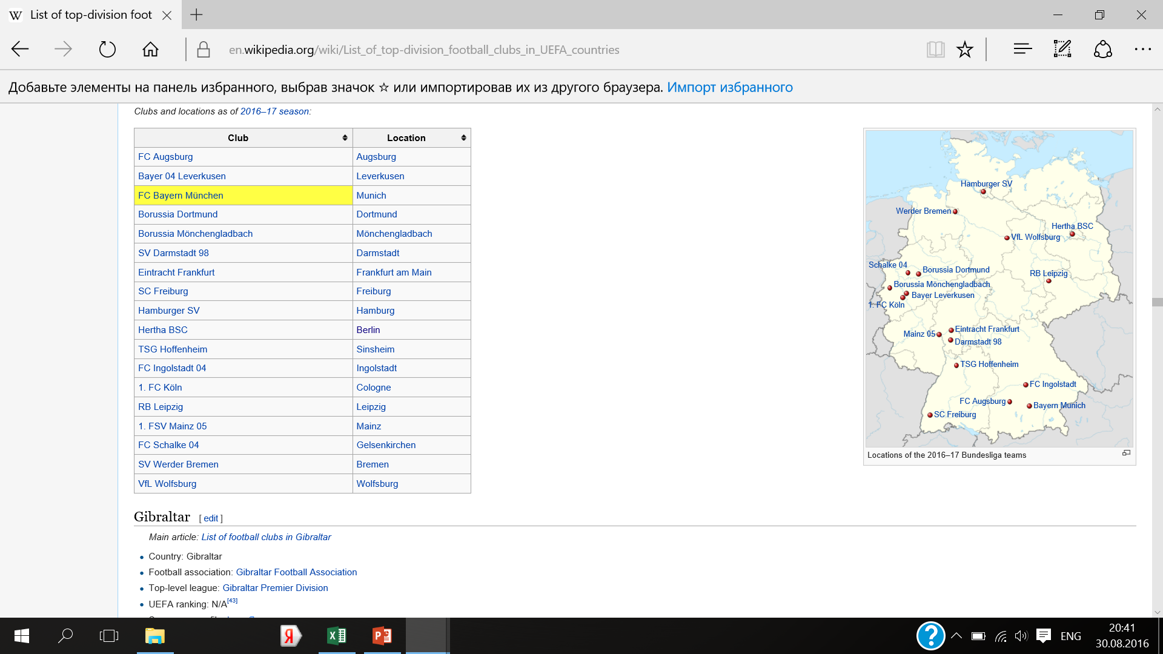
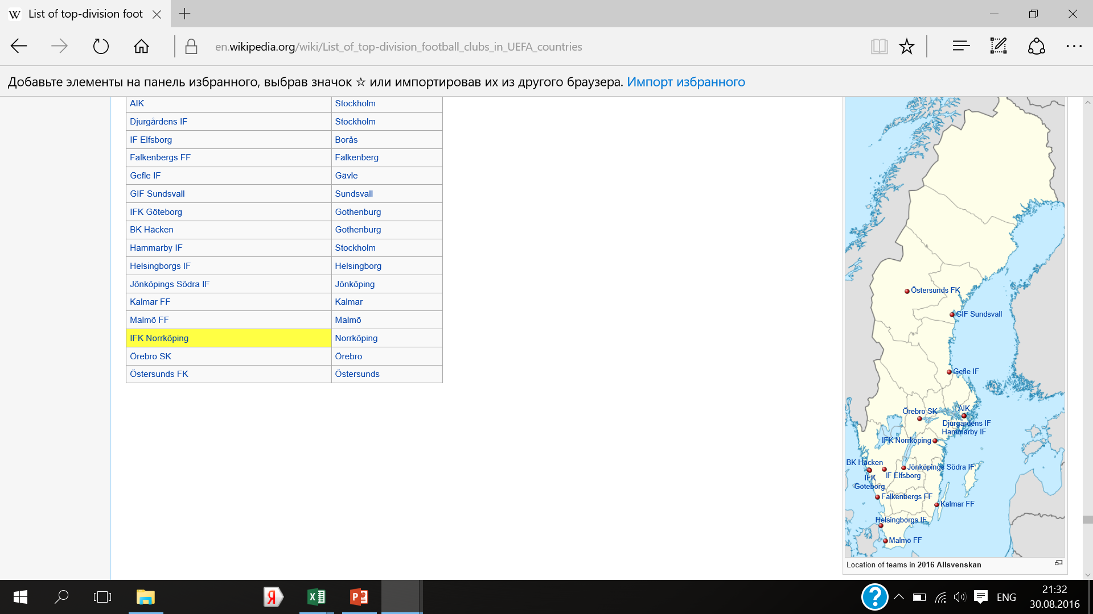
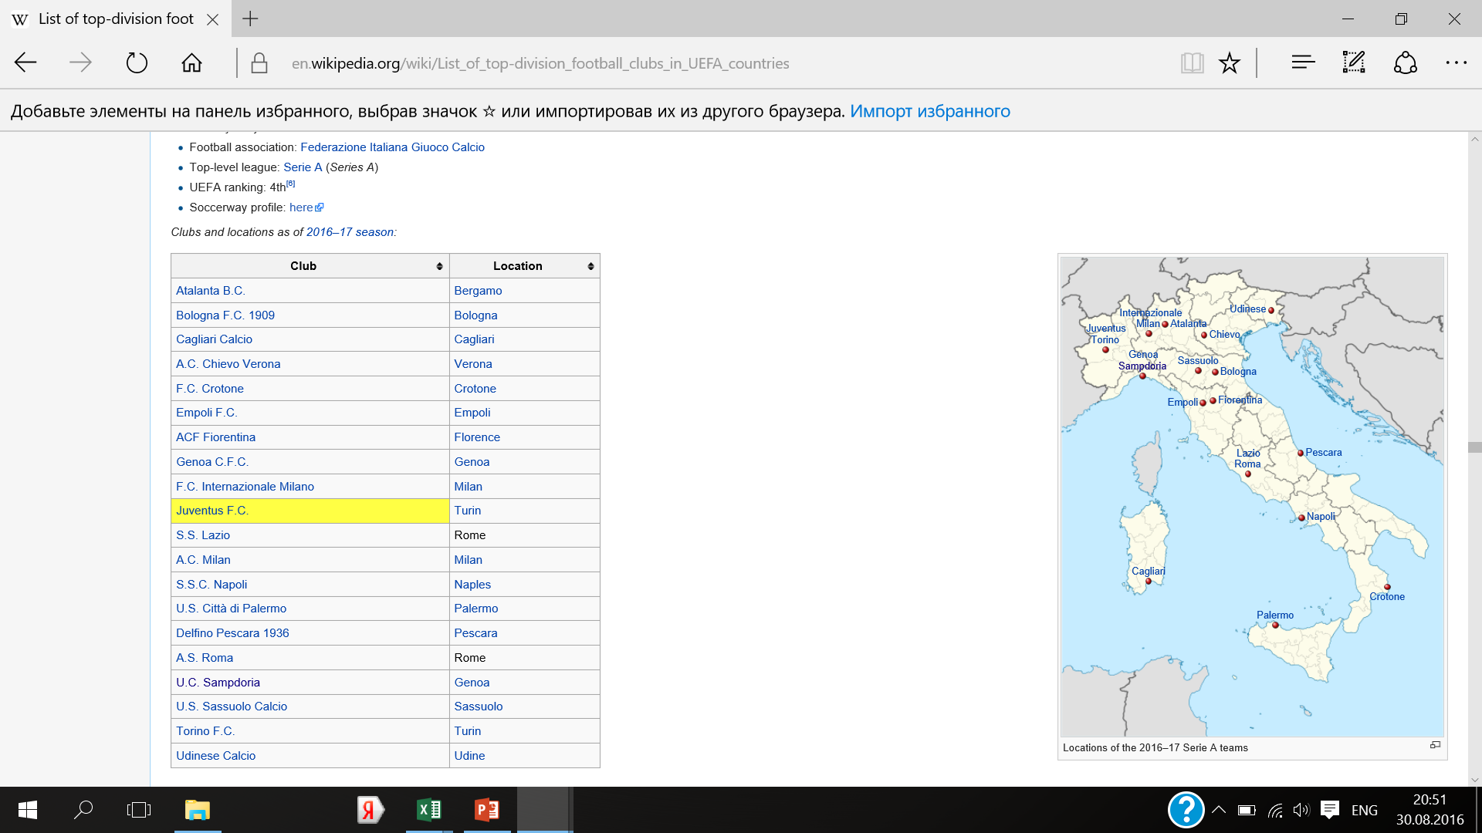
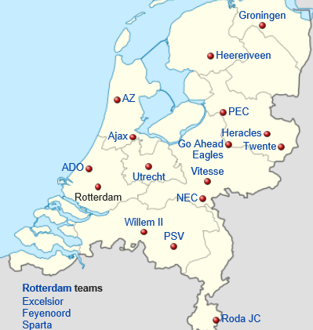
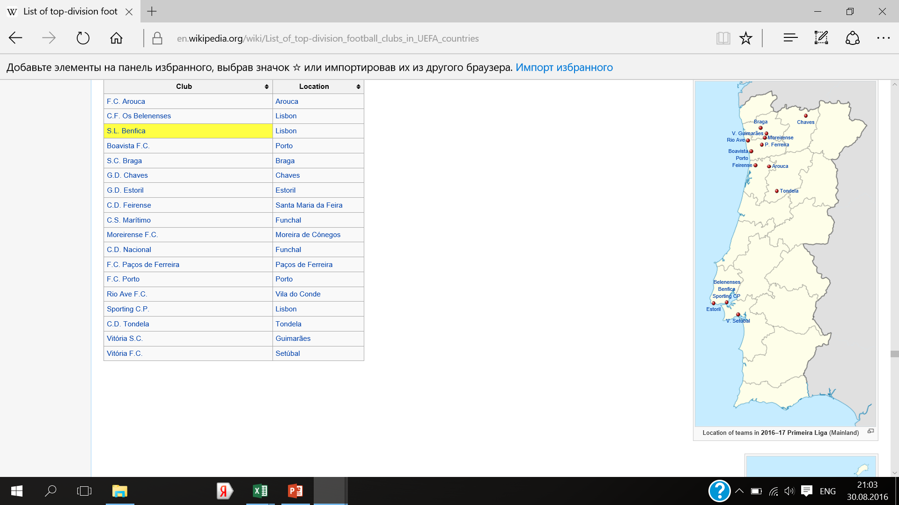
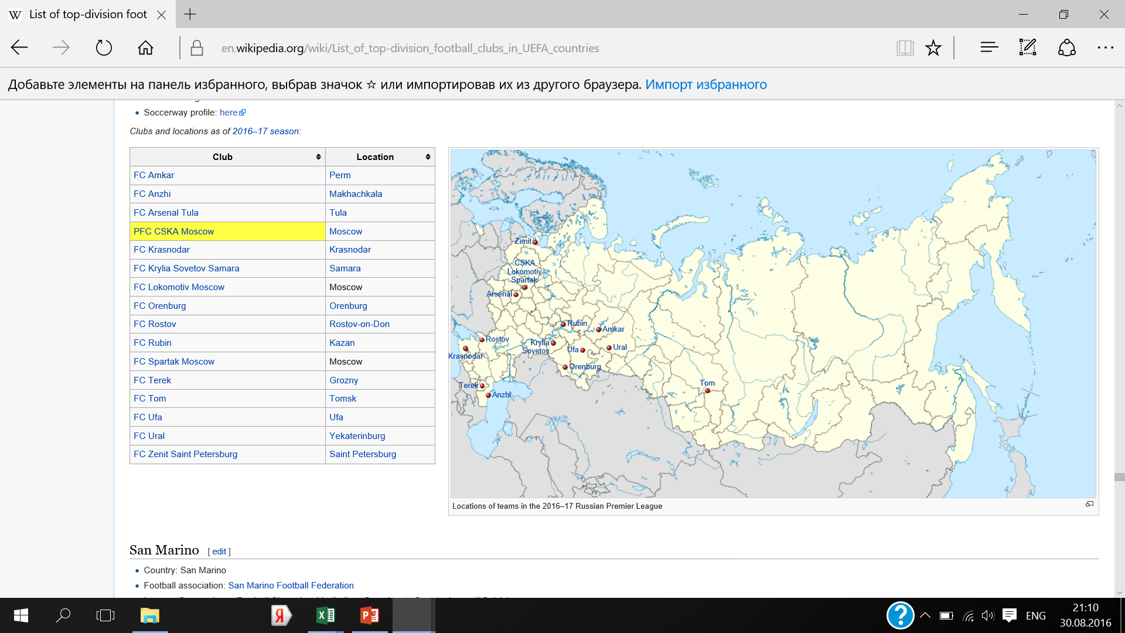
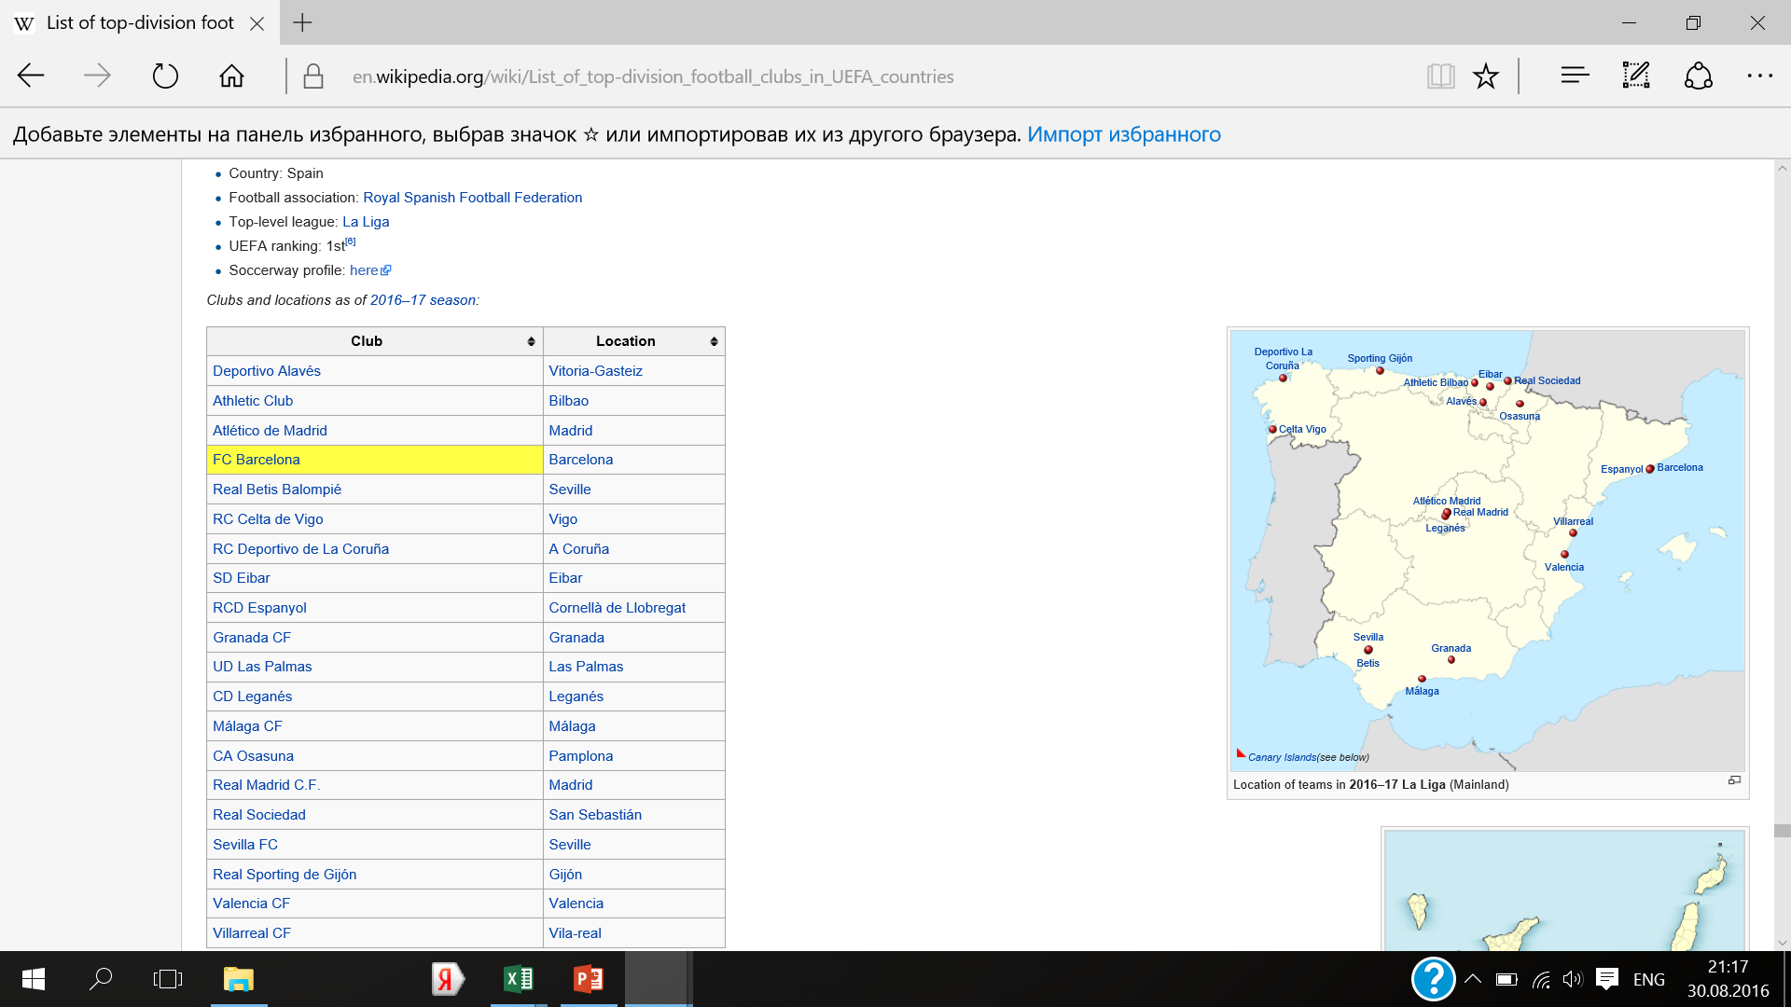
Football exclusivity in Europe. Inter-competition via intra-competition in 2016/2017
Resource: List of top-division football clubs in UEFA countries
Germany
England
Sweden
Belgium
Austria
Croatia
Italy
Netherlands
Russia
Portugal
2 alternatives
Spain
3 alternatives
1 alternative
with competitive soccer club
Sports for comparison: basketball, baseball, rugby, hockey, American football, baseball, handball, volleyball (team aggressive active sports)
multiple choice
Notes:
Sports for comparison: basketball, baseball, rugby, hockey, American football, baseball, handball, waterpolo, volleyball (team aggressive active sports). They should be re-checked due to the attendance (popularity) and level of clubs. Multiple means more than 3 alternative to soccer. Only clubs alternatives counted (not between sports itself):

Slide 8
Current results
There may be a followership for a particular type of sport
Does population matter? Strong competition may be both in the capital and small cities (Zagreb and Split, Leicester or Hull and London, Augsburg and Munich etc). Sometimes capitals compete for fans less than small cities (Bologna and Milan)
For many European cities football is the only sport to be presented in the highest league (the only reason for pride)
Basically there are
Regional inter-sport countries (with more than 50% of cities with competed sports): Sweden, Russia, Spain, Italy – coincidence with previous classification
«Football countries»: Portugal (with almost no competition between sports), Belgium
and Austria as a capital-centered sports country

Slide 9
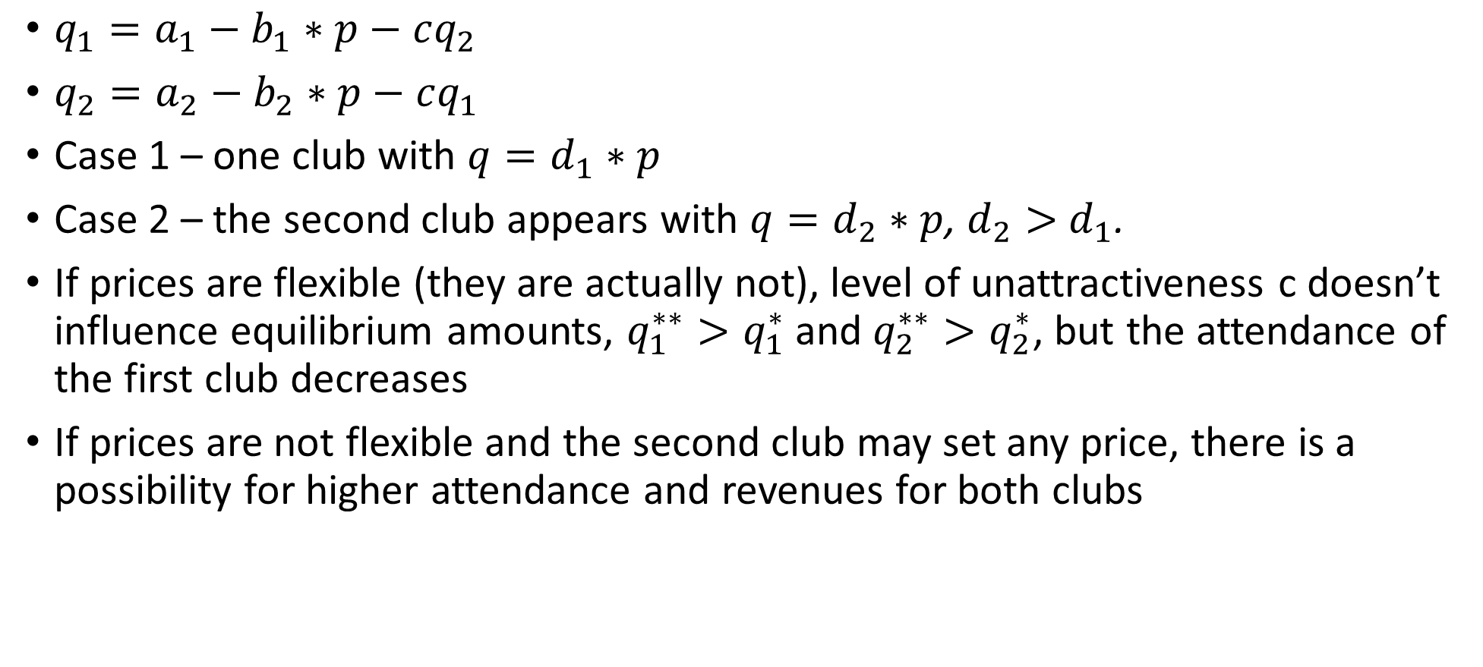
An optimal number of clubs presented in a city
${q_{1}=a}_{1}−b_{1}∗p−cq_{2}$
${q_{2}=a}_{2}−b_{2}∗p−cq_{1}$
Case 1 – one club with $q=d_{1}∗p$
Case 2 – the second club appears with $q=d_{2}∗p$, $d_{2}>$ $d_{1}$.
If prices are flexible (they are actually not), level of unattractiveness c doesn’t influence equilibrium amounts, $q_{1}^{∗∗}>q_{1}^{∗}$ and $q_{2}^{∗∗}>q_{2}^{∗}$, but the attendance of the first club decreases
If prices are not flexible and the second club may set any price, there is a possibility for higher attendance and revenues for both clubs

Slide 10
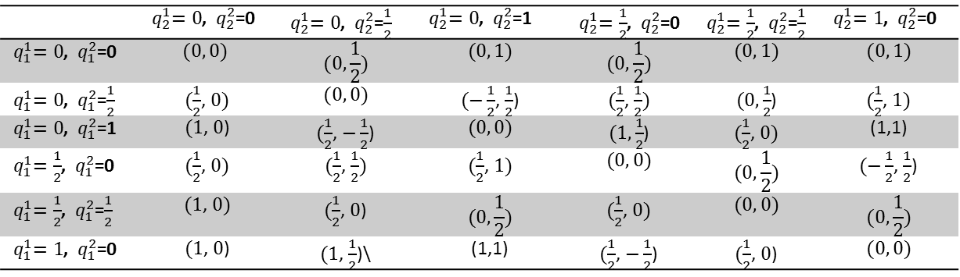

An optimal number of clubs presented in a city-2
$U_{1}=U(q_{1}^{+},q_{2}^{−})$
$U_{2}=U(q_{1}^{−},q_{2}^{+})$
In case 1 both types go to the stadium, their utility is zero
In case 2 fans are redistributed among two teams because of higher utility
 | ${ q}_{2}^{1}=0$, ${ q}_{2}^{2}$=0 | ${ q}_{2}^{1}=0$, ${ q}_{2}^{2}$=$\frac{1}{2}$ | ${ q}_{2}^{1}=0$, ${ q}_{2}^{2}$=1 | ${ q}_{2}^{1}=\frac{1}{2}$, ${ q}_{2}^{2}$=0 | ${ q}_{2}^{1}=\frac{1}{2}$, ${ q}_{2}^{2}$=$\frac{1}{2}$ | ${ q}_{2}^{1}=1$, ${ q}_{2}^{2}$=0
${ q}_{1}^{1}=0$, ${ q}_{1}^{2}$=0 | $$(0, 0)$$ | $$(0, \frac{1}{2})$$ | $$(0, 1)$$ | $$(0, \frac{1}{2})$$ | $$(0, 1)$$ | $$(0, 1)$$
${ q}_{1}^{1}=0$, ${ q}_{1}^{2}$=$\frac{1}{2}$ | $(\frac{1}{2}$, $0)$ | $$(0, 0)$$ | $(−\frac{1}{2}$, $\frac{1}{2}$) | $(\frac{1}{2}$, $\frac{1}{2})$ | $(0, \frac{1}{2}$) | $(\frac{1}{2}$, $1)$
${ q}_{1}^{1}=0$, ${ q}_{1}^{2}$=1 | $(1$, $0$) | $(\frac{1}{2}$, $−\frac{1}{2}$) | $$(0, 0)$$ | $(1, \frac{1}{2}$) | $(\frac{1}{2}$, $0)$ | (1,1)
${ q}_{1}^{1}=\frac{1}{2}$, ${ q}_{1}^{2}$=0 | $(\frac{1}{2}$, $0)$ | $(\frac{1}{2}$, $\frac{1}{2})$ | $(\frac{1}{2}$, $1)$ | $$(0, 0)$$ | $$(0, \frac{1}{2})$$ | $(−\frac{1}{2}$, $\frac{1}{2}$)
${ q}_{1}^{1}=\frac{1}{2}$, ${ q}_{1}^{2}$=$\frac{1}{2}$ | $(1$, $0)$ | $(\frac{1}{2}$, $0$) | $$(0, \frac{1}{2})$$ | $(\frac{1}{2}$, $0)$ | $$(0, 0)$$ | $$(0, \frac{1}{2})$$
${ q}_{1}^{1}=1$, ${ q}_{1}^{2}$=0 | $(1$, $0$) | $(1$, $\frac{1}{2}$)\ | (1,1) | $(\frac{1}{2}$, $−\frac{1}{2}$) | $(\frac{1}{2}$, $0$) | $$(0, 0)$$

Slide 11
An optimal number of clubs presented in a city-3
Who betters off? Clubs, fans, regional government…
What influences the decision on the attendance? Is it among all the belongingness to a certain type of audience?
Derby –segregation:
Economical: blue collars (Milan, Atletico, Sparta, Boca Juniors) and middle class or wealthy (Inter, Real, Slavia, River Plate)
Political views: nationalists (Barcelona) and monarchists (Espanol)
Distance from the center: city (Rome) and surroundings (Lazio)
Religion: Celtic and Rangers, etc.
Not for all derbies – Manchester, Liverpool, Genoa, Lisbon
And for Krasnodar?

Slide 12

Consumers’ behavior in Krasnodar
T=67, N=2, Seasons 2011/2012, 2012/2013, 2013/2014, 2014/2015
${attendance}_{it}=β_{1i}∗{pgame}_{it}+β_{2i}∗{opgame}_{it}+β_{3i}∗{derby}_{it}+β_{4i}∗{quality}_{it}+β_{5i}∗{quality}_{it}+β_{6i}∗{month}_{it}+β_{7i}∗{earn}_{it}+α_{it}+ε_{it}$

Slide 13
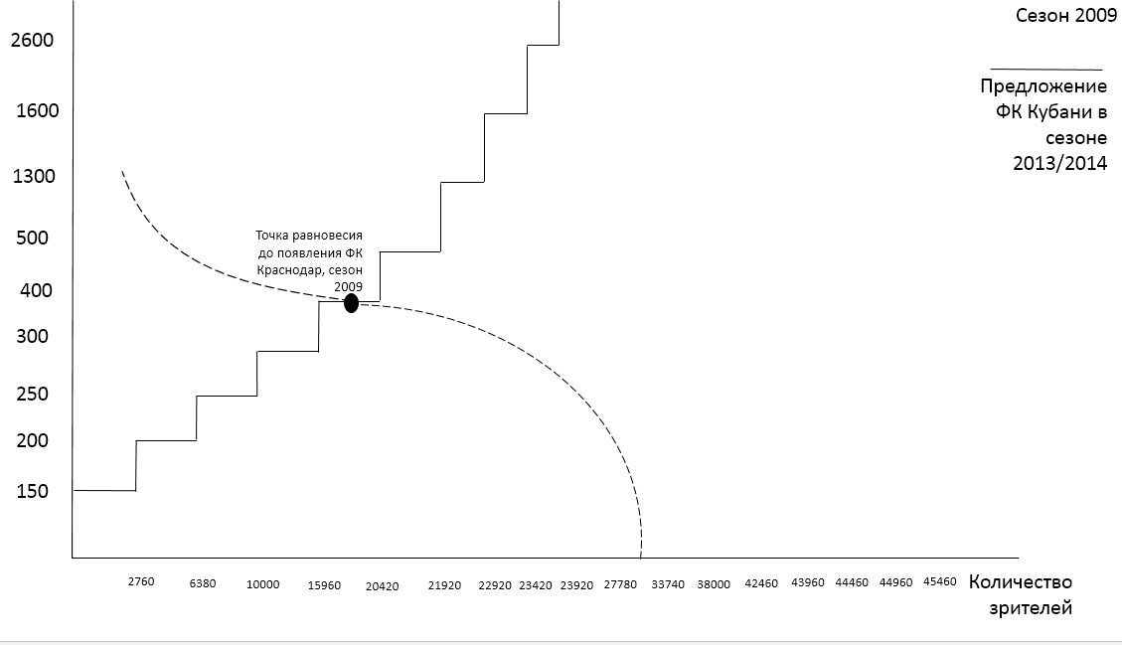
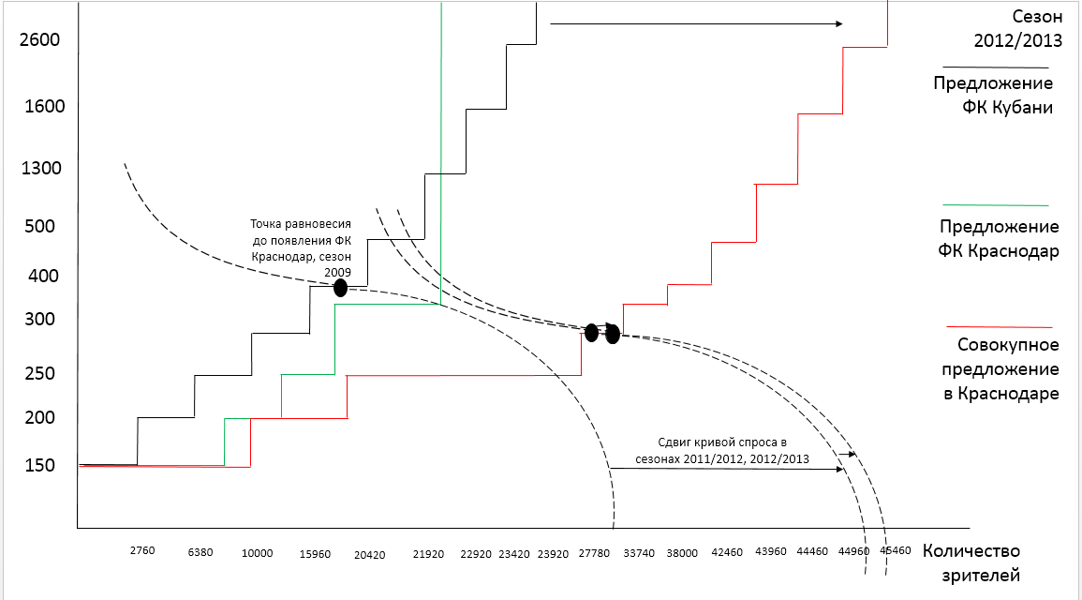
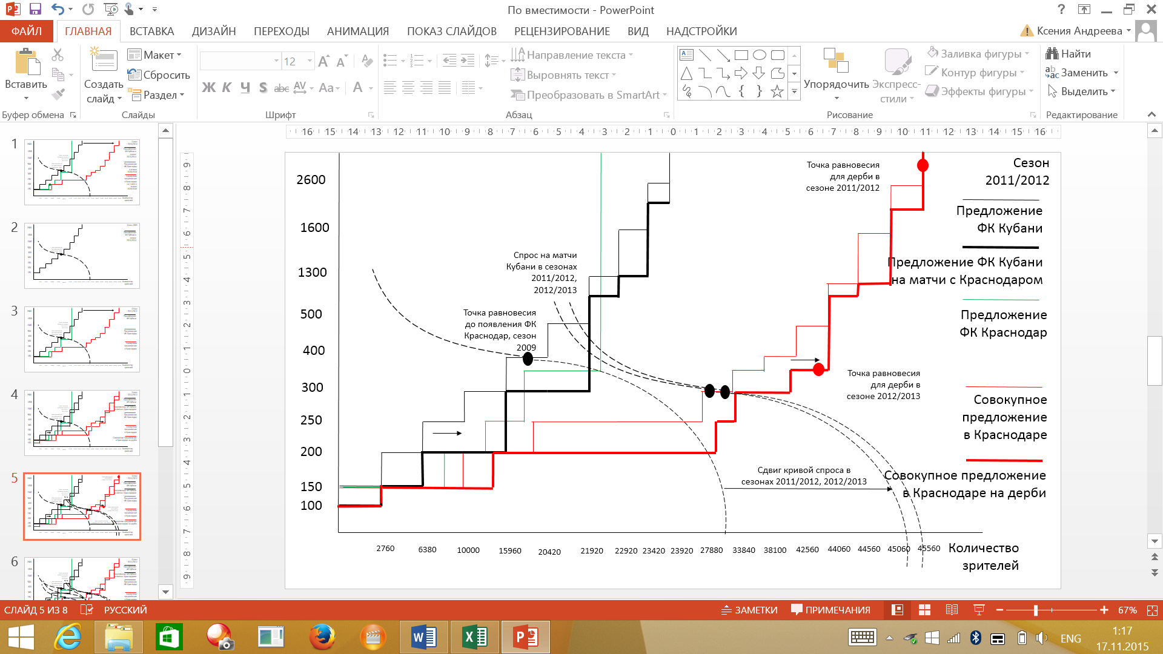
What is a Krasnodar experiment about?
Redistribution effect – not the monopoly model
No competition between clubs – rival’s results
do not influence (percentage difference between the fact and the ideal behavior)
If costs didn’t matter, the best strategy would be to visit games of both clubs

Slide 14
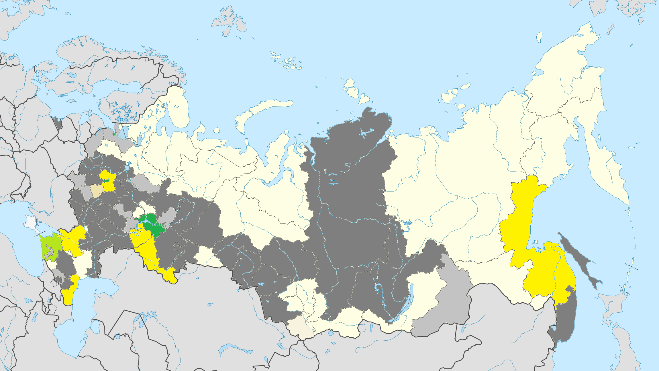
Perspectives for intra-city competition in Russia
Clubs in 1 league from the competitive city
Clubs in 1 league from non-competitive city
Clubs in 2 leagues from the competitive cities
Clubs in 2 leagues from non-competitive cities
Clubs in 3 leagues from the competitive cities
Clubs in 3 leagues from non-competitive cities
We have 4 cities for potential internal competition (we do not take into account the second teams of the main one):
Makhachkala (Anzhi in the Premier League and FC Legion-Dynamo Makhachkala, founded in 2015, in the second league)
Saint-Petersburg (Zenit in the Premier League, Dynamo in the PFL)
Krasnodar (Krasnodar in the Premier League and Kuban in the FNL)
Rostov-na-donu (Rostov in the Premier League and SKA in the PFL)
The only question is the resistance to constraints – but all are in the ½ in the GRP ranking

Slide 15
General regulatory policy
Monopolization is sustained through the following instruments:
Licensing and fair play (no possibility for the aggressive market entrance)
Multidivisional approach (it takes 4-5 years for the European club to play in the Premier league). Or even no rotation at the end of the season (USA)
Property rights
Limited number of clubs in the league (9 in Lithuania, 20 in Spain) - no correlation between population and number of clubs in general
Distribution of income etc.

Slide 16
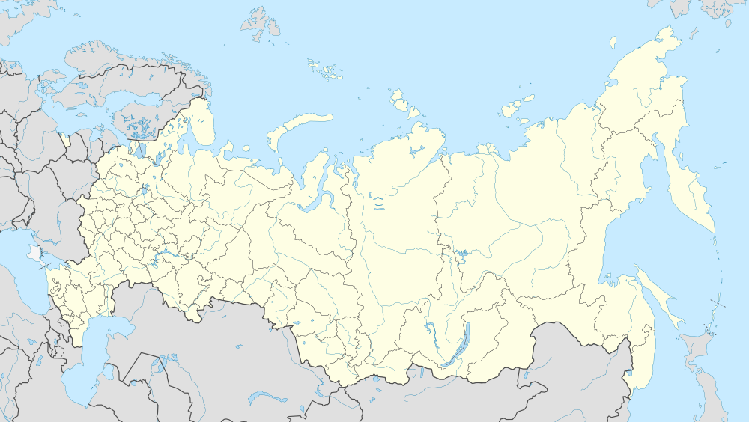
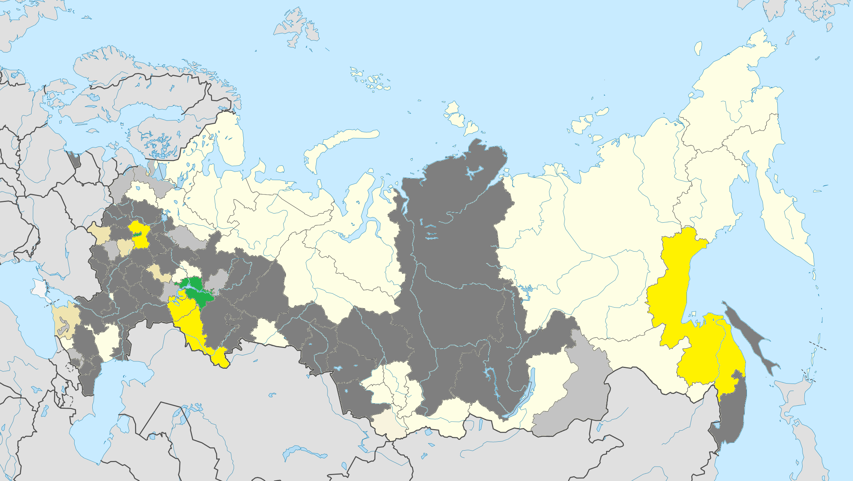
Hypothetical map of the Russian Premier league in 2022/2023
All 4 cities are represented by 2 clubs
Moscow is also presented by 2 clubs with the highest own attendance and the highest attendance of derby (now its Spartak and CSKA)
  Lokomotiv Moscow moves to Bryansk (the light grey zone, according to the fans distribution, local stadium capacity, social structure)
  Dynamo Moscow moves to Saransk
Let other clubs to be Terek, Tom, Rubin, Amkar

Slide 17
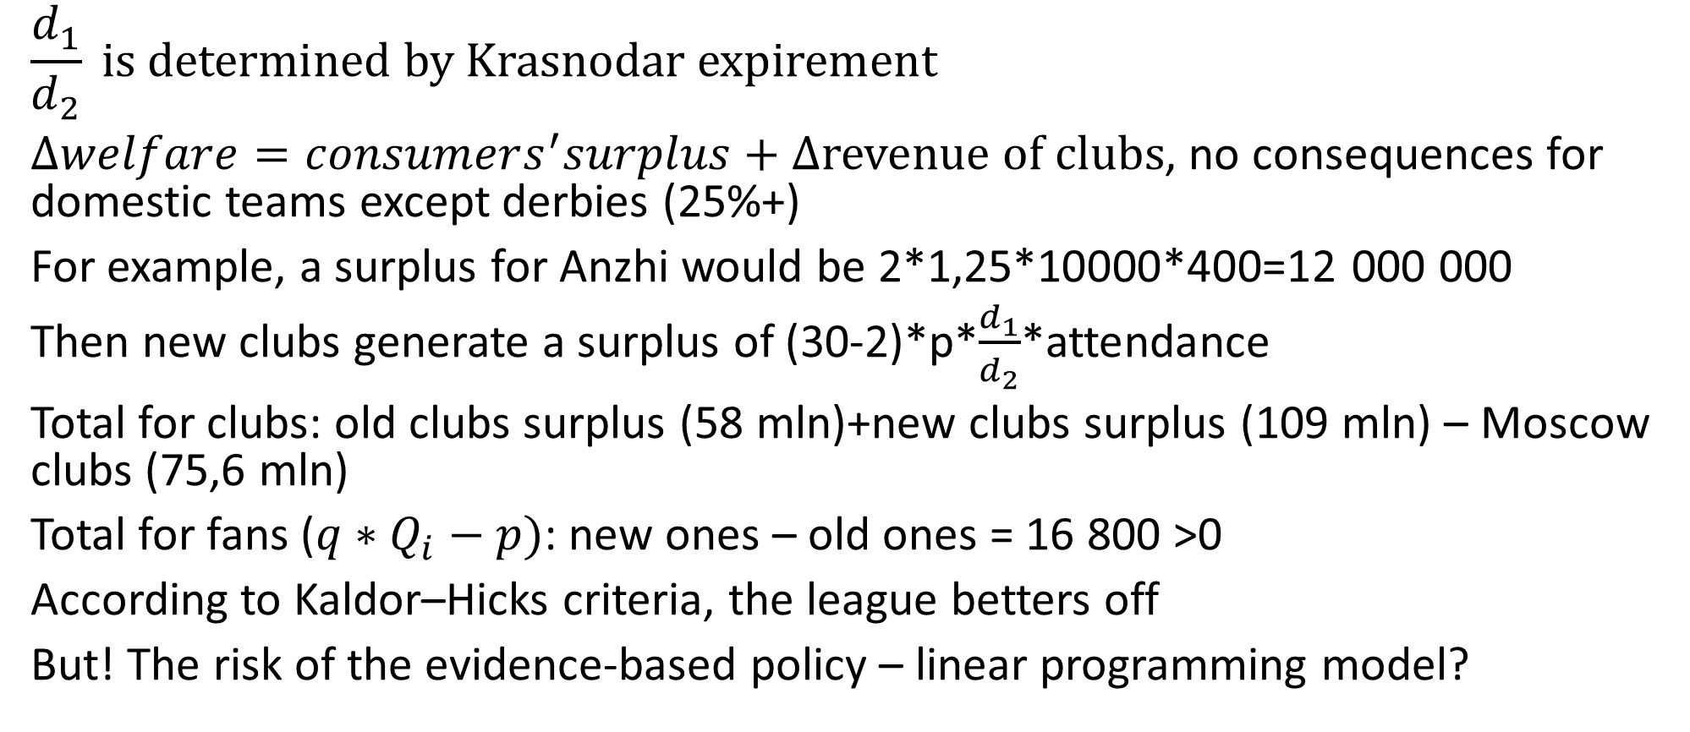
Wealfare model (The optimal size of a sports league (S. Kesenne, 2008))
$$\frac{d_{1}}{d_{2}} is determined by Krasnodar expirement$$
$∆welfare=consumers^{′}surplus+$ $∆revenue of clubs$, no consequences for domestic teams except derbies (25%+)
For example, a surplus for Anzhi would be 2*1,25*10000*400=12 000 000
Then new clubs generate a surplus of (30-2)*p*$\frac{d_{1}}{d_{2}}$*attendance
Total for clubs: old clubs surplus (58 mln)+new clubs surplus (109 mln) – Moscow clubs (75,6 mln)
Total for fans ($q∗Q_{i}−p)$: new ones – old ones = 16 800 >0
According to Kaldor–Hicks criteria, the league betters off
But! The risk of the evidence-based policy – linear programming model?

Slide 18
Regulatory policy
Instruments:
Tax reductions
Stadium sharing
Rankings – competitive index
Natural experiment
Smooth limits on foreign players
Conditions:
Complicated social structure in the city
Zero transaction costs for clubs

Slide 19
Conclusions
The directions of the future research are the following:
Regions – not cities
Audience criteria (especially in the inter-sport competition)
Updating classifications
Difference-in-difference modelling for all derbies of the same period
Modelling the structure changes and its consequences

Slide 20
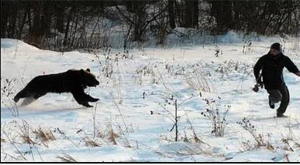
Thank you for your attention. For any recommendations or suggestions please contact me via AndreevaKA1@yandex.ru

