Slide 1
Bank Runs and Media Freedom:
What You Don’t Know Won’t Hurt You?
Maria Semenova (LaBS HSE, msemenova@hse.ru)
Vladimir Sokolov (ICEF HSE)
Alexander Benov (HSE)
iCEBA Conference, September 27, 2024

Slide 2
Motivation
Market discipline concept: by reallocating funds from more risky banks to less risky ones or demanding higher rates on the invested funds, depositors can implicitly control their banks, reducing their risk appetites, consequently enhancing the stability of the overall banking system.
Avoiding inefficient (panic) bank runs
Bank panics are especially painful for both financial and non-financial economy during the crises
…As they can involve the healthful banks alongside with those in a weak financial condition
Depositors are sensitive to the information they receive (Hasan et al. (2013), Jansen et al. (2015), Pyle et al. (2012), Wisniewski and Lambe (2013))

Slide 3
Motivation (con’t)
How the information asymmetry between banks/regulators and depositors influences the latter’s saving strategies during the crisis?
Asymmetry proxied by country’s level of media restrictions
Political economy approach: free press enables the public to distinguish between different types of politicians, helping in electing 'good' politicians, thereby reducing a country's corruption levels (e.g., Bhattacharyya and Hodler (2015), Brunetti and Weder (2003)).
Restrictive media environment can hinder depositors' capacity to accurately gauge the severity of the financial crisis and differentiate between banks with varying risk levels
Heightened uncertainty caused by the banking crisis→ a trigger for a run on all banks

Slide 4
Literature: market discipline
Country studies:
USA – Hannan, Hanweck (1988), Ellis, Flannery (1992); Goldberg, Hudgins (1996); Park (1995), Park, Peristiani (1998), Jordan (2000) Bliss, Flannery (2002), Morgan and Stiroh (2001), Jagtiani and Lemieux (2001), Evanoff and Wall (2002)
Developed countries: Birchler, Maechler (2001) (Switzerland), Murata, Hori (2006) (Japan)
Developing and emerging countries: Calomiris, Powell (2001) (Argentina), Martinez Peria, Schmuckler (1999, 2001) (Argentina, Chile and Mexico), Goday, Gruss (2005) (Uruguay), Barajas, Steiner (2000) (Colombia), Ioannidou, de Dreu (2006) (Bolivia)
Russia – Ungan, Caner (2008), Karas, Pyle, Schoors (2006, 2010, 2013), Semenova (2007), Semenova, Shapkin (2019)
Cubillas, Fonseca, González (2012): MD weakens during the crisis, especially in countries where regulation and institutions promote MD

Slide 5
Literature: media impact on financial decisions
Tausch, Zumbuehl (2018) – risk perception of individual agents is influenced by the amount of economic news coverage
Mitchell, Mulherin (1994), Deephouse (2000), Barber, Odean (2007), Einwiller et al. (2010), Engelberg, Parsons (2011), – information disclosed in media influences behaviour of investors in the stock market
Carroll, McCombs (2003), Deephouse (2000) – reputation uncovered through the media influences company’s counterparties and its performance
Wisniewski, Lambe (2013) – negative characteristics of crisis events in the UK, the USA and Canada in 2007 in articles led to the further reductions in the market value of bank equity
Hasan et al. (2013) – in CEE larger deposit withdrawals during the 2008-09 financial crisis in banks with negative rumours in the media regarding their parent companies

Slide 6
Literature: media and depositors
Ziebarth (2016): during the Great depression higher radio coverage was associated with higher deposit withdrawal rate at the state level
Pyle, Schoors, Semenova, Yudaeva (2012): during the 1998 crisis in Russia Sberbank depositors withdrew with higher probability if they were informed about the crisis (reading Kommersant-daily, watching NTV)
Semenova, Kaul (2017) (in Russian): during the 2008–2009 crisis in the Russian regions where the media freedom was controlled to a greater extent, the reduction in retail deposit growth was much less severe

Slide 7
Empirical strategy
85 countries, 2004-2019
Hypothesis 1: During a banking crisis, greater restrictions on a country’s media freedom contribute to a reduction in the growth of the country’s retail deposits
$$DepGrowth_{i,t}=α_{i}+β_{0}+β_{1}Medi{aRestr}_{i,t}+β_{2}Crisis_{i,t}×Medi{aRestr}_{i,t}$$ $${+β}_{3}Crisis_{i,t}+ γ′X_{i,t}+τ_{t}+ε_{i,t} ,$$
Hypothesis 2: In countries going through a banking crisis, the negative impact of media restrictions on the growth of retail deposits is mitigated by a less risky banking sector.
$$DepGrowth_{i,t}=α_{i}+β_{0}+β_{1}{Media_Restr}_{i,t}+β_{2}{ln_Zscore}_{i,t}+β_{3}Crisis_{i,t}×{Media_Restr}_{i,t}+β_{4}{Media_Restr}_{i,t}×{ln_Zscore}_{i,t}+β_{5}Crisis_{i,t}×{ln_Zscore}_{i,t}+β_{6}Crisis_{i,t}×{Media_Restr}_{i,t}×{ln_Zscore}_{i,t}+β_{7}Crisis_{i,t}+{γ′X}_{i,t}+τ_{t}+ε_{i,t} ,$$

Slide 8
Variables
Dependent:
DepGrowth_{𝑖,𝑡}– growth in retail deposits amount (at time t in country i) – IMF Financial Access Survey (+Brazil, Canada, China, Indonesia, and the Philippines)
Main explanatory:
MediaRestr _{𝑖,𝑡} – by Reporters without Borders (international non-profit, non-governmental organization supporting freedom of the press and journalists worldwide)
accounts for Pluralism, Media independence, Environment and self-censorship, Legislative framework, Transparency and Infrastructure regarding media
2012 change in methodology
Normalized values, [0;1]
Crisis _{𝑖,𝑡} – binary variable for the crisis period
Dating methodology - Nguyen et al. (2022) based on Laeven, Valencia (2013)
Notes:
Constant US dollars

Slide 9
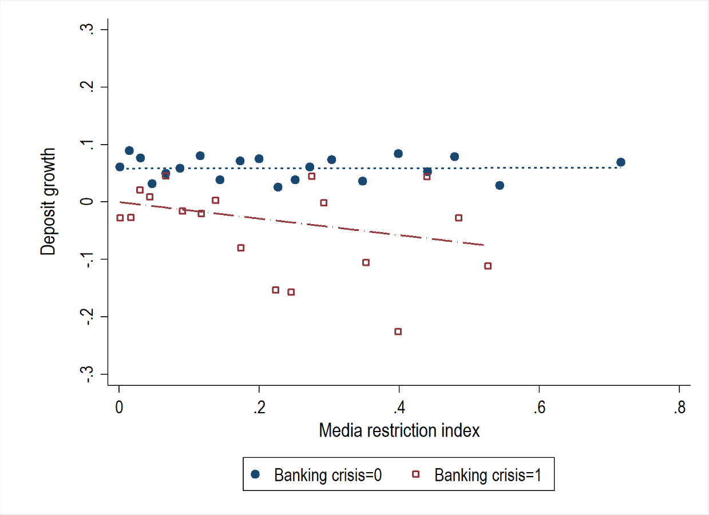

Slide 10
Variables (cont’d)
Risk measure:
ln_Zscore_{𝑖,𝑡}– bank riskiness ratio, measured by ln(1+Zscore), normalized to the [0;1] - Global Economy Database based on the Bankscope/BankFocus bank-level data
Controls:
GDPgrowth _{𝑖,𝑡} – growth of thousands of 2010 US $ (real terms)
Inflation_{𝑖,𝑡} – consumer price index change
DepGDP_{𝑖,𝑡} – the ratio of total bank deposits to GDP, in %
Educ _{i,𝑡} - Education index produced as a part of country composite Human Development Index published in Human Development Reports under UN Development program (mean of years of schooling for adults aged 25 years and more and expected years of schooling for children of school entering age)
Branches _{𝑖,𝑡} – the number of commercial bank branches per 100,000 adults
Country and year FEs included

Slide 11
What influences the relationship?
Sub-sampling by:
Institutional quality: Regulatory Quality index (World bank) - measures the public’s perception of the quality of policy formulation and implementation by the government and its commitment to fulfill the policies (La Porta et al. (2000), Beck et al. (2001), Breuer (2006)) – by sample median
Economic development: High income OECD (OECD members with an average GDP per capita above 50 thousand USD) and Rest of the world (all non-OCED and upper-middle-income OECD countries).
Financial literacy: Standard & Poor’s Global Financial Literacy Survey index – measures the share of the adult population that is financially literate -by sample median
The survey was conducted in 2014 only, so we label each country with the 2014 value for the whole period of the study

Slide 12
Results: hypothesis I
Subsample: | Full sample | High regulatory quality | Low regulatory quality | High-Income OECD | Rest of the world | High fin. literacy | Low fin. literacy
 | (1) | (2) | (3) | (4) | (5) | (6) | (7)
Crises | 0.010 | 0.030 | -0.222*** | -0.029 | 0.017 | 0.006 | 0.051
 | (0.018) | (0.023) | (0.047) | (0.031) | (0.030) | (0.021) | (0.058)
Media_Restr. | -0.040 | 0.009 | -0.110 | -0.151 | -0.035 | -0.007 | -0.059
 | (0.058) | (0.060) | (0.080) | (0.127) | (0.064) | (0.035) | (0.119)
Crises× Media_Restr | -0.361*** | -0.449** | 0.297*** | 0.166 | -0.385*** | -0.480*** | -0.392**
 | (0.106) | (0.218) | (0.105) | (0.333) | (0.143) | (0.111) | (0.190)
Controls | YES | YES | YES | YES | YES | YES | YES
Country FE | YES | YES | YES | YES | YES | YES | YES
Time FE | YES | YES | YES | YES | YES | YES | YES
Number of countries | 85 | 42 | 43 | 17 | 68 | 38 | 39
Observations | 1,083 | 528 | 555 | 218 | 865 | 498 | 506
R²_{within} | 0.374 | 0.451 | 0.407 | 0.492 | 0.383 | 0.412 | 0.396

Slide 13
Results: hypothesis II
Subsample: | Full sample | High regulatory quality | Low regulatory quality | High-Income OECD | Rest of the world | High fin. literacy | Low fin. literacy
 | (1) | (2) | (3) | (4) | (5) | (6) | (7)
Crises | 0.090 | 0.113* | -0.844 | 0.019 | 0.126 | 0.091 | -1.010
 | (0.062) | (0.065) | (0.603) | (0.068) | (0.101) | (0.071) | (0.694)
Media_Restr. | -0.058 | -0.195 | -0.154 | -1.445** | -0.076 | 0.129 | -0.766
 | (0.164) | (0.187) | (0.302) | (0.622) | (0.197) | (0.091) | (0.546)
Crises × Media_Restr | -0.960*** | -1.120*** | 1.735 | 0.952 | -1.105** | -1.063*** | 2.138
 | (0.268) | (0.351) | (1.416) | (1.803) | (0.487) | (0.357) | (1.683)
Crises × Media_Restr × Ln_zscore | 1.075*** | 1.364** | -2.760 | -0.880 | 1.320* | 1.146* | -3.989
 | (0.392) | (0.655) | (2.681) | (2.245) | (0.771) | (0.614) | (2.512)
Constant | 0.295* | 0.718*** | 0.094 | 0.577 | 0.247 | 0.234 | 0.355
 | (0.176) | (0.238) | (0.305) | (0.418) | (0.207) | (0.336) | (0.257)
Control variables | YES | YES | YES | YES | YES | YES | YES
Country FE | YES | YES | YES | YES | YES | YES | YES
Time FE | YES | YES | YES | YES | YES | YES | YES
Number of countries | 85 | 42 | 43 | 17 | 68 | 38 | 39
Observations | 1,083 | 528 | 555 | 218 | 865 | 498 | 506
R²_{within} | 0.376 | 0.457 | 0.408 | 0.502 | 0.384 | 0.416 | 0.406

Slide 14
Robustness checks
Alternative measure of media freedom: The Freedom of the Press index – by US Freedom House (US-based non-governmental organization dedicated to the promotion of freedom and democratic principles around the world)
the most well-known
considers legal, political and economic environment of media in a country
Alternative measures for institutional quality:
Government effectiveness index (World Bank): perceptions of the quality of public and civil services, and their independence from political pressures; the quality of policy formulation and implementation
Rule of law (World bank): Perceptions of the extent to which agents have confidence in and abide by the rules of society, and in particular the quality of contract enforcement, property rights, the police, and the courts, as well as the likelihood of crime and violence

Slide 15
Alternative Media freedom measure
Subsample: | Full sample | High regulatory quality | Low regulatory quality | High-Income OECD | Rest of the world | High fin. literacy | Low fin. literacy
 | (1) | (2) | (3) | (4) | (5) | (6) | (7)
Basic model
Crises× Media_Restr (FH) | -0.215*** | 0.034 | 0.150* | 0.442* | -0.252*** | -0.217** | -0.257**
 | (0.063) | (0.146) | (0.091) | (0.209) | (0.084) | (0.086) | (0.108)
Extended model
Crises × Media_Restr(FH) | -0.627*** | -0.934** | -0.059 | -0.510 | -0.509** | -0.728** | 1.387
 | (0.231) | (0.353) | (0.520) | (1.082) | (0.245) | (0.332) | (1.822)
Crises × Media_Restr (FH)×Ln_zscore | 0.774* | 1.892*** | 0.685 | 1.527 | 0.502 | 1.119* | -2.712
 | (0.431) | (0.632) | (0.968) | (1.627) | (0.485) | (0.680) | (2.952)
Control variables | YES | YES | YES | YES | YES | YES | YES
Country FE | YES | YES | YES | YES | YES | YES | YES
Time FE | YES | YES | YES | YES | YES | YES | YES
Number of countries | 87 | 42 | 43 | 17 | 70 | 38 | 39
Observations | 907 | 439 | 450 | 186 | 721 | 413 | 414

Slide 16
Alternative measures for institutional quality
 | Government effectiveness instead of Regulatory quality |  |  |  | Rule of law instead of Regulatory quality
Subsamples: | High govern. effective. |  | Low govern. effective. |  | High rule of law |  | Low rule of law
 | Baseline | Z-score | Baseline | Z-score | Baseline | Z-score | Baseline | Z-score
 | (1) | (2) | (3) | (4) | (5) | (6) | (7) | (8)
Crises×MediaRestr | -0.445** | -1.111*** | 0.302*** | 1.388 | -0.448* | -1.142*** | 0.301*** | 1.346
 | (0.217) | (0.346) | (0.107) | (1.318) | (0.222) | (0.332) | (0.110) | (1.262)
Crises× ln_zscore ×MediaRestr |  | 1.361** |  | -2.080 |  | 1.420** |  | -2.070
 |  | (0.650) |  | (2.508) |  | (0.629) |  | (2.422)
Control variables | YES | YES | YES | YES | YES | YES | YES | YES
Country FE | YES | YES | YES | YES | YES | YES | YES | YES
Time FE | YES | YES | YES | YES | YES | YES | YES | YES
Number of countries | 42 | 42 | 43 | 43 | 42 | 42 | 43 | 43
Observations | 537 | 537 | 546 | 546 | 533 | 533 | 550 | 550
R²_{within} | 0.441 | 0.447 | 0.412 | 0.412 | 0.436 | 0.442 | 0.426 | 0.428

Slide 17
Conclusion
Cross-country evidence that more control over media is associated with lower retail deposit growth (= withdrawals) during the periods of financial turmoil
This effect is lower in countries with less risky banks
If the media is less controlled the overall information environment becomes more noisy and the financial decisions become less based on the riskiness
Market discipline is not totally undermined under media restrictions
Both effects appear if the quality of institutions is high. Under low-quality institutions the media restrictions make depositors avoid withdrawals
Both effects are preserved if the countries with the highest income are excluded
The reduction of the deposit growth under media restrictions appear if the depositors are financially literate enough. Financial literacy supports the a-la market discipline effect as well

Slide 18
Thank you!

