Slide 1
Unlocking Green Innovation Potential Amidst Digital Transformation Challenges - The Evidence from ESG Transformation in China World Finance Conference December, 2024 - Abu Dhabi
Unlocking Green Innovation Potential Amidst Digital Transformation Challenges-The Evidence from ESG Transformation in China
School of Finance
Abu Dhabi
2024
Wu Yanfei
Prof. Dr. Irina Ivashkovskaya
Prof. Dr. Galina Besstremyannaya
Chunfeng Liu

Slide 2
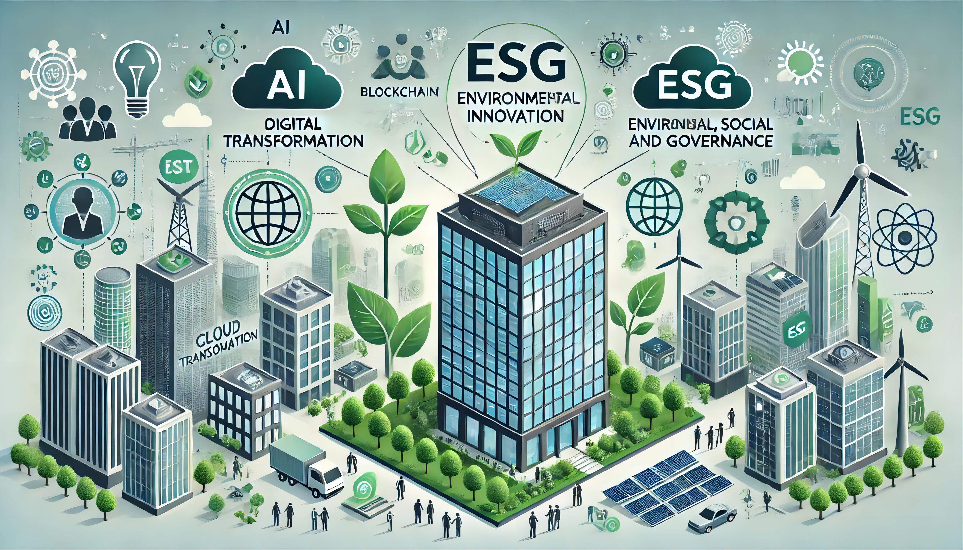
Contents
School of Finance
Unlocking Green Innovation Potential Amidst Digital Transformation Challenges-The Evidence from ESG Transformation in China
Abu Dhabi 2024
Hypotheses
Research Design
Models
Results of Regression
Conclusions

Slide 3
Introduction
School of Finance
Unlocking Green Innovation Potential Amidst Digital Transformation Challenges-The Evidence from ESG Transformation in China
Introduction
Heavily polluting businesses are under pressure to balance economic and environmental benefits (Vazquez-Brust, Liston-Heyes, Plaza- Úbeda, & Burgos-Jiménez, 2010; Weng et al., 2015).
Green innovation helps companies fulfill their environmental responsibilities while ensuring profitability (Le, 2022). It can enhance institutional legitimacy, attract government subsidies, improve market competitiveness (Tu and Wu, 2021), and play a pivotal role in reinforcing environmental performance and enhancing corporate image (Xie, Huo, and Zou, 2019), making green innovation an indispensable strategy for responding to environmental needs.
Digitalisation has been identified as one of the major trends transforming society and business (Butt, 2020; Tian, Chen, Tian, Huang, & Hu, 2023).
The relationship between digital transformation and green innovation are inconsistent:
Digital Transformation Drives Green Innovation in Business (Ning, Jiang, & Luo, 2023)
by enhancing resource and knowledge bases (Q. He, Ribeiro-Navarrete, & Botella-Carrubi, 2023), internal control (Y. Sun &He, 2023), reducing financial constraints, and drawing government subsidies (Xue, Zhang, Zhang, & Li, 2022), thus improving both the number and quality of green innovations (Rao, Pan, He, & Shangguan, 2022)....
Conversely, other scholars argue that digital transformation can hinder the development of green innovation (Ardito, Raby, Albino, & Bertoldi, 2021; Ghasemaghaei & Calic, 2020; X. Wang, Ma, & Yao, 2024; Ahmadova, Delgado-Márquez, Pedauga, & Leyva-dela Hiz, 2022)
by increasing energy consumption and pollution (Avom, Nkengfack, Fotio, & Totouom, 2020);
overuse of digital technology can deplete a firm's long-term capacity to innovate (Usai et al., 2021) ;
the goals of digital transformation and environmental protection may inherently conflict (Ardito et al., 2021);
beyond a certain threshold, additional investments in digital transformation can create a "rebound effect" that increases resource use and leads to increased pollution (Ahmadova, Delgado-Márquez, Pedauga, & Leyva-de la Hiz, 2022)....
Data from companies listed on the main board of the Shanghai Stock Exchange in China, Number of data: 1444 companies; 9531
observations.

Slide 4
Hypotheses
School of Finance
Unlocking Green Innovation Potential Amidst Digital Transformation Challenges-The Evidence from ESG Transformation in China
Hypotheses
Both require substantial investment and have uncertain returns (Hall & Lerner, 2010);
Different goals means different knowledge, relationships, and human resources are needed for digital transformation and green innovation (De Roeck & Delobbe, 2012);
Mature large-cap firms have larger infrastructures and therefore greater organisational inertia, more difficult structural changes and need more resources to invest in DT (Rolland and Hanseth, 2021);
Internal competition for resources in similar functions of large enterprises complicates simultaneous investments (Ardito et al., 2021; Xun Zhang & Xu, 2019).
Resource competition
Digital transformation increases internal operational uncertainty (Gao et al., 2023):
Accelerates the flow of factors of production introducing external factors that increase internal risk (Zhao, 2015);
Specific digital assets can become sunk costs, making strategic choices critical and increasing production process uncertainty (Zhang et al., 2024)
Digital transformation can lead to knowledge spillovers, lowering competitive barriers and intensifying competition (Ying et al., 2018; Bai & Yu, 2021);
Focus on short-term innovations (such as technological and marketing) to maintain competitive advantage may lead to neglecting green innovation with dual externalities.
Internal operational uncertainty and external industry competition risks
Hypothesis 1: Digital transformation may inhibit the enhancement of green innovation performance in Chinese mature large-cap companies.

Slide 5
Hypotheses
School of Finance
Unlocking Green Innovation Potential Amidst Digital Transformation Challenges-The Evidence from ESG Transformation in China
Hypotheses
Real-time data may reveal financial issues, reducing investor confidence (Ghasemaghaei & Calic, 2020);
New technologies can confuse investors(Forcadell, Aracil, & Úbeda, 2020), complicating internal and external communication, creating new information asymmetries, leading to adverse selection and moral hazard issues (Rajan, Servaes, & Zingales, 2000)；
High failure rate of digital transformation (Tabrizi, Lam, Girard, & Irvin, 2019) and disruption of traditional business models and competitive landscape(Carcary et al., 2016) , increasing the risk of uncertainty and information asymmetry, leading to financing constraints (Valencia, 2017);
The application of big data technologies introduces substantial privacy protection and regulatory compliance risks (Forcadell, et al., 2020)
Information Asymmetry Theory
Hypothesis 2: Digital transformation increases financing constraints, thereby negatively impacting green innovation performance.

Slide 6
Hypotheses
School of Finance
Unlocking Green Innovation Potential Amidst Digital Transformation Challenges-The Evidence from ESG Transformation in China
Hypotheses
Stakeholder Trust: Enhances reputation, attracts green consumers and sustainable investors, foster positive market expectations for digital transformation and offsetting potential downsides of digital transformation (K. Wang et al., 2023; da Cunha Bezerra et al., 2020);
Policy Support: Secures government subsidies, reduces initial costs and market risks, encouraging green innovation (Xuan Zhang et al., 2023; Y. Wang et al., 2021).
External Advantages
Human Capital: Strong ESG attracts high-quality talent, promoting green human resource management and enhancing human capital (Liu & Nemoto, 2021);
Knowledge Integration: Facilitates effective integration of internal and external knowledge for green innovation (Yin & Yu, 2022);
By incorporating ESG principles into every stage from raw material selection to product production and sales, companies can achieve digital green process innovation;
Internal Motivation
Hypothesis 3: ESG performance can mitigate the negative impact of digital transformation on corporate green innovation performance.

Slide 7
Hypotheses
School of Finance
Unlocking Green Innovation Potential Amidst Digital Transformation Challenges-The Evidence from ESG Transformation in China
Hypotheses
Good ESG may gain support from investors, green consumers, and government entities (K. Wang et al., 2023), and increases stakeholders' tolerance for potential short-term operational or financial performance dips during digital transformation and alleviates external financial constraints and debt costs (Raimo, Caragnano, Zito, Vitolla, & Mariani, 2021);
Secures long-term capital, alleviating financing constraints during digital transformation (Raimo et al., 2021)
Boosting Investor Confidence
Signal Theory
Enhancing Stakeholder Relationships
Attracts long-term investors and gains government support (C. Yang et al., 2024).
Facilitates stable supply chain relationships and commercial credit financing (Yujie Huang et al., 2023).
Increases access to financial subsidies and tax incentives (Neubig et al., 2024).
Hypothesis 4: Good ESG performance can mitigate the financial constraints caused by digital transformation, thereby alleviating the negative impact of digital transformation on green innovation performance.

Slide 8
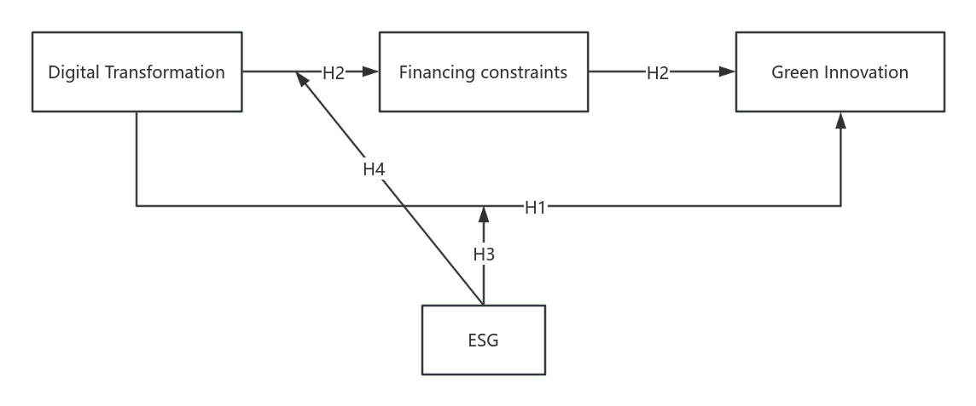
Research Design
School of Finance
Unlocking Green Innovation Potential Amidst Digital Transformation Challenges-The Evidence from ESG Transformation in China
Research Design
Fig. 1 Research Model
Independent variable: Digital Transformation
Mediating variable: Financing constraints
Dependent variable: Green Innovation
Moderating variable: Environmental, social and Governance

Slide 9
School of Finance
Unlocking Green Innovation Potential Amidst Digital Transformation Challenges-The Evidence from ESG Transformation in China
Description of variables
Description of variables - Core variables
Variable Type | Variable Name | Variable Symbol | Variable Description
Dependent variable | Green innovation performance | GI | Sum of green invention disclosure, invention patent grant and utility model
Explanatory variable | DigitalTransformation | DT | Text mining method is used to count the word frequency of 76 keywords in five dimensions: artificial intelligence technology, big data technology, cloud computing technology, blockchain technology and the use of digital technology, and finally get the variable indicators to measure the digital transformation of enterprises.
Mediator variable | Finance constraints | FC | Absolute value of SA index (Xiaosheng, Di, & Yihua, 2013) SA =-0.737×Size +0.043×Size2 -0.04×Age
Moderator variable | Corporate ESG | ESG | Huazheng ESG Rating
Data on main board companies listed on the Shanghai Stock Exchange in China
Data number: 1543 companies; 12,833 observations

Slide 10
School of Finance
Unlocking Green Innovation Potential Amidst Digital Transformation Challenges-The Evidence from ESG Transformation in China
Description of variables
Digital transformation keywords and their classification
Moderating variables - ESG
Classification | Keyword thesaurus
Artificial Intelligence Technology | Artificial Intelligence; Business Intelligence; Image Understanding; Investment Decision Aids; Intelligent Data Analytics; Intelligent Robotics; Machine Learning; Deep Learning; Semantic Search; Biometrics Face Recognition; Speech Recognition; Identity Verification; Autonomous Driving; Natural Language Processing
Big Data Technology | Big Data; Data Mining; Text Mining; Data Visualization; Heterogeneous Data; Credit; Augmented Reality; Mixed Reality; Virtual Reality
Cloud Computing Technology | Cloud Computing; Streaming Computing; Graph Computing; In-Memory Computing; Multi-Party Secure Computing; Brain-Like Computing; Green Computing; Cognitive Computing; Converged Architecture; Billion-Class Concurrency; EB-Class Storage; Internet of Things; Information Physical Systems
Blockchain Technology | Blockchain; digital currency; differential privacy technology; smart financial contracts
Digital Technology Utilization | Mobile Internet; Industrial Internet; Mobile Internet; Internet Healthcare; E-commerce; Mobile Payment; Third-party Payment; NFC Payment; Smart Energy; B2B; B2C; C2B; C2C; O2O; NetLink; Smart Wear; Smart Agriculture; Smart Transportation; Smart Healthcare; Smart Customer Service; Smart Home; Smart Investment; Smart Culture and Tourism; Smart Environmental Protection; Smart Grid; Smart Marketing; Digital marketing; unmanned retail; internet finance; digital finance; Fintech; fintech; Quantitative finance; Open banking
CSI ESG | Score
AAA | 9
AA | 8
A | 7
BBB | 6
BB | 5
B | 4
CCC | 3
CC | 2
C | 1
ESG rating: CSI (HuaZheng) ESG Rating;
Score as ESG performance: from 1 to 9;
Data source: Wind Financial Terminal
Reference:
Hongjun Xie and Xue Lv (2022) ;
Yu Wang et al. (2022)
Documents: "14th Five-Year Plan"; "14th Five-Year Plan" for the Development of the Digital Economy"; "14th Five-Year Plan" for the Development of Intelligent Manufacturing"; "White Paper on the Digital Transformation of Enterprises in 2021"; "Special Action Plan for the Digital Empowerment of Small and Medium-sized Enterprises"; "14th Five-Year Plan for the Green Development of Industry".
Reference: Wu Fei et al. 2021; Wang Molin et al. 2022; Yi Luxia et al. 2021; Xiao Hongjun et al. 2021; Li Qi et al. 2021

Slide 11
School of Finance
Unlocking Green Innovation Potential Amidst Digital Transformation Challenges-The Evidence from ESG Transformation in China
Description of variables
Description of variables - Control variables
Variable Type | Variable Name | Variable Symbol | Variable Description
 | Return on total assets | ROA | Net profit/total assets
Control variable | Enterprise size | Size | ln(Total assets)
 | Enterprise age | Age | Years of observation minus years of establishment and taking natural logarithms
 | Growth rate of revenue | Growthrate | (Current operating income minus previous operating income)divided by previous operating income
 | Gearing | Lev | Total liabilitiesdivided by total assets
 | R&D expenditure | R&D | The total firm R&D expenditures are taken in logarithms
 | Property rights contexts | SOE | In the case of state-owned enterprises, the value is "1"; in the case of non-state-owned enterprises, the value is "0"
 | Board independence | Indep | Number of independent directorsdivided by number of directors
 | Tobin's Q | TbQ | Market value of assets/replacement cost of assets
 | Shareholding concentration | Top1 | Proportion of shares held by the largest shareholder of the enterprise
 | Percentage of Greenbonds | Greenbonds | Greenbond financing/total debt
Data on main board companies listed on the Shanghai Stock Exchange in China
Data number: 1444 companies; 9531 observations

Slide 12
1.1 Digital transformation may inhibit the enhancement of green innovation performance of traditional large-cap companies
School of Finance
Unlocking Green Innovation Potential Amidst Digital Transformation Challenges-The Evidence from ESG Transformation in China
Model
i - the firm;
t - time;
GI_{i,t} - green innovation performance of firm i at time t;;
DT_{i,t} - the level of digital transformation of firm i at time t.
Controls_{i,t} - a set of control variables;
∑Ind - the individual fixed effects;
∑Year - the time fixed effects;
ɛ_{i,t} - the exogenous disturbance term, which follows a normal distribution with mean 0 and variance σ^{^2}.

Slide 13
School of Finance
Unlocking Green Innovation Potential Amidst Digital Transformation Challenges-The Evidence from ESG Transformation in China
Model
1.2 Digital transformation increases financing constraints, thereby negatively impacting green innovation performance
FC_{i,t} - the corporate financing constraints;
If β₁ in model (2) and γ₂ in model (3) are significant at the same time, indicates a mediating effect of financing constraints between digital transformation and green innovation.

Slide 14
School of Finance
Unlocking Green Innovation Potential Amidst Digital Transformation Challenges-The Evidence from ESG Transformation in China
Regression results
2.1. Benchmark regression and mediation effect regression results
Variables | Model 1 |  |  | Model 2 |  | Model 3
 | GI_{i,t} | GI_{i,t} |  | FC_{i,t} |  | GI_{i,t}
DT_{i,t} | -0.030* | -0.044*** |  | 0.004*** |  | -0.039**
 | (-1.81) | (-2.60) |  | (5.10) |  | (-2.27)
FC_{i,t} |  |  |  |  |  | -0.931***
 |  |  |  |  |  | (-4.30)
Constant | 0.264*** | -0.626** |  | 3.567*** |  | 2.822***
 | (6.52) | (-2.29) |  | (260.23) |  | (3.40)
Controls | No | Yes |  | Yes |  | Yes
Year FE | No | Yes |  | Yes |  | Yes
Industry FE | No | Yes |  | Yes |  | Yes
Observations | 9,531 | 9,531 |  | 9,531 |  | 9,531
R-squared | 0.008 | 0.011 |  | 0.809 |  | 0.013
The results of Model 1 indicate that digital transformation inhibits green innovation performance in chinese traditional large-scale enterprises;
The result of Model 2 indicates that as the degree of digital transformation increases, the financing constraints faced by enterprises also increase;
Model 2 and 3 indicate that FC plays an significant mediation effect between DT and GI;
Partial mediation effect
Note: t-statistics in parentheses, *** p<0.01, ** p<0.05, * p<0.1

Slide 15
1.3 ESG performance can mitigate the negative impact of digital transformation on corporate green innovation performance
School of Finance
Unlocking Green Innovation Potential Amidst Digital Transformation Challenges-The Evidence from ESG Transformation in China
Model
ESG_{i,t}×DT_{i,t} - the interaction term；
If α₃ is significant, it means that the moderating effect of ESG exists.

Slide 16
1.4 Good ESG performance can mitigate the financial constraints caused by digital transformation, thereby alleviating the negative impact of digital transformation on green innovation performance.
School of Finance
Unlocking Green Innovation Potential Amidst Digital Transformation Challenges-The Evidence from ESG Transformation in China
Model
If the coefficient β₃ is significant, it means that ESG moderates the mediating effect of financing constraints caused by digital transformation；
If the coefficient γ₄ is significant, it means that the moderating effect of ESG on digital transformation and green innovation does not work entirely through the mediating variable FC_{i,t} , But the direct effect of ESG is also significant

Slide 17
School of Finance
Unlocking Green Innovation Potential Amidst Digital Transformation Challenges-The Evidence from ESG Transformation in China
Regression results
2.2. Moderated effects and moderated mediating effects
Variables | Model 4 | Model 5 | Model 6 | Model 7
 | GI | FC | FC | GI
DT | -0.159*** | 0.004*** | 0.018*** | -0.147***
 | (-3.38) | (5.12) | (7.60) | (-3.13)
ESG | -0.039* | -0.001 | 0.004*** | -0.041*
 | (-1.75) | (-1.35) | (3.27) | (-1.86)
DT*ESG | 0.028*** |  | -0.003*** | 0.026**
 | (2.61) |  | (-6.17) | (2.48)
FC |  |  |  | -0.905***
 |  |  |  | (-4.17)
Constant | -0.454 | 3.571*** | 3.550*** | 2.891***
 | (-1.59) | (256.16) | (248.10) | (3.47)
Controls | Yes | Yes | Yes | Yes
Year FE | Yes | Yes | Yes | Yes
Individual FE | Yes | Yes | Yes | Yes
Observations | 9,531 | 9,531 | 9,531 | 9,531
R-squared | 0.012 | 0.809 | 0.810 | 0.014
GI
Fig. 2 Two-way linear interaction effects for DT
The opposite signs of the interaction term coefficient and the DT coefficient in Model 4 indicate that ESG performance can significantly mitigate the negative effects of DT on GI;
In Model 6, ESG performance can significantly mitigate the financing constraints caused by DT;
The result of Model 6 and 7 indicate that ESG performance can both directly mitigate the correlation between DT and GI and also promote GI by reducing the financing constraints exacerbated by DT.
t-statistics in parentheses, *** p<0.01, ** p<0.05, * p<0.1

Slide 18
School of Finance
Unlocking Green Innovation Potential Amidst Digital Transformation Challenges-The Evidence from ESG Transformation in China
Regression results
2.3. Robustness test and Endogeneity test
 | Replacement of core variables | First stage |  | Second stage
 | GI2 | DT | DT | GI
DT Asset | -3.868**
 | (-1.97)
DT |  |  |  | -0.063**
 |  |  |  | (-2.34)
DTI |  | 1.239***
 |  | (69.60)
DEI |  |  | 1.469***
 |  |  | (13.69)
Kleibergen-Paap rk LM statistic |  |  |  | 1575.167[0.000]
Kleibergen-Paap rk Wald F statistic |  |  |  | 2533.136
Cragg-DonaldWald F statistic |  |  |  | 2430.995
Sargantest |  |  |  | 1.795[0.180]
Hansen J test |  |  |  | 1.922[0.166]
C statistic |  |  |  | 1.795[0.180]
Year FE | Yes | Yes | Yes | Yes
Individual FE | Yes | Yes | Yes | Yes
Observations | 9,302 | 9,531 | 9,531 | 9,531
R-squared | 0.011 | 0.389 | 0.096 | 0.031
DT Asset - The proportion of intangible assets related to digital transformation to the total intangible assets for that year;
GI2 - The sum of green invention patent grant and utility models
Instrumental variables: Average level of industry digitalization (DTI) and digital economy index of prefecture-level cities (DEI)
The p-value for the Kleibergen-Paap rk LM statistic is below 0.01, indicating that there is no under-identification of instrumental variables;
The Cragg-Donald Wald F statistic and the Kleibergen-Paap Wald rk F statistic both exceed the 15% critical value (11.59), which shows a strong correlation between the instrumental variables and the endogenous explanatory variables;
The Hansen J test and the Sargan test yield p-values greater than 0.1, indicating that there are no overidentification problems;
t-statistics in parentheses, *** p<0.01, ** p<0.05, * p<0.1; P value in brackets.

Slide 19
School of Finance
Unlocking Green Innovation Potential Amidst Digital Transformation Challenges-The Evidence from ESG Transformation in China
Conclusion
Conclusion
Firms' digital transformation hinders green innovation performance in Chinese mature large-cap companies. This may be because both digital transformation and green innovation require substantial long-term resource investment, digital transformation increases internal resource competition, leading to insufficient resource allocation for green innovation and consequently affecting its performance. This finding aligns with Ardito et al. (Ardito et al., 2021).
Secondly, digital transformation increases corporate financing constraints, which in turn negatively impacts green innovation. This finding aligns with Yaya et al (Yaya & Deming, 2021). Digital transformation leads to negative information exposure and new information asymmetries, resulting in financing constraints. Furthermore, while many studies assume that digital transformation will be successful, the reality is that many digital transformation efforts fail (Tabrizi, Lam, Girard, & Irvin, 2019; Appio et al., 2021), resulting in financial losses. This study considers the risk of uncertainty and information asymmetry (Valencia, 2017) caused by digital transformation failures as well as the operational risks and negative signals that the lowering of competitive barriers may create for firms. This finding supports the research of Gebauer et al. (Gebauer et al., 2020) on the digital paradox.
ESG performance not only substantially moderates the relationship between digital transformation and green innovation but also significantly alleviates the financial constraints caused by digital transformation, thereby enhancing green innovation performance. Good ESG performance enables firms to better cope with the challenges of digital transformation and provide external pull and internal push for green innovation, thus promoting synergies between digital technologies and environmental goals and improving green innovation performance. Firms with good ESG performance can enhance the trust and support of the capital market, obtain adequate financing, and use their limited capital for green innovations with long-term growth value.

Slide 20
Thank you for your attention!

