Slide 1
National Research University Higher School of Economics
Research working group
«Centre for Spatial Econometrics in Applied Macroeconomic Research»
The impact of public health spending on economic growth in russia: a regional aspect
O. Demidova
E. Kayasheva
A. Demyanenko
SEA, 2021

Slide 2
relevance
COVID-19 pandemic
Searching for new economic growth opportunities
Regional analysis

Slide 3
Healthcare expenditures and economic growth
The inclusion of healthcare expenditures in the production function as a factor that increases the life expectancy of the workforce (Bloom, 2001; Lorentzen, 2008; Kurt, 2015)
Consideration of healthcare expenditures as a factor that can reduce the costs of restoring the ability to work and smooth out the negative consequences for the economy during epidemics(Gallup, 2001; Dixon, 2002)
Studying of investments in healthcare as a factor contributing to the development of human capital (Chang, Ying, 2006; Untura, Kaneva, 2015)

Slide 4
Determining factors
Initial economic growth rate
(Kuan-MinWang, 2011)
Time period (short or long term) (Ashraf et al., 2008; Boussalem et al., 2014)
Level of the economy development (Mielck, 2013)
The spread of a healthy lifestyle among the population
(Zasimova, Kolosnitzyna, 2011)

Slide 5
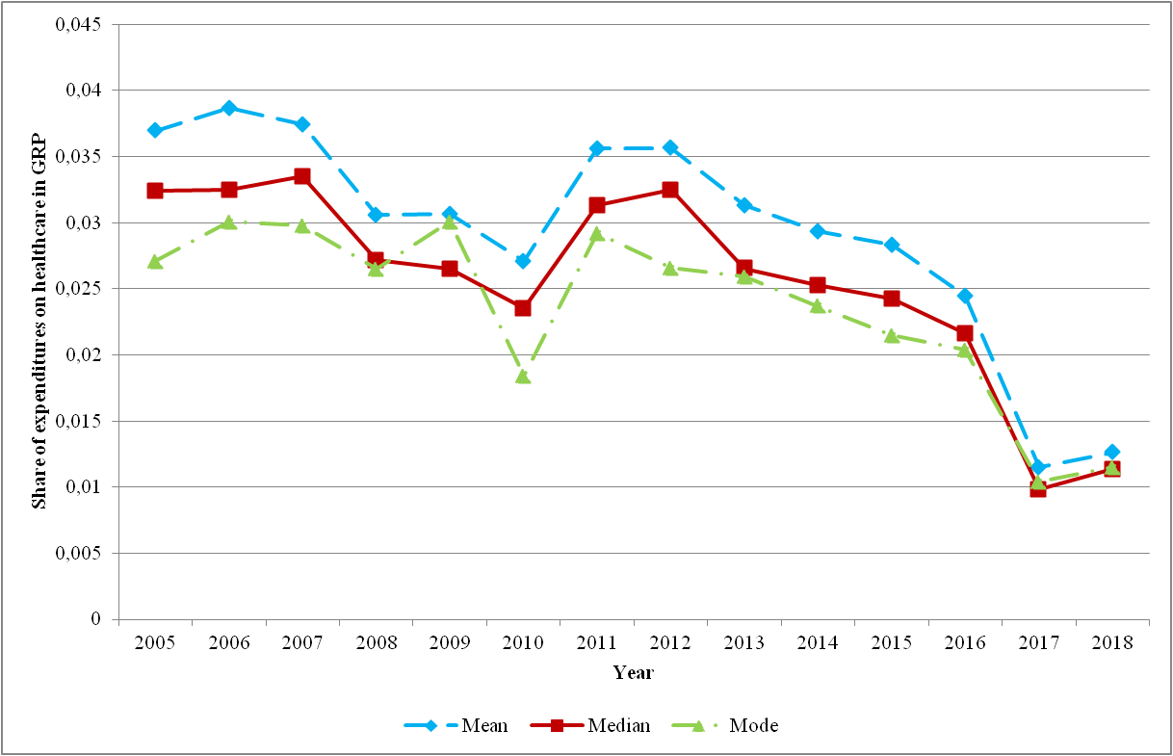
regional share of healthcare expenditures in grp

Slide 6
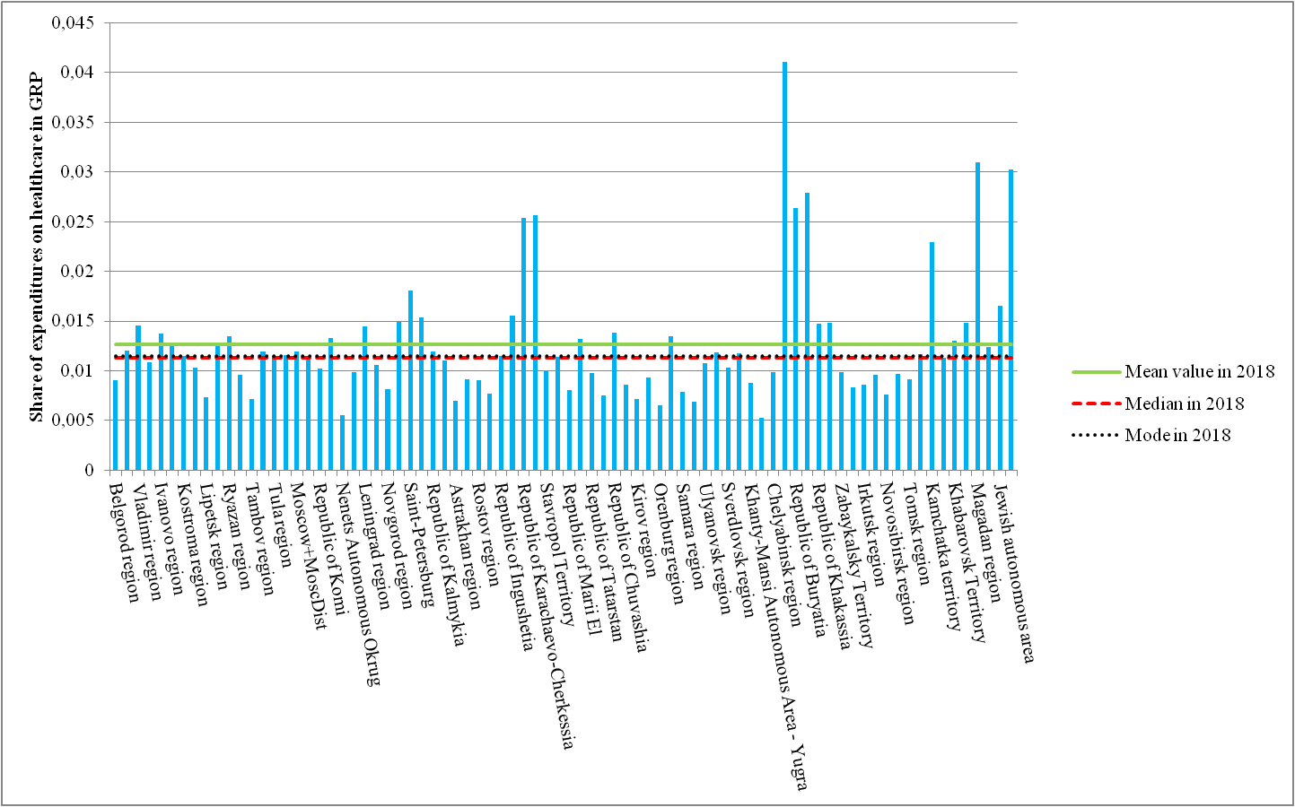
regional share of healthcare expenditures in grp in 2018 (by region)

Slide 7
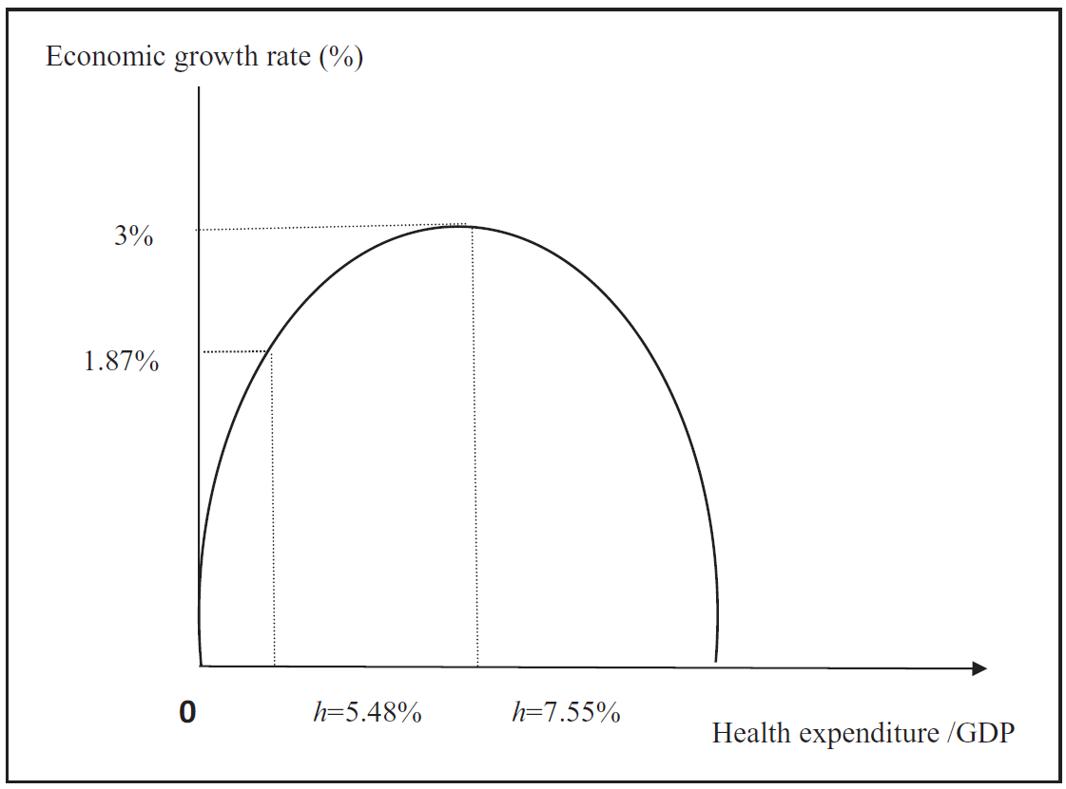
Basic hypothesis
There is an average optimum share of public expenditure on health and sport in GRP which has the greatest positive impact on the average growth rate of GRP.
Chang K., Ying Y. H. Economic growth, human capital investment, and health expenditure: a study of OECD countries //Hitotsubashi Journal of Economics. 2006. Pp. 1-16.

Slide 8
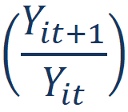
Data and variables
Panel data
80 Russian regions, annual data since 2005 till 2018
Variables
Dependent variable: growth of GRP per capita = , where is the value of GRP in region with number i in year t
Independent variables (categories of consolidated budget expenditures):
Share of expenditures on healthcare, physical education and sports in GRP
Share of expenditures on the government issues in GRP
Share of expenditures on the national economy in GRP
Share of expenditures on housing in GRP
Share of expenditures on education in GRP
Share of expenditures on social policy in GRP Source: Collection «Regions of Russia» (Rosstat)

Slide 9
Data and variables
Control variables:
Ratio of fixed investment to GRP (Solow, 1956)
Share of the population in cities with more than 500,000 citizens (Henderson, 2003; Friedmann, 2006)
Share of imports in GRP (Kamenskikh, Ivanova, 2011)
Herfindahl-Hirschman index (Essletzbichler, 2007; Shediac, 2008)
Proportion of people with university education (Maddison, 1991; Lutz, Samir, 2011)
Road density (Shcherbanin, 2011)
GRP per capita in constant prices (Barro, Sala-i-Martin, 1992)
Investment risk index
Aggregate index of the region’s banking services
Sources: Collection «Regions of Russia» (Rosstat), Bank of Russia, rating agency «Expert RA»

Slide 10
Descriptive statistics
Variable | Mean | Standard deviation | Minimum value | Maximum value
GRP growth | 1.027317 | 0.054224 | 0.794569 | 1.270315
Share of expenditures on the government issues in GRP | 0.017278 | 0.012917 | 0.004338 | 0.218050
Share of expenditures on the national economy in GRP | 0.036261 | 0.023386 | 0.003748 | 0.228752
Share of expenditures on housing in GRP | 0.023240 | 0.023343 | 0.003757 | 0.382926
Share of expenditures on education in GRP | 0.055366 | 0.027233 | 0.016403 | 0.224432
Share of expenditures on healthcare, physical education and sports in GRP | 0.030578 | 0.016241 | 0.005047 | 0.142410
Share of expenditures on social policy in GRP | 0.032588 | 0.017766 | 0.004999 | 0.170596
GRP per capita in constant prices | 149687.5 | 166736.9 | 19320.69 | 1619000
Share of the population in cities with more than 500,000 citizens | 0.171778 | 0.225002 | 0 | 1
Ratio of fixed investment to GRP | 0.271301 | 0.099994 | 0.107714 | 1.079940
Proportion of people with high education | 0.270396 | 0.057587 | 0.125000 | 0.5
Herfindahl-Hirschman index | 0.154627 | 0.074101 | 0.090893 | 0.626676
Road density | 192.6211 | 275.7826 | 0.800000 | 2468
Share of imports in GRP | 0.098100 | 0.118068 | 0 | 1.015152
Aggregate index of the region’s banking services | 0.822701 | 0.195905 | 0.150000 | 1.770427
Investment risk index | 0.275422 | 0.193745 | 0 | 1
Source: authors’ calculations

Slide 11
model
(1)
(2)
- a vector of GRP growth values
- a matrix of independent variables except for the share of healthcare expenditures in GRP
- a matrix of all independent variables
- a vector of fixed effects
- a vector of time effects
- a spatial weights matrix
- an error term
, , - vectors of estimated parameters

Slide 12
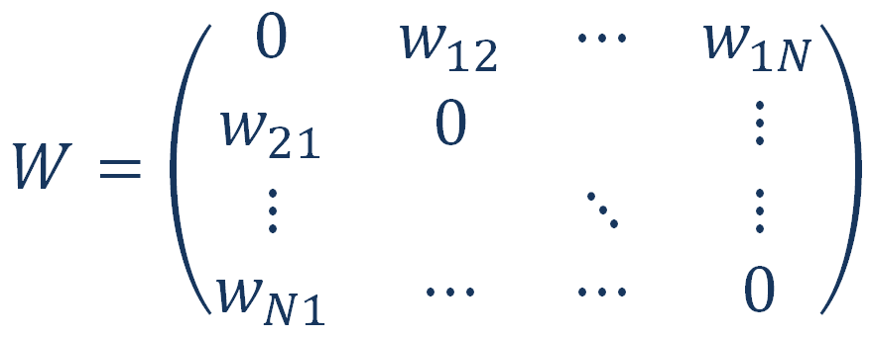
Spatial weights matrix and moran’s Index
Moran’s index values
Year | Moran’s I value
2005 | 0.760
2006 | 0.278
2007 | -0.024
2008 | 0.209***
2009 | 0.139**
2010 | 0.187***
2011 | 0.309***
2012 | 0.159**
2013 | 0.224***
2014 | 0.067
2015 | -0.039
2016 | -0.028
2017 | -0.015
2018 | 0,224***
- elements of W matrix
, where N is a number of regions
- number of neighboring regions
- Moran’s index
- the value of GRP per capita growth in region i
- the mean of y
Source: authors’ calculations
Significance levels: * - 10%; ** - 5%; *** - 1%

Slide 13
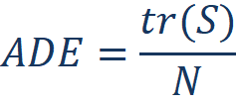
Results interpretation
(2)
(3) - result of differentiating (2) with respect to any independent variable
Let us denote the matrix obtained in (3) as S, with elements , where :
Direct effect (elements of the matrix S with i = j), i. e. the reaction of the dependent variable of a given region with index i to a change in the explanatory variable in the same region with index i
Indirect effect, that is also called the spillover-effect (elements of the matrix S with i ≠ j ), i. e. the reaction of the dependent variable of a given region with index i to a change in the explanatory variable in another region with index j
(4)
Average effects:
(5)
(6)
(7)

Slide 14
Estimation results
Source: authors’ calculations
Significance levels: * - 10%; ** - 5%; *** - 1%
Regressors | β | θ | Direct effect | Indirect effect | Total effect
Share of expenditures on the government issues in GRP | 0.282 (0.274) | -1.567* (0.835) | 0.172 (0.275) | -2.001* (1.327) | -1.829 (1.132)
Share of expenditures on the national economy in GRP | 0.0037 (0.196) | -0.042 (0.280) | -0.006 (0.193) | 0.013 (0.378) | 0.007 (0.427)
Share of expenditures on housing in GRP | 0.156 (0.164) | 0.682 (0.514) | 0.231 (0.151) | 0.947 (0.675) | 1.178* (0.686)
Share of expenditures on education in GRP | 0.290 (0.243) | -0.578 (0.578) | 0.229 (0.255) | -0.743 (0.892) | -0.514 (1.055)
Share of expenditures on healthcare in GRP | 1.520*** (0.576) | -0.797 (0.935) | 1.499*** (0.585) | -0.318 (1.290) | 1.182 (1.586)
Share of expenditures on healthcare in GRP (square) | -12.89*** (4.847) | 7.531 (7.837) | -12.53*** (4.918) | 4.115 (10.88) | -8.411 (13.043)
Share of expenditures on social policy in GRP | -0.296 (0.285) | -0.085 (0.395) | -0.322 (0.287) | -0.313 (0.611) | -0.634 (0.776)
GRP per capita in constant prices | 1.47e-07** (8.68e-08) | 2.27e-07 (2.08e-07) | 1.63e-07** (8.32e-08) | -2.55e-07 (2.81e-07) | 9.24e-08 (2.92e-07)
Share of the population in cities with more than 500,000 citizens | 0.027 (0.020) | -0.077 (0.074) | 0.0235 (0.0224) | -0.093 (0.107) | -0.069 (0.121)
Ratio of fixed investment to GRP | -0.0266 (0.0249) | -0.0484 (0.0427) | -0.0301 (0.0259) | -0.074 (0.063) | -0.104 (0.077)
Proportion of people with high education | 0.1517** (0.0767) | -0.091 (0.165) | 0.1455* (0.0802) | -0.0485 (0.2290) | 0.097 (0.266)
Herfindahl-Hirschman index | -0.1564** (0.0795) | --0.038 (0.169) | -0.157** (0.080) | -0.122 (0.237) | -0.279 (0.255)
Road density | -6.95e-05 (4.29e-05) | 4.36e-05 (5.78e-05) | -7.47e-05* (4.23e-05) | 9.08e-05 (7.49e-05) | -1.66e-04 (.8.84e-05)
Share of imports in GRP | 0.0476** (0.0203) | -0.0137 (0.0388) | 0.0478** (0.0219) | 5.92e-04 (0.0546) | 0.0484 (0.0648)
Aggregate index of the region’s banking services | 0.0191 (0.0217) | 0.0203 (0.0591) | 0.0223 (0.0238) | 0.0509 (0.0818) | 0.073 (0.092)
Investment risk index | 0.0016 (0.0228) | 0.0158 (0.0354) | 0.0034 (0.0219) | 0.0256 (0.0483) | 0.0290 (0.0581)

Slide 15
Estimation results
Direct effect on GRP growth form the change in :
(8)
After differentiating (8) by and equating it to 0,
We get the maximum value of GRP growth which is achieved at:
in our model with spatial effects
after excluding spatial effects from the model

Slide 16
conclusions
An increase in the share of government spending on healthcare and sports in GRP can stimulate economic growth in the region
The optimal share of government expenditures on healthcare and sports in GRP is 5,9%.
In most regions, this proportion has not exceeded 3% in the last 15 years and has declined since 2012
The assumption of the spatial interdependence between regions has made it possible to take into account the impact of health investment in one region on its neighbors, so that the average optimal share of health and sport expenditure in GRP can then be reduced from 6,4% to 5,9%

Slide 17
Thank you for your attention!

